Slide 1

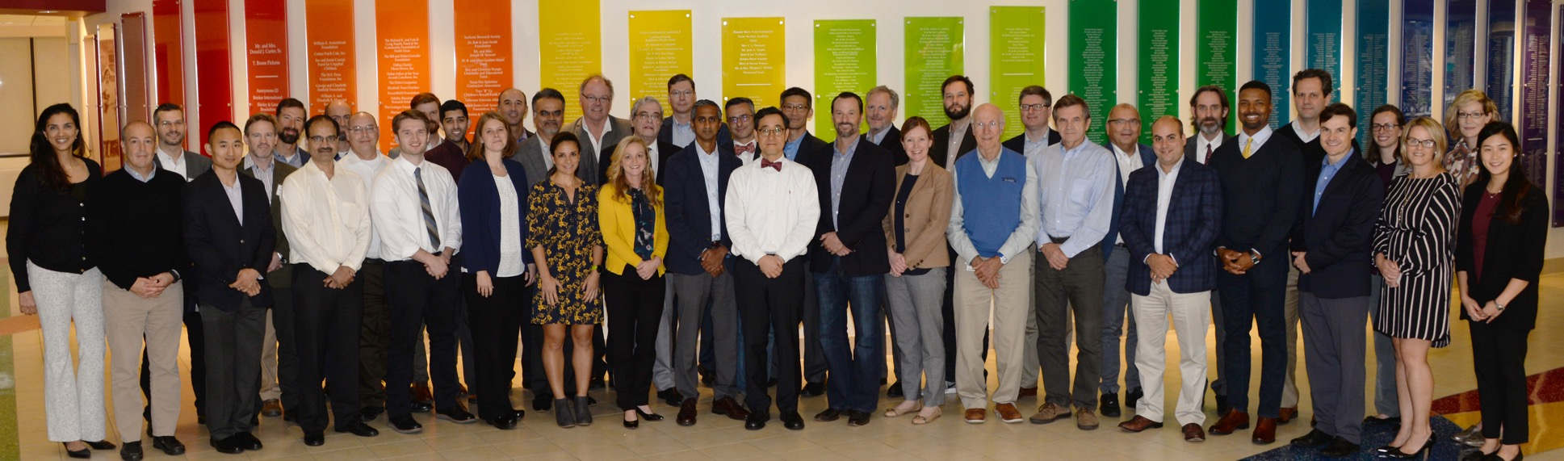
Big Welcome
12th Annual Meeting!

Slide 2
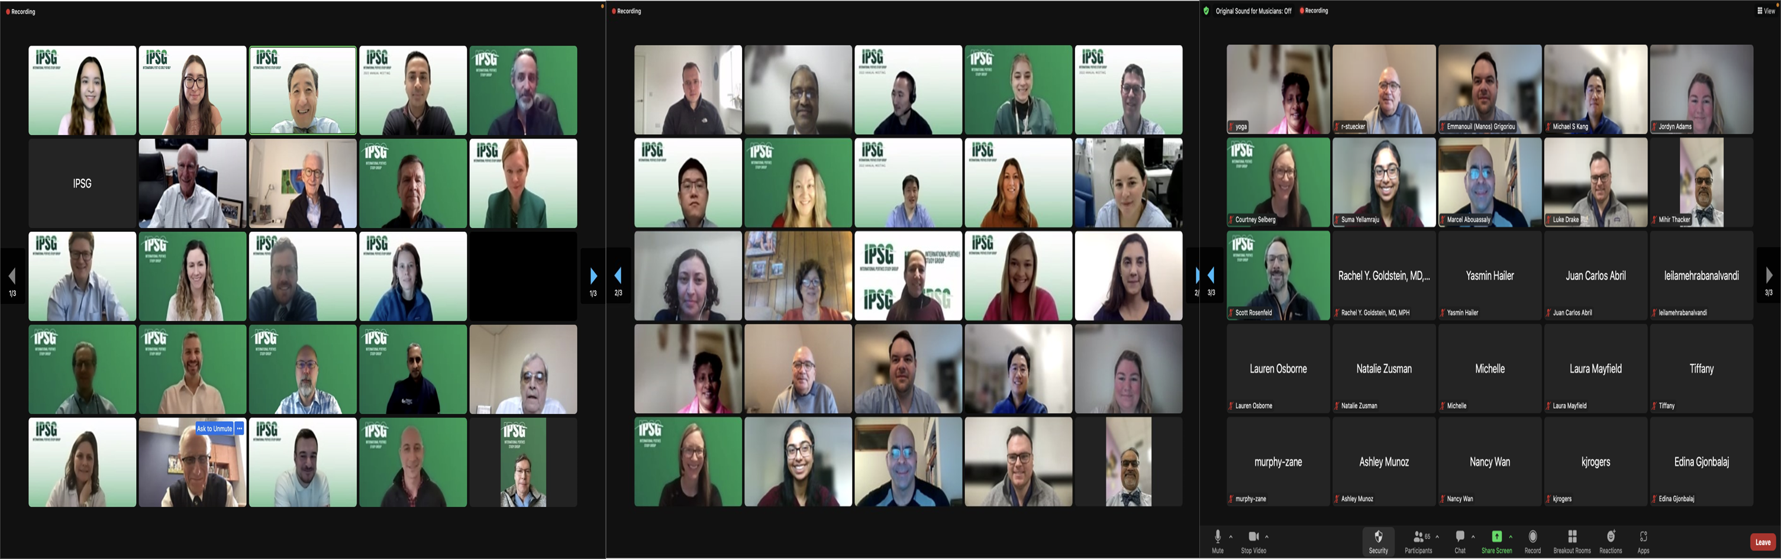
2023 Annual Meeting Group Photo

Slide 3
2023 Annual Meeting Group Photo

Slide 4
2023 Annual Meeting Group Photo

Slide 5
Virtual Meeting Rules
Meeting is being recorded
We are recording attendance – make sure your name is correct
Keep your microphone on mute
Raise Hand or use Chat for comments/questions

Slide 6
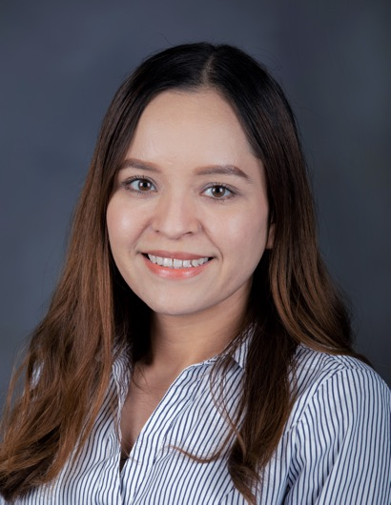
Thank You!
All Participating Members/Presenters/Coordinators
Candelaria Mercado (IPSG Manager)
Carlos Carlos (CORA)
Cody (communications)
Matt Ferguson (research administration)
Alice Marcee (attorney)
Lisa Gardner (admin)
Notes:
Presenters, moderators time and effort
Fantastic job organizing the meeting, looking after all the details and even making the slides for some presentations;
Stuart for his technical expertise on running a Zoom meeting goes smoothly

Slide 7
Thanks to Executive & Steering Committee Leadership!
IPSG Chair
Harry Kim, MD
Executive Committee
Jennifer Laine, MD
Wudbhav Sankar, MD
Harry Kim, MD
IPSG Manager
Candelaria Mercado, BS
Membership
Derek Kelly, MD
Treasurer
Benjamin Martin, MD
Web/Social Media
Craig Smith, MD
Rachel Goldstein, MD
Science Editor
Shawn Gilbert, MD
PROMIS & PROs
Eric Fornari, MD
Susan Novotny, PhD
Data Monitoring & Retention
Wudbhav Sankar, MD
Publications
Jennifer Laine, MD
Scientific Review
Susan Novotny, PhD
MRI
David Chong, MD
Radiographic Outcomes
Hitesh Shah, MD
William Morris, MD
Notes:
Develop the agenda and format of the meeting, ideas and input

Slide 8
Annual Meeting – Virtual Agenda

Slide 9

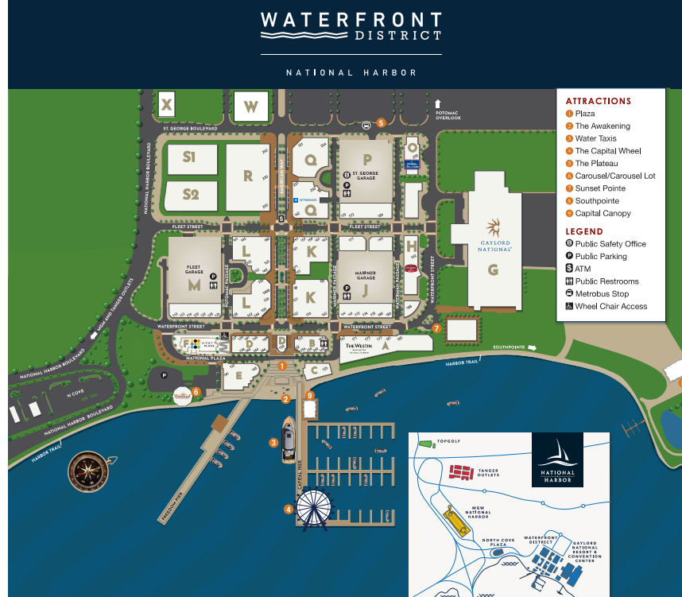
In-person Meeting: Study Discussions
Date: May 7th, 2024 Time: 9AM – 1PM Eastern Time (US & Canada)
Location: Residence Inn, Harbor Room (192 Waterfront St, National Harbor, Maryland, USA)
In-Person Session Topics:
Where are we with CORE studies and reaching the target sample sizes?
What should we study? What can we study?
  PROMIS based studies
  <6 Registry – data overview and study ideas
  Randomized clinical trial
  Treatment guidelines based on Delphi or IPSG expert opinions
  New study ideas
Authorship guidelines Discussion
Community Outreach
Ben Joseph and Tony Herring Case Discussions

Slide 10
2023 Accomplishments and Activities
>950 hips enrolled to date
  54 Institutions
  Improved good 2-year retention
Retention Efforts launched with 11% improvement for 5-year FU
IPSG webinar “Perthes for Parents”: organized by Skip
  86 attendees
  Recording available on the IPSG website & Facebook
Perthes Camp held in Minnesota 2023
  Drs. Laine and Novotny represented the IPSG
POSNA/EPOS Presentations 2023
  2 POSNA podium, 1 POSNA e-poster
  1 EPOS podium, 1 EPOS e-poster

Slide 11

Do Weightbearing Restrictions Cause Excess Weight Gain in Children with
Legg-Calvé-Perthes Disease?
Novotny SA, Hailer YD, Laine JC, Wetzel M, Gillespie SE, Gilbert SR, Goldstein RY, Kim HKW, Schrader T; International Perthes Study Group.
J Pediatr Orthop. 2023.

Slide 12

MRI perfusion correlates with duration of stages and lateral pillar class in Legg-Calvé-Perthes Disease: pMRI and Duration of LCPD stages.
Wudbhav Sankar, Julianna Lee, David Chong, Yasmin Hailer, Luis Renato Agrizzi De Angeli, Scott Yang, Jennifer Laine, Harry Kim, International Perthes Study Group.
JPOSNA (in press)
Predictors of Persistent Limp Following Proximal Femoral Varus Osteotomy for Perthes Disease.
Kevin Orellana BS, Joshua T. Bram, Morgan Batley, Susan Novotny, Hitesh Shah, Derek Kelly, Benjamin Martin, Tim Schrader, Jennifer C. Laine, Harry Kim, Wudbhav Sankar. International Perthes Study Group.
JPO (in press)

Slide 13
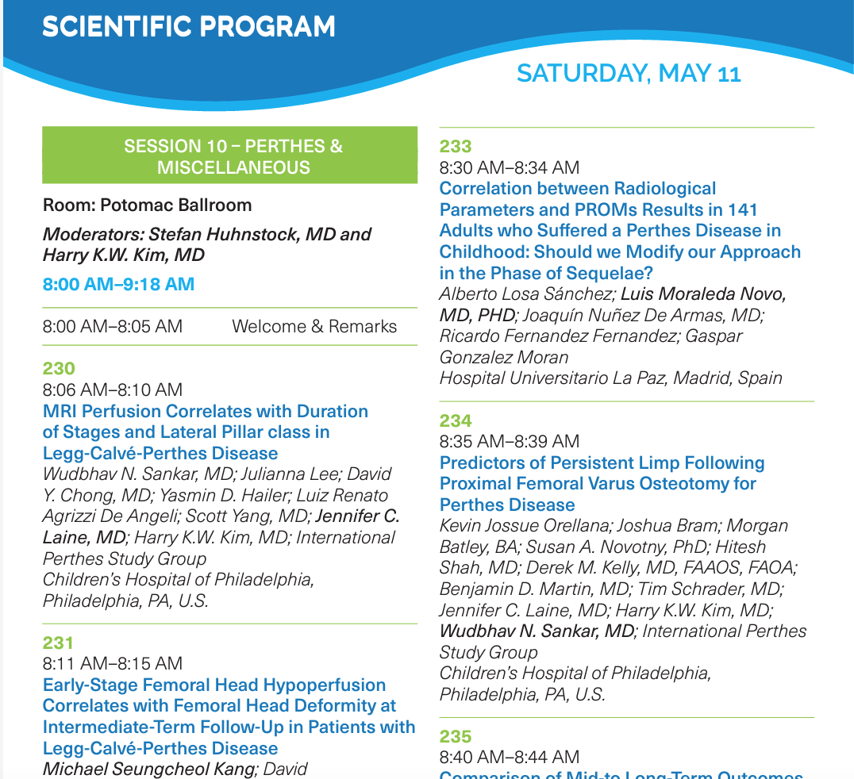
EPOSNA Annual Meeting
2 IPSG Podium Presentations
Perthes Session moderated by Harry and Stefan!

Slide 14
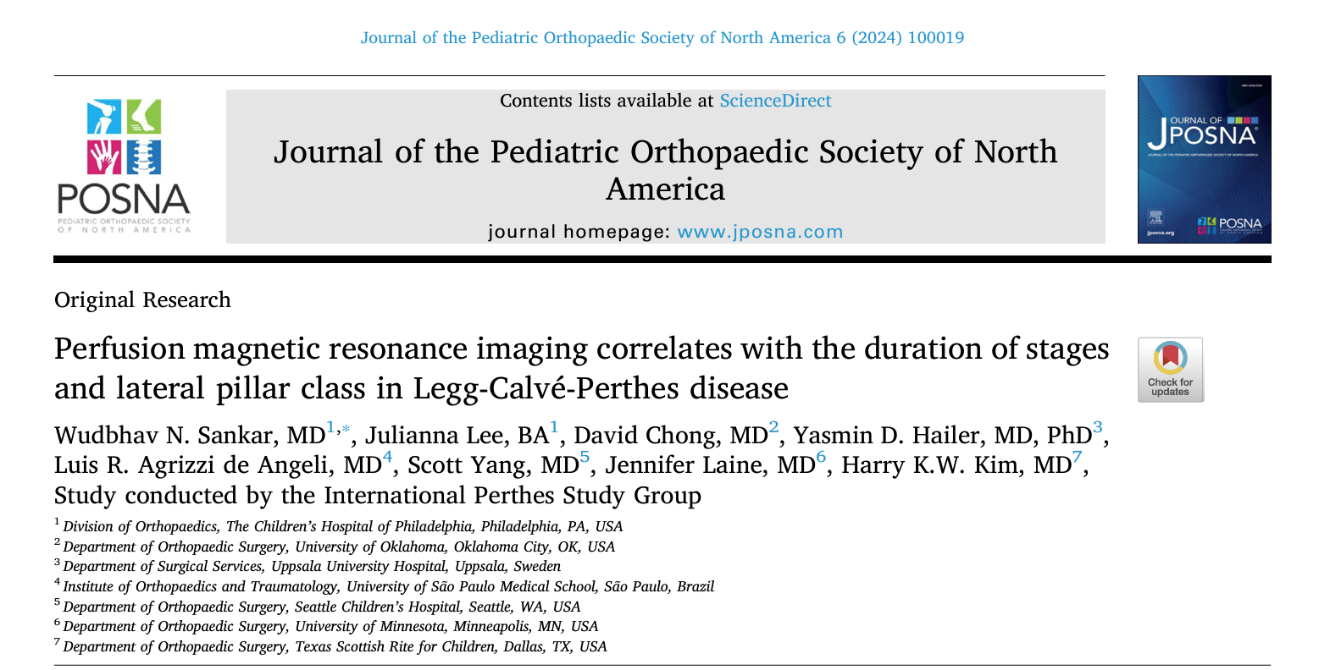
Manuscripts Submitted/Accepted

Slide 15
Manuscripts Submitted/Accepted
Predictors of Persistent Limp Following Proximal Femoral Varus Osteotomy for Perthes Disease.
Kevin Orellana BS, Joshua T. Bram, Morgan Batley, Susan Novotny, Hitesh Shah, Derek Kelly, Benjamin Martin, Tim Schrader, Jennifer C. Laine, Harry Kim, Wudbhav Sankar. International Perthes Study Group.
JPO (online)

Slide 16
Manuscripts in Process
Mike, Bella, Harry- Adult Survey Study results of survey participants who had THR
Susan and Eric – Perthes PROMIS (2 manuscripts)
Jennifer, Susan, Tim, Rachel -- <6 Delay in Diagnosis
David, Harry – Perfusion MRI

