Slide 1
Recent Perthes Literature Review
IPSG 2024
Shawn R. Gilbert, MD
Correspondence: srgilbert@uabmc.edu
.

Slide 2
Search
Search “Perthes” April 5, 2024
88 possibly relevant
83 total
Manual search JPOSNA – 1 Schoenecker POSNA Best Basic Science research paper

Slide 3
Pubmed citations Perthes - 88

Slide 4
ACL-2238

Slide 5
Journals
J Pediatr Orthop – 8
Cureus - 4
J Child Ortho -4
Acta Orth Traum Surg - 3
Bone Joint J/BJJ Open– 3
J Pediatr Orthop B – 3
Sci Rep – 3
Acta Orthop – 2
Acta Orth Bras – 2
CORR – 2
J Clin Med – 2
J Orth Res – 2
Ostearth Cart - 2
Radiologie - 2
Rev Bras Orth – 2
1 each:
Acta Chir Orthop Trauma Cech
Acta Rras,
Adv Clin Exp Med
Am Fam Phy
Arch Disord Child
Arthroscopy
Arthroplasty today
BMC Comp Med
BMC MSK Disord
Children
Clin Anat
Clin Appl Ther
Curr Rev Msk
Curr Sports Med
Cytokine
EFORT open
Endo Metab Immun Drug
Exp Ther
Exp Rev Med Pharm
Front Gen
Front Peds
Front Surg
Gait Posture
Indian J Orth
Int Orth
Front Gen
JBJS
JBJS Case Con
J Clin Rheum
J Med Primatol
J Orth Case Rep
Mymensingh Med
NPG Regen Med
Ped Rep
Sci Prog
Res SQ
StatPearls
Tissue Eng
Vet Clin NA
World J Ortho
Zhonguo

Slide 6
Article type
Basic/Animal – 15 (3)
Case report–8 (5)
Imaging/Rad Valid – 2 (2)
Rad Feature – 5 (6)
Rad Outcome -5 (2)
Late sequelae/adult recon – 5 (3)
Long term f/u – 2 (1)
Gait – 1
Patient factors/Epidemiology – 6 (4)
Review – 9 (8)
Surgical treatment techniques – 3 (4)
Surgical outcomes - 15 (10)
Outcomes measures/QOL – 3 (2)
Comment/Literature rev – 3 (3)
Mixed case series/Non-op – 2 (5)

Slide 7
Country
Austria – 2
Brazil - 3
China - 4
Germany - 4
India – 3
Japan - 4
Mexico – 2
Poland - 3
Spain – 2
Switzerland 7
Taiwan – 2
Thailand – 2
Turkey - 2
US – 10
1 each:
Belgium, Canada, Czech, Italy, Israel, Korea, New Zealand, Saudi Arabia, Sweden, UK

Slide 8
IPSG

Slide 9
Article type
Basic/Animal – 15
Case report–8
Imaging/Rad Valid – 2
Rad Feature – 5
Rad Outcome -5
Late sequelae/adult recon – 5
Long term f/u – 2
Gait – 1
Patient factors/Epidemiology – 6
Review – 9
Surgical treatment techniques – 3
Surgical outcomes - 15
Outcomes measures/QOL – 3
Comment/Literature rev – 3
Mixed case series/Non-op – 2

Slide 10
Basic/Animal
Biochanin A inhibits endothelial dysfunction induced by IL‑6‑stimulated endothelial microparticles in Perthes disease via the NFκB pathway. Liu J, Lin C, Li B, Huang Q, Chen X, Tang S, Luo X, Lu R, Liu Y, Liao S, Ding X. Exp Ther Med.
Isoflavone – reduced inflamm response HUVECs
Prediction of the active compounds and mechanism of Biochanin A in the treatment of Legg-Calvé-Perthes disease based on network pharmacology and molecular docking. Liu J, Hua Z, Liao S, Li B, Tang S, Huang Q, Wei Z, Lu R, Lin C, Ding X. BMC Complement Med Ther.
Identify targets of BCA
Notes:
microarray of periosteum, implicated some vascular pathways

Slide 11
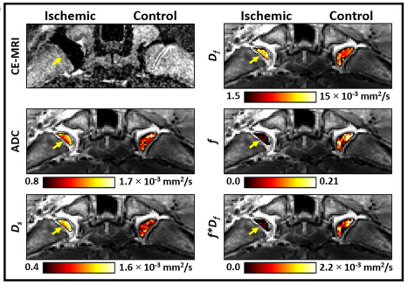
Basic/Animal
Animal Model Standardization for Studying Avascular Necrosis of the Femoral Head in Legg-Calvé-Perthes Disease. Miashiro EH, Zanella LF, Cardoso GS, Silva GDS, de Angelis K, de Almeida SHM. Rev Bras Ortop
Intravoxel incoherent motion (IVIM) detects femoral head ischemia in a piglet model of Legg-Calvé-Perthes disease. Buko EO, Bhave S, Moeller S, Laine JC, Tóth F, Johnson CP. J Orthop Res
Perfusion without contrast
Notes:
microarray of periosteum, implicated some vascular pathways

Slide 12
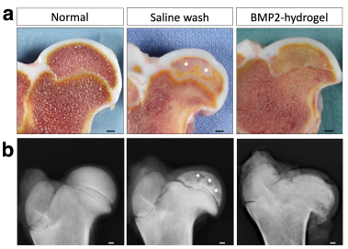
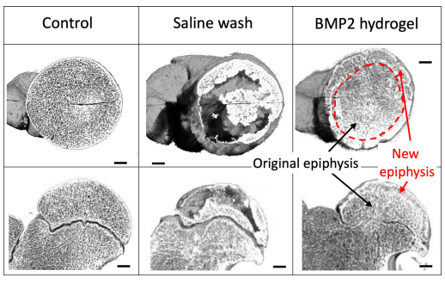
Basic/Animal
Local BMP2 hydrogel therapy for robust bone regeneration in a porcine model of Legg-Calvé-Perthes disease. Ma C, Park MS, Alves do Monte F, Gokani V, Aruwajoye OO, Ren Y, Liu X, Kim HKW. NPJ Regen Med
Increased bone formation
Also increased growth plate fusions
Local Administration of Bone Morphogenetic Protein-2 Using a Hydrogel Carrier for Robust Bone Regeneration in a Large Animal Model of Legg-Calvé-Perthes disease. Kim H, Ma C, Park M, Monte F, Gokani V, Aruwajoye O, Ren Y, Liu X. Res Sq
Notes:
microarray of periosteum, implicated some vascular pathways

Slide 13
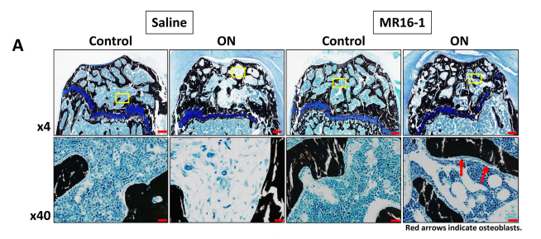
Basic/Animal
Interleukin-6 receptor blockade improves bone healing following ischemic osteonecrosis in adolescent mice. Kuroyanagi G, Kamiya N, Yamaguchi R, Kim HKW. Osteoarthr Cartil Open
Il-6 (cartilage) pro inflamm, pro bone resorption, inhibit bone formation

Slide 14
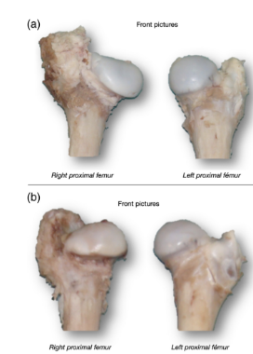
Basic/Animal
Intraosseous injection of mesenchymal stem cells for the treatment of osteonecrosis of the immature femoral head and prevention of head deformity: A study in a pig model. Martínez-Álvarez S, Galán-Olleros M, Azorín-Cuadrillero D, Palazón-Quevedo Á, González-Murillo Á, Melen-Frajlich GJ, Ramírez-Orellana M, Epeldegui-Torre T, Forriol F. Sci Prog
Effects of bone marrow-derived mesenchymal stem cell transplantation in piglet Legg-Calve-Perthes disease models: a pilot study. Tomaru Y, Sugaya H, Yoshioka T, Arai N, Abe T, Tsukagoshi Y, Kamada H, Yamazaki M, Mishima H. J Pediatr Orthop B

Slide 15
Basic/Animal
Construction of ceRNA network based on RNA-seq for identifying prognostic lncRNA biomarkers in Perthes disease. Zhang T, Hu X, Yu S, Wei C. Front Genet.
Rabbit model - Competing endogenous RNA, most genes assoc with angiogenesis and platelets
Avascular necrosis of the femoral head in a cynomolgus macaque (Macaca fascicularis). Frankel JS, Gardiner KL, Brice AK, Hagan L, Manzi TJ, Makaron L. J Med Primatol
Exosomes from chondrocytes overexpressing miR-214-3p facilitate M2 macrophage polarization and angiogenesis to relieve Legg Calvé-Perthes disease. Lan X, Yu R, Xu J, Jiang X. Cytokine
Promotes macrophageM2 polarization (anti-inflame) and angiogenesis
Inhibition of Toll-Like Receptor 4 Signaling Pathway Accelerates the Repair of Avascular Necrosis of Femoral Epiphysis through Regulating Macrophage Polarization in Perthes Disease. Yu R, Ma C, Li G, Xu J, Feng D, Lan X. Tissue Eng Regen Med
Rat model

Slide 16
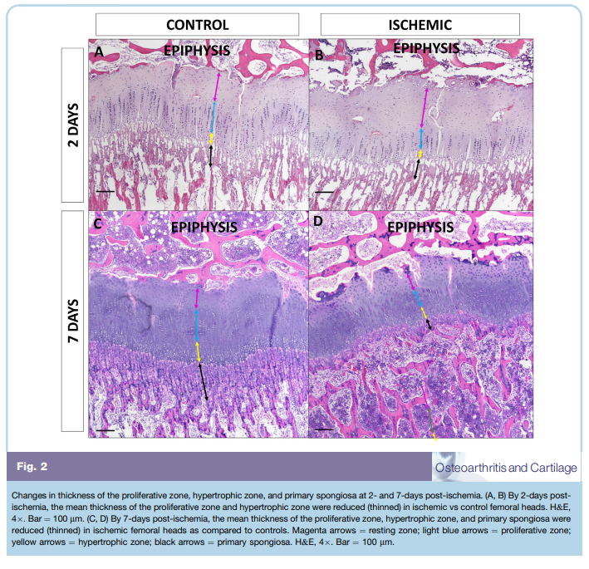
Basic/Animal
Rspo1 inhibited apoptosis of glucocorticoid-induced osteoblasts via Wnt/β-catenin pathway in Legg-Calve-Perthes disease. Zhang T, Ji Y, Yu S, Wang N, Zhang Q, Guo K. Adv Clin Exp Med
Rabbit model
Rspo downregulated, addition prevents osteoblast apoptosis in vivo
Effects of acute femoral head ischemia on the growth plate and metaphysis in a piglet model of Legg-Calvé-Perthes disease. Armstrong AR, Tóth F, Carlson CS, Kim HKW, Johnson CP. Osteoarthritis Cartilage
Notes:
microarray of periosteum, implicated some vascular pathways

Slide 17
Article type
Basic/Animal – 15
Case report–8
Imaging/Rad Valid – 2
Rad Feature – 5
Rad Outcome -5
Late sequelae/adult recon – 5
Long term f/u – 2
Gait – 1
Patient factors/Epidemiology – 6
Review – 9
Surgical treatment techniques – 3
Surgical outcomes - 15
Outcomes measures/QOL – 3
Comment/Literature rev – 3
Mixed case series/Non-op – 2

Slide 18
Case Reports
OSTEOCHONDRITIS DISSECANS OF THE HIP IN LEGG-CALVÉ-PERTHES DISEASE: CASE REPORT AND REVIEW. de Angeli LRA, Serafim BLC, Cordeiro FG, Bessa FS, Maranho DAC. Acta Ortop Bras
Perthes-Like Disorder in a Child with Atypical Bohring-Opitz Syndrome. Altaf MT, Kandagaddala M, Selina A, Madhuri V. JBJS Case Connect
The Practicality of the Robotic Total Hip Arthroplasty for the Treatment of Complex Bilateral Adult Hip Dysplasia. Technology Makes It Easy. Marcinko M, Sadhwani S, Dahl R, Ali M. Arthroplast Today
Monozygotic Twins with Legg-Calvé-Perthes Disease and with Non-Identical Lumbosacral Malformation: a Case Report and Literature Review. Hrubá M, Bárta P, Džupa V, Krbec M. Acta Chir Orthop Traumatol Cech

Slide 19
Case Reports
Long-term Survival after Femoral Anterior Rotational Osteotomy for Late-onset Legg-Calvé-Perthes Disease: A Case Report with 27-year Follow-up? Ikegami A, Oka Y, Yamazoe S, Takahashi K. J Orthop Case Rep
Legg-Calvé-Perthes Disease Following Nephrotic Syndrome With Long-Term Steroid Use in a Three-Year-Old Boy: A Case Report. Ueshima M, Shimasaki A, Yasu T. Cureus
Growth Hormone Treatment in Children with Perthes Disease and Growth Hormone Deficiency: A Case Report and Literature Review. Shi Y, Ying Y, Luo X, Hou L. Endocr Metab Immune Disord Drug Targets
The Mushroom Femoral Head in Legg-Calvé-Perthes Disease. Alhassan E, Christianakis S. J Clin Rheumatol

Slide 20
Article type
Basic/Animal – 15
Case report–8
Imaging/Rad Valid – 2
Rad Feature – 5
Rad Outcome -5
Late sequelae/adult recon – 5
Long term f/u – 2
Gait – 1
Patient factors/Epidemiology – 6
Review – 9
Surgical treatment techniques – 3
Surgical outcomes - 15
Outcomes measures/QOL – 3
Comment/Literature rev – 3
Mixed case series/Non-op – 2

Slide 21
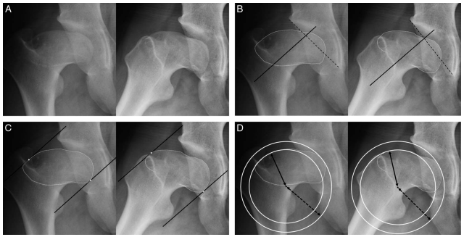
Imaging/Rad Valid
Reliability of the Modified Method for Sphericity Deviation Score Using Only the Involved Hip Radiographs in the Patients With Legg-Calve-Perthes Disease. Kang MS, Kak A, Prasadh JG, Kim HK. J Pediatr Orthop
Excellent inter/intra reliability, correlates with conventional and Stulberg
An AI based classifier model for lateral pillar classification of Legg-Calve-Perthes. Soydan Z, Saglam Y, Key S, Kati YA, Taskiran M, Kiymet S, Salturk T, Aydin AS, Bilgili F, Sen C. Sci Rep.
Trained on simulated images. CCN better than 7/11 MDs
Notes:
TRICKS MRA not enough resoluition?

Slide 22
Rad Feature
Fully automatic system to detect and segment the proximal femur in pelvic radiographic images for Legg-Calvé-Perthes disease. Ditmer S, Dwenger N, Jensen LN, Kim H, Boel RV, Ghaffari A, Rahbek O. J Orthop Res
[Clinical aspects of imaging the hip in infants, children and adolescents]. Heimkes B, Berger N, Frimberger V. Radiologie (Heidelb).
Morphometric assessment of the hip joint in children aged 2-13 years. Önal V, Metin Tellioğlu A, Durum Polat Y. Clin Anat
Skeletal Maturity in Legg-Calve-Perthes Disease: Significant Discrepancy Present Between the Hand and the Hip. Shaw KA, Herring JA. J Pediatr Orthop
Oxford more similar to CA than GP. GP<CA
Coxa Magna following treatment of developmental dysplasia of the hip: investigation for associated potential factors. Topak D, Aslan A, Yorgancigil H. J Pediatr Orthop B

Slide 23
Rads Outcome
Ipsilateral Healthy-segment Response to Leg Length Discrepancy. Birch JG, Makarov MR, Jo CH. J Pediatr Orthop
Outcome Prediction Model Following Proximal Femoral Osteotomy in Legg-Calvé-Perthes Disease Using Machine Learning Algorithms. Kim S, Seon JK, Ko B, Lim JH, Song WC, Kang GR, Shin Y, Jung ST. J Pediatr Orthop
Does Acetabulum Remodel Following Varus Derotation Osteotomy for Perthes' Disease? Deo NB, Agarwal A. Rev Bras Ortop
Notes:
With regards to duration of waldenstrom stages, looked at kids ,6. longer initial and fragmentation stages correlated with worse stulberg

Slide 24
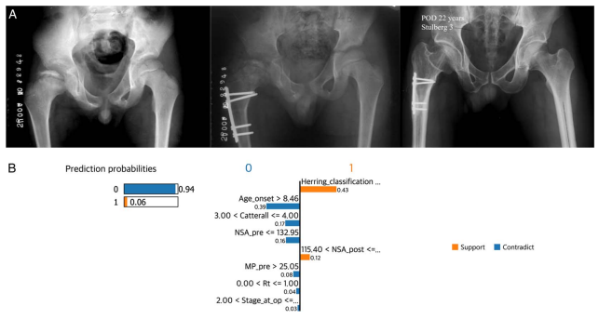
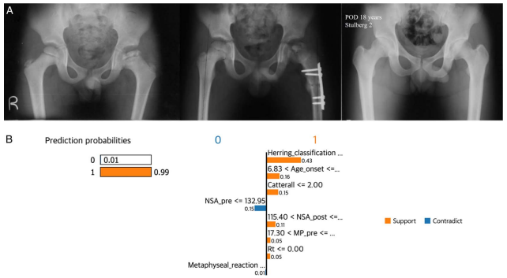
Rads Outcome
Ipsilateral Healthy-segment Response to Leg Length Discrepancy. Birch JG, Makarov MR, Jo CH. J Pediatr Orthop
Outcome Prediction Model Following Proximal Femoral Osteotomy in Legg-Calvé-Perthes Disease Using Machine Learning Algorithms. Kim S, Seon JK, Ko B, Lim JH, Song WC, Kang GR, Shin Y, Jung ST. J Pediatr Orthop
Does Acetabulum Remodel Following Varus Derotation Osteotomy for Perthes' Disease? Deo NB, Agarwal A. Rev Bras Ortop
NO
Notes:
With regards to duration of waldenstrom stages, looked at kids ,6. longer initial and fragmentation stages correlated with worse stulberg

Slide 25
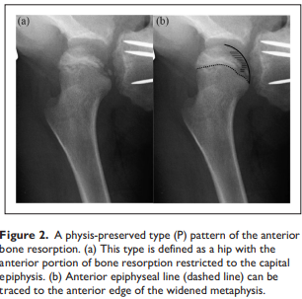
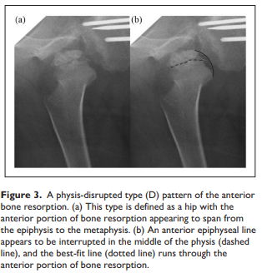
Rads Outcome
Prognostic value of bone resorption pattern in the anterior portion of the femoral head in Legg-Calvé-Perthes disease. Mishima K, Kamiya Y, Matsushita M, Imagama S. J Child Orthop
Clinical Outcomes of Open-Wedge Varus Derotation Osteotomy in Legg-Calve-Perthes Disease Among 6-12-Year-Old Children. Gumin Tayeng A, Sengupta A, Chaterjee P. Cureus

Slide 26
Article type
Basic/Animal – 15
Case report–8
Imaging/Rad Valid – 2
Rad Feature – 5
Rad Outcome -5
Late sequelae/adult recon – 5
Long term f/u – 2
Gait – 1
Patient factors/Epidemiology – 6
Review – 9
Surgical treatment techniques – 3
Surgical outcomes - 15
Outcomes measures/QOL – 3
Comment/Literature rev – 3
Mixed case series/Non-op – 2

Slide 27
Adult Reco
Total hip arthroplasty in patients with common pediatric hip orthopedic pathology. De Salvo S, Sacco R, Mainard N, Lucenti L, Sapienza M, Dimeglio A, Andreacchio A, Canavese F. J Child Orthop
LCPD THA similar results to OA
Total hip arthroplasty with monobloc press-fit acetabular components and large-diameter bearings for atypical acetabula is safe: a consecutive case series of 125 hips with mean follow-up of 9 years. Synnott PA, Kiss MO, Shahin M, Morcos MW, Binette B, Vendittoli PA. Can J Surg
Trends in the Use of Total Hip Arthroplasty in the Pediatric Population: A Review of the Literature. Peagler CL Jr, Dobek AJ, Tabaie S. Cureus
Incidence of total hip arthroplasty in patients with Legg-Calve-Perthes disease after conservative or surgical treatment: a meta-analysis. Zhi X, Wu H, Xiang C, Wang J, Tan Y, Zeng C, Xu H, Canavese F. Int Orthop
Reprted 6.8% non-op, 5.1 surgical patients had THA
Total hip arthroplasty through the direct anterior approach for sequelae of Legg-Calvé-Perthes disease. Hasler J, Flury A, Hoch A, Cornaz F, Zingg PO, Rahm S. Arch Orthop Trauma Surg

Slide 28
Long term follow up
Rate of Total Hip Replacement after Legg Calve Perthes Disease in a Canadian Province. Tan J, Sharma A, Bansal R, Tan Q, Prior HJ, McRae S, McCammon JR. Pediatr Rep
Pop database Manitoba 200 patients (20 with surgical treatment) 39% THA
Long-Term Outcomes at Skeletal Maturity of Combined Pelvic and Femoral Osteotomy for the Treatment of Legg-Calve-Perthes Disease. Regan CM, Su AW, Stans AA, Milbrandt TA, Larson AN, Shaughnessy WJ, Grigoriou E. J Clin Med
14 pts 20yr f/u 40% StulbergI/II, 60% III/IV

Slide 29
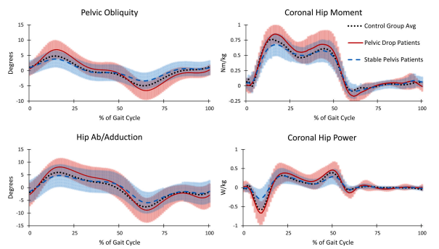
Gait
Investigating pelvic drop gait abnormality in adolescent hip pathology patients. Anable NR, Luginsland LA, Carlos C Jr, Stevens WR Jr, Loewen AM, Jeans KA, Sucato DJ. Gait Posture
Uncompensated Trendelumberg, weakly correlates w pain

Slide 30
Article type
Basic/Animal – 15
Case report–8
Imaging/Rad Valid – 2
Rad Feature – 5
Rad Outcome -5
Late sequelae/adult recon – 5
Long term f/u – 2
Gait – 1
Patient factors/Epidemiology – 6
Review – 9
Surgical treatment techniques – 3
Surgical outcomes - 15
Outcomes measures/QOL – 3
Comment/Literature rev – 3
Mixed case series/Non-op – 2

Slide 31
Patient Factors/Epidemiology
No correlation to collagen synthesis disorders in patients with Perthes' disease: a nationwide Swedish register study of 3488 patients. Lindblad M, Bladh M, Björnsson-Hallgren H, Sydsjö G, Johansson T. BMC Musculoskelet Disord
Association between Polymorphism eNOS4, tPA, Factor V Leiden, Prothrombin, and Methylenetetrahydrofolate Reductase and the Occurrence of Legg-Calvé-Perthes Disease. Matuszewska A, Sygacz O, Matuszewski Ł, Stec S, Grzegorzewski A, Gągała J. J Clin Med
Platelet to lymphocyte ratio was a risk factor in Perthes disease. Wang T, Luo X, Li B, Huang Q, Liu J, Tang S, Liu Y, Lu R, Liao S, Ding X. Sci Rep
AUC .67

Slide 32
Patient Factors/Epidemiology
Legg-Calve-Perthes' disease: an opportunity to prevent blindness? Wang A, Nixon T, Martin H, Richards A, McNinch A, Alexander P, Pujari R, Bale P, Shenker N, Bearcroft P, Brown S, Blackwell A, Poulson A, Snead M. Arch Dis Child
Prothrombin Time and Coagulation Factor IX as Hemostatic Risk Markers for Legg- Calvé-Perthes Disease. Hernández-Zamora E, Rodríguez-Olivas AO, Rosales-Cruz E, Galicia-Alvarado MA, Zavala-Hernández C, Reyes-Maldonado E. Clin Appl Thromb Hemost
Found some predictive value with PT, F IX

Slide 33
Article type
Basic/Animal – 15
Case report–8
Imaging/Rad Valid – 2
Rad Feature – 5
Rad Outcome -5
Late sequelae/adult recon – 5
Long term f/u – 2
Gait – 1
Patient factors/Epidemiology – 6
Review – 9
Surgical treatment techniques – 3
Surgical outcomes - 15
Outcomes measures/QOL – 3
Comment/Literature rev – 3
Mixed case series/Non-op – 2

Slide 34
Reviews
Atraumatic Limping Child, a Challenge for Pediatricians: An Observational Age-Related Study in a Pediatric Emergency Department. Cristaldi S, Boni A, Ferro V, Musolino A, Della Vecchia N, Boccuzzi E, Bellelli E, Biagiarelli FS, Aulisa AG, Cirillo M, Raucci U, Villani A. Children (Basel).
Legg-Calvé-Perthes Disease: Diagnosis, Decision Making, and Outcome. Ng T, Liu R, Kulkarni VA. Curr Sports Med Rep
Epidemiology, natural evolution, pathogenesis, clinical spectrum, and management of Legg-Calvé-Perthes. Joseph B, Shah H, Perry DC. J Child Orthop
Legg-Calve-Perthes Disease. Mills S, Burroughs KE. 2023 Jul 10. In: StatPearls
[Legg-Calvé-Perthes disease]. Schwert A. Radiologie (Heidelb).
Notes:
CRFA – use a needle probe to ablate nerves in 40 yo with perthes related OA

Slide 35
Review
Common Orthopedic Traits and Screening for Breeding Programs. Hayward JJ, Todhunter RJ. Vet Clin North Am Small Anim Pract
Evaluating the Child With a Limp. Morancie NA, Helton MR. Am Fam Physician
Molecular Biomarkers in Perthes Disease: A Review. Spasovski V, Srzentić Dražilov S, Nikčević G, Baščarević Z, Stojiljković M, Pavlović S, Spasovski D. Diagnostics (Basel).
What is New in Pediatric Orthopaedic: Basic Science. Lynch B, Botros D, Halanski M, Barsi J. J Pediatr Orthop

Slide 36
Article type
Basic/Animal – 15
Case report–8
Imaging/Rad Valid – 2
Rad Feature – 5
Rad Outcome -5
Late sequelae/adult recon – 5
Long term f/u – 2
Gait – 1
Patient factors/Epidemiology – 6
Review – 9
Surgical treatment techniques – 3
Surgical outcomes - 15
Outcomes measures/QOL – 3
Comment/Literature rev – 3
Mixed case series/Non-op – 2

Slide 37
Surgical Techniques
Upper limb and lower limb radiofrequency treatments in orthopaedics. Rodríguez-Merchán EC, Delgado-Martínez AD, De Andrés-Ares J. EFORT Open Rev
Pediatric Hip Arthroscopy: a Review of Indications and Treatment Outcomes. Crofts H, McConkey M, Lodhia P. Curr Rev Musculoskelet Med
[Study of virtual reality technology combined with reduction plasty of femoral head in treatment of coxa plana]. Qiu Y, Xia T, Yuan Z, Huan D, Zhang C, Shen J. Zhongguo Xiu Fu Chong Jian Wai Ke Za Zhi

Slide 38
Surgical Outcomes
Radiographic outcome after greater trochanteric epiphysiodesis in patients with Perthes disease. Osterholt AC, Bittersohl B, Westhoff B. J Child Orthop
Curette + 2 screws; Effective age<8
Mini-open Femoroacetabular Osteoplasty in Patients With Tönnis Grade 2 or Higher Osteoarthritis is Associated With a Higher Risk of Subsequent Conversion to THA. Abdelaal MS, Sutton RM, Sherman MB, Parvizi J. Clin Orthop Relat Res
Functional adaptation after femoral intertrochanteric valgus osteotomy in Legg-Calvé-Perthes disease. Wagner F, Weiß B, Holzapfel BM, Ziegler CM, Heimkes B. Sci Rep
Mid-term results of sub-trochanteric valgus osteotomy for symptomatic late stages Legg-Calvé-Perthes disease. Emara KM, Diab RA, Emara AK, Eissa M, Gemeah M, Mahmoud SA. World J Orthop
Labral Support Shelf Acetabuloplasty for Late Presenting Perthes Disease: Outcomes in Indian Patients. Vinayak U, Gundawar C, Shyam A, Sancheti P, Vaidya SV, Agashe MV, Patwardhan S. Indian J Orthop

Slide 39
Surgical Outcomes
Treatment of Symptomatic Residual Deformity in Legg-Calvé-Perthes Disease: Mid-Term Outcomes and Predictors of Failure After Surgical Hip Dislocation with Femoral-Head Reshaping and Relative Neck Lengthening. Novais EN, Ferraro SL, Justo PG, Ferrer MG, Miller P, Kim YJ, Millis MB. J Bone Joint Surg Am
60 patients, 60% survival mean 10yrs
Femoral head reduction osteotomy for the treatment of late sequela of Legg-Calvé-Perthes disease and Perthes-like femoral head deformities. Eltayeby HH, El-Adwar KL, Ahmed AA, Mosa MM, Standard SC. J Pediatr Orthop B
22 patients 3.2yr f/u , mean HHS 62->81
Evaluating the effectiveness of interventions targeting only the acetabular side in the surgical treatment of Legg-Calvé-Perthes disease. Albayrak M, Ugur F. Eur Rev Med Pharma
Outcomes of Varus Derotation Femoral Osteotomy By Angle Blade Plate in Legg-Calve-Perthes Disease for Patient Above Eight Years of Age in The Lateral Pillar B or B/C Group. Alam QS, Alam MT, Sutrodhar PK, Islam MS, Hossain MM, Salam SI, Saha MK, Rahman MM, Hossain MZ, Roy MK. Mymensingh Med J

Slide 40
Surgical outcomes
Hip survival after periacetabular osteotomy in patients with acetabular dysplasia, acetabular retroversion, congenital dislocation of the hip, or Legg-Calvé-Perthes disease: a cohort study on 1,501 hips. Rosendahl Kristiansen A, Holsgaard-Larsen A, Bøgehøj M, Overgaard S, Lindberg-Larsen M, Ovesen O. Acta Orthop
Timing From Symptom Onset to Hip Arthroscopy Does Not Affect Patient-Reported Outcome Measures for the Treatment of Femoroacetabular Impingement in Adolescent Patients. Ruzbarsky JJ, Comfort SM, Fukase N, Briggs KK, Vidal LB, Philippon MJ. Arthroscopy
Pedicled iliac bone flap grafting in the treatment of late presentation Legg-Calvé-Perthes disease. Xiao YB, Du W, Wu PF, Qing LM, Yu F, Tang JY. Front Surg
13 patients, 12 Stulberg I,II
Progressive lateralization and constant hip geometry in children with DDH, NDH, and LCPD following hip reconstructive surgery: a cohort study of 73 patients with a mean follow-up of 4.9 years. Pisecky L, Großbötzl G, Gahleitner M, Stevoska S, Stadler C, Haas C, Gotterbarm T, Klotz MC. Arch Orthop Trauma Surg
LCPD 2.7x risk conversion THA

Slide 41
Article type
Basic/Animal – 15
Case report–8
Imaging/Rad Valid – 2
Rad Feature – 5
Rad Outcome -5
Late sequelae/adult recon – 5
Long term f/u – 2
Gait – 1
Patient factors/Epidemiology – 6
Review – 9
Surgical treatment techniques – 3
Surgical outcomes - 15
Outcomes measures/QOL – 3
Comment/Literature rev – 3
Mixed case series/Non-op – 2

Slide 42
PRO/QOL
"Waiting for the best day of your life". A qualitative interview study of patients' and clinicians' experiences of Perthes' disease. Galloway AM, Pini S, Holton C, Perry DC, Redmond A, Siddle HJ, Richards S. Bone Jt Open
Read it
Radiological hip shape and patient-reported outcome measures in healed Perthes' disease. Ali MS, Khattak M, Metcalfe D, Perry DC. Bone Joint J
Simplified Stulberg (spherical, ovoid, aspherical) correlates with PROs
A Comparison Between 3 Functional Hip Scores for Evaluation of the Pediatric Hip. Huebschmann NA, Masrouha KZ, Dib A, Moscona L, Castañeda P. J Pediatr Orthop
IHS, HHS, CHOHES Correlate with each other but not global PODCI

Slide 43
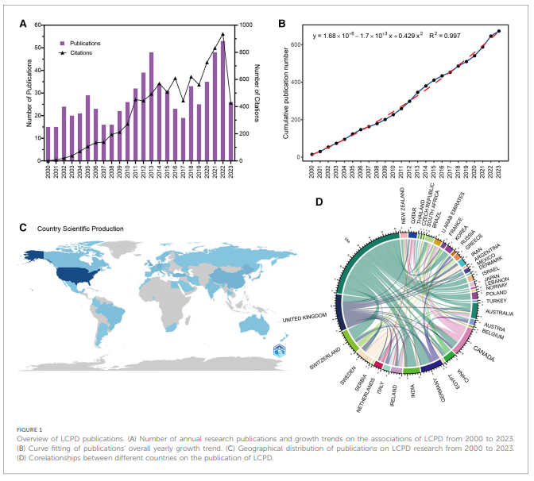
Comments, Literature review
Global trends in the research on Legg-Calve-Perthes disease in Web of Science. Qin W, He M, Qin H, Wei Q, Yan H. Front Pediatr
Positive outcome reporting in orthopaedic literature. Filtes P, Sobol K, Lin C, Anil U, Roberts T, Pargas-Colina C, Castañeda P. Bone Joint J
130 manuscripts, 110 reported positive results
The quality of online information on Legg-Calvé-Perthes disease: can we do better? Nassur JA, Samuel LT, Acuña AJ, Ellsworth B, Kamath AF. Arch Orthop Trauma Surg
We scored well on accessibility and usability, less good on reliability
Few HON certified

Slide 44
Non-op/Mixed Case series
Recommendations for physiotherapy and physical activity for children with Legg-Calvé-Perthes disease: a survey of pediatric orthopedic surgeons and physiotherapists in Sweden. Melin L, Rendek Z, Hailer YD. Acta Orthop
Agreement on stretching, disagreement on strengthening during initial and fragmentation
Patient Adherence to Wide Abduction Brace Treatment for Legg-Calvé-Perthes Disease. Prasadh JG, Jo CH, Kim HKW. J Pediatr Orthop
Overall about 60% adherence, correlates with age, prior petrie

Slide 45
Summary thoughts
Increased understanding of deformity
Roles for AI?
Clinical studies still predominately single center retrospective, but increasing multi center
Longer f/u
More PRO
? Value of surgery
Long term studies confirm burden of disease
Surgery is great at improving xrays

Slide 46
Thank You!
Will post the pubmed bibliography
Have PDFs of all citations
Skip Gilbert: srgilbert@uabmc.edu

