Slide 1
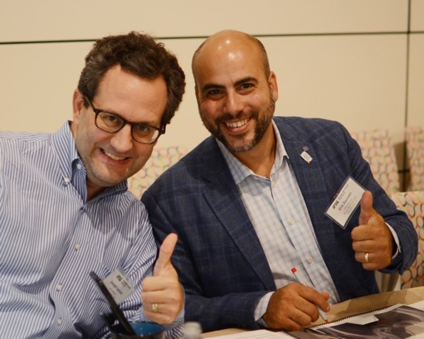

Patient-Reported Outcome Data
Eric Fornari, MD

Slide 2
What PROs are we using?
PRO | Frequency | Domains | Reference
Clinic Visit Questionnaire | Each Visit | Pain, Medications, Physical Activity | IPSG Surgeon Members
PROMIS | Each Visit (Proxy for 5-8 years old) | Mobility, Fatigue, Anger, Anxiety, Depressive Symptoms, Pain Interference, Peer Relationships | DeWalt, D., Gross, H., Gipson, D., et al. (2015). PROMIS® Pediatric Self-Report Scales Distinguish Subgroups of Children within and across Six common Pediatric Chronic Health Conditions. Quality of Life Research, 1-14.
Modified Harris Hip Score | Initial, 2-year, 5-year, and final follow-up visits (if ≥10 years old) | Pain, Hip Function | Byrd, J. W. and K. S. Jones (2000). Prospective analysis of hip arthroscopy with 2-year follow-up. Arthroscopy 16(6): 578-587.
Modified HOOS-15 | 5-year visit, and each visit thereafter | Pain, Other Symptoms, Physical Function in Daily Living, Function in Sport and Rec, Hip-Related QOL | Klassbo M, Larsson E, Mannevik E. (2003) Hip disability and osteoarthritis outcome score. An extension of the Western Ontario and McMaster Universities Osteoarthritis Index. Scand J Rheumatol. 32(1):46-51. *modified by the IPSG for younger population
Iowa Hip Score | Discontinued 5/2018 |  | Larson, C. B. (1963). Rating scale for hip disabilities. Clin Orthop Relat Res 31: 85-93.

Slide 3
Summary of 2023 - present
Collected more data
Continued to evaluate and understand the data we have
Partnered with Susan to oversee PRO’s
Two sub-studies of longitudinal PROMIS data are now underway
  <6 and 6-11 cohorts
  Not easy due to number of variables at play
  Thank you Jennifer, Susan, Leila, Nick, Chris, Candelaria

Slide 4
PROMIS Data Collection
Collected at each visit for kids over 5 years old

Slide 5
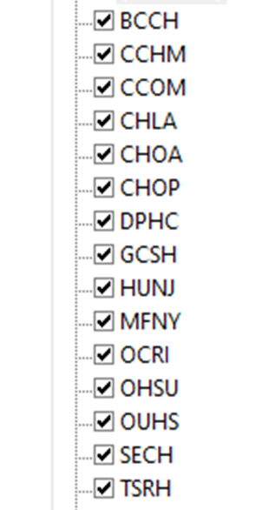
PROMIS Administration
Regulatory modifications and site training is on-going
15 sites collecting total
Standard of care clinic OR research-only administration
To start collecting PROMIS, contact IPSG@tsrh.org

Slide 6
PROMIS Data Collection
Over 800 initial, 3-,6-,9-, and 12-month visits completed for all enrolled participants
>2400 visits where PROMIS was administered
1010 Proxy surveys (<8yrs old)
1397 Self-reported surveys (>8ys old)
Notes:
Note:
Pre and Post Op surveys not included here

Slide 7
PROMIS Data Jan 2023

Slide 8
PROMIS Data April 2024

Slide 9
Proxy-Report PROMIS Data
Children <8 at time of survey

Slide 10
Proxy Parent-Report Data 2024
858 age-appropriate surveys collected
Collected from Apr2014-April2024 at 15 Sites
Age range 2.72-7.99 (mean 6.06)
858 surveys represent 235 unique study IDs
Notes:
For entire database.

Slide 11
Notes:
Not as important

Slide 12
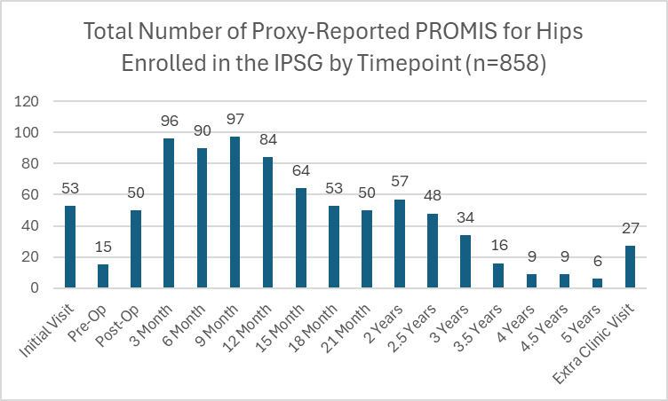
Proxy-Report Data Through 2024

Slide 13
Pediatric Self-Report Data
Children >8 at time of survey

Slide 14
Pediatric Self-Report Data 2021
904 age-appropriate surveys
Collected from Mar2015-Dec2024 at 15 sites
Age range 8.01-14.52 (mean 10.35)
904 surveys represent 297 unique hips
Notes:
*Post Op (n=13) and Pre Op visits not included

Slide 16
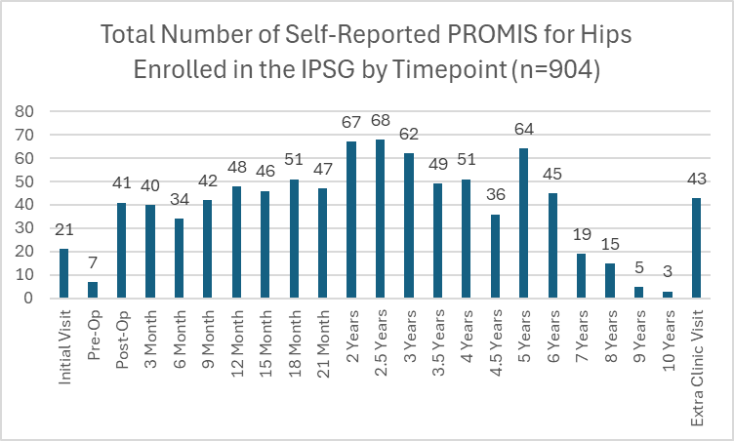
Pediatric Self-Report Data Through 2024

Slide 17
What to do with this data?

Slide 18
PROMIS Data Sub-Study Concepts
Impact of activity restrictions and mobility restrictions on QoL
Describe QoL before and after FVO
Describe QoL before, during, and after bracing/casting
Understanding mobility and anxiety in Perthes patients
2-year cross-sectional sample: are our kids normal?
Impact on socioeconomic status on PROMIS scores/trends
Where are patients at the healed stage?
  Back to normal? Better than where they started? Are improvements lasting?

Slide 19
Modified Harris Hip Score
Children >10 years old at time of survey

Slide 20
Modified Harris Hip Score Data Collection
Initial Visit
2-Year Visit
5-Year Visit
92 age eligible hips
39 attempted survey
34 completed survey
167 age eligible hips with visit data
99 attempted survey
94 completed survey
169 age eligible hips with visit data
123 attempted survey
120 completed survey

Slide 21
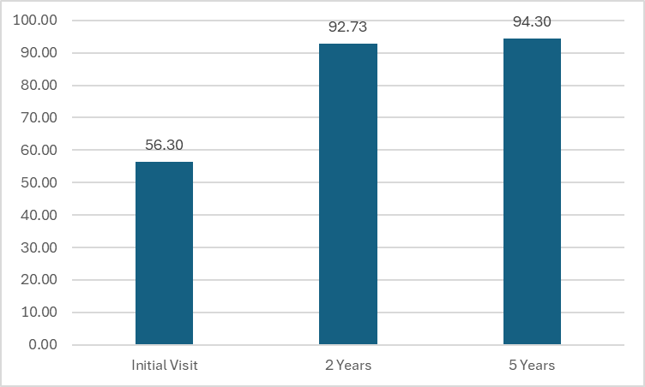
Average MHH Scores at Initial, 2- and 5-Year Visits
Notes:
- Would be interesting to look at patient report of mhhs by cohort to see if some patients recover faster.

Slide 22
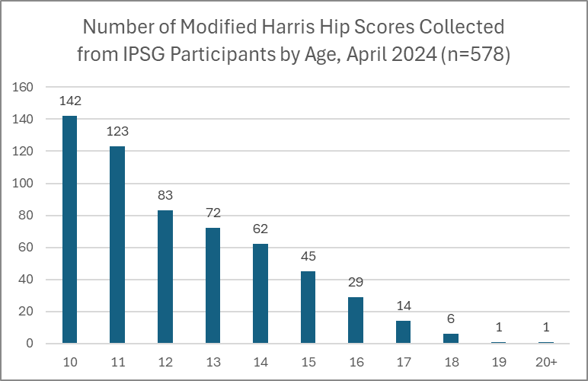

Slide 23
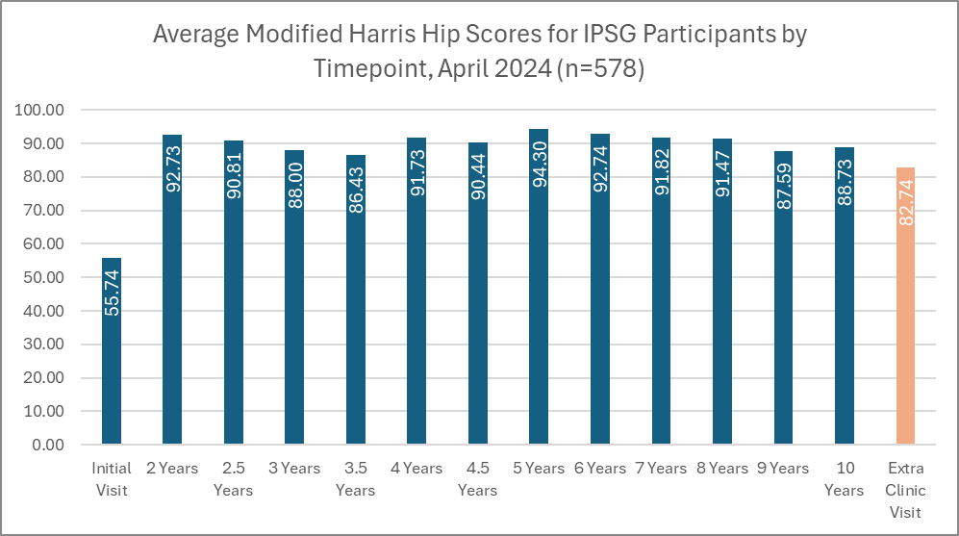
Notes:
Extra Clinic Visit can fall under any time point.

Slide 24
Modified HOOS-15
Children >10 at time of survey

Slide 25
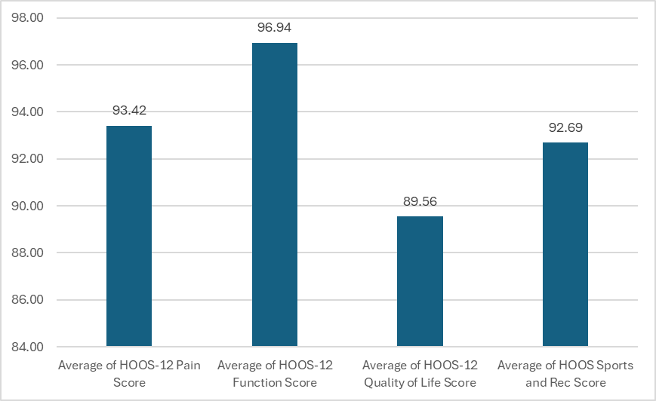
Average Modified HOOS-15 Domain Scores at 5-Year Visit, n=94

Slide 26
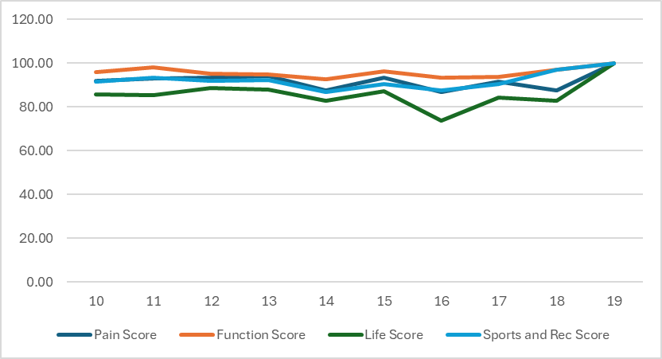
Average Modified HOOS-15 Domain Scores at by age, n=373

Slide 27
Average Modified HOOS-15 Domain Scores at by age, n=373

Slide 28
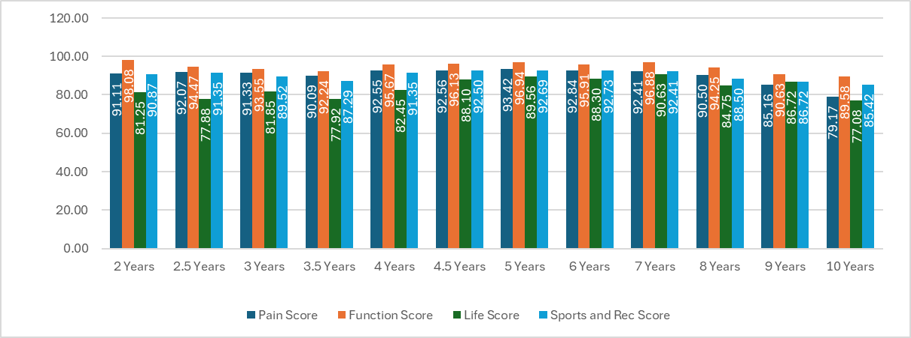
Average Modified HOOS-15 Domain Scores at by Timepoint, n=373

Slide 29
Average Modified HOOS-15 Domain Scores at by Timepoint, n=373

Slide 30
Summary
Appreciate everyone’s efforts to continue to collect this critical data
  As important to collect at as xrays and perfusion MRI
  Esp as follow-up get out past 1-2 years
We are here to help to navigate any issues you are having with collection process
Reach out to me if you are interested in discussing sub-study ideas

