Slide 1
Membership Engagement
Derek Kelly, MD & Ben Martin, MD

Slide 2
Name, Degrees, Affiliations
In the Chat
  Name as it should be spelled for authorship credit
  Credentials and Degrees
  Institutional Affiliations
  Preferred email contact for authorship/acknowledgement
  Derek M. Kelly, MD
  Campbell Clinic Orthopedics and Le Bonheur Children’s Hospital
  dkelly@campbellclinic.com

Slide 3
IPSG Membership Pathway
Provisional
Active Member
Inactive Member
Scientific member

Slide 4
What is considered “active” membership?
Each item below is worth 1 point.
  IRB approval active for current year
  Executed Data Use Agreement
  At least 1 perfusion MRI approved
  On average, 1 patient enrolled per year of active membership
  At least 80% of data complete in REDCap
  At least 80% Data Retention (% Eligible AP Radiographs at 2y + visits)
  Annual meeting attendance for previous year (2022)
  Annual meeting attendance for current year (2023)
  Membership contribution for previous year
  Membership contribution for current year ($250 scientific/non-US; $500 US members)
Need 5/10 points for “active” status

Slide 6
Authorship Acknowledgement
Authorship acknowledgement for 2024 includes those with “active” status AND were in attendance at the 2023 and 2024 Annual Meetings
Acknowledged authors for current manuscripts are generated from 2023 end of year data
Run your individual report to see whether you qualify
Active members are also listed on the IPSG Website under the Surgeon Locator section

Slide 7

Donate Today!
$500 US Members / $250 Scientific and Non-US Members

Slide 8
Membership Dues
70% of active members paid dues in 2019 (28/40)
84% of active members paid dues in 2020 (37/44)
87% of active members paid dues in 2021 (40/46)
61% of active members paid dues in 2022 (30/49)
56% of active members paid dues in 2023 (28/50)
Fundraising goal of $20K
Pays for 25% of salary + fringe of coordinator

Slide 9
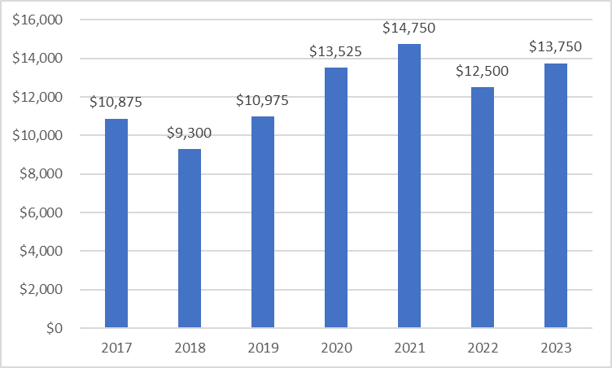
IPSG Dues Paid by Calendar Year, 2017-2023

Slide 10
2023 Contributors
Suggested amounts:
  $250 International/Scientific
  $500 for Domestic

Slide 11
IPSG Treasurer's Report
 | 2023 | 2022 | 2021 | 2020
Donations | 2,647 | 11,330 | 7,225 | 5,510
Dues | 15,750 | 13,500 | 14,750 | 13,525
Grants | 0 | 0 | 50,000 | 50,000
Revenue | 18397 | 24,830 | 71,975 | 69,035
Admin | 109,974 | 79,300 | 75,853 | 74,101
Website | 578 | 0 | 459
Annual Meeting | 2,314 | 150 | 123 | 3,300
Expenses | 112,866 | 79,450 | 76,435 | 77,401
Net | ($94,469) | ($54,620) | ($4,460) | ($8,366)
Notes:
- Other expenses include travel for Ben Joseph and Hitesh Shah from 2019 Annual Meeting (was charged in 2020)
Wages/Benefits in 2019 FYTD = $70,384 ; Expenses in 2019 FYTD = $13,763
Grant earmarked for: Coordinator, Imaging software, Meeting costs, Michelle, Website

