Slide 1
IPSG MRI Report
19 April 2024
David Y. Chong, MD

Slide 2
MRI Chair Update
Ongoing work:
Screening MRI’s
HipVasc Measurements
MRI Reliability and Usability study
Added boy #3

Slide 3
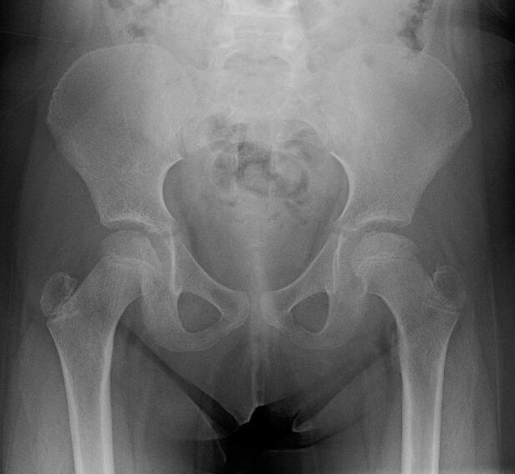
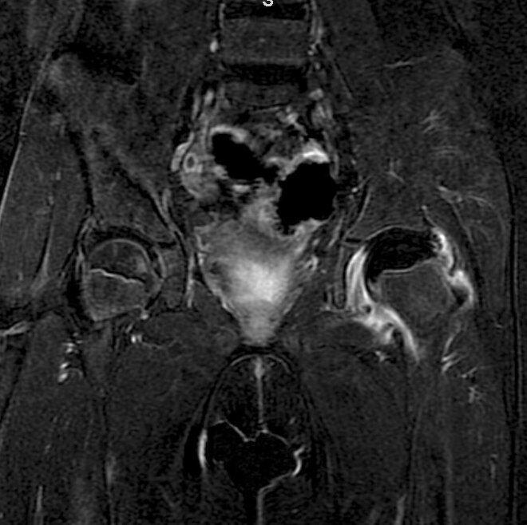
Importance of MRI
Standard radiographs have time lag
Determine the actual real-time severity of the femoral head AVN
Objective, accurate, and reliable measurements for research

Slide 4
MRI Workflow
MRI received from external site
(Candelaria)
Initial audit and approval in AMBRA (Cloud PACS
(Candelaria)
Candelaria receives MRI from site
Candelaria audits and approves in AMBRA
Screeners review (if no good, collect visual estimation)
Candelaria moves MRI into SECTRA and flags key series
Candelaria export to files > DICOM sort > Order series > Test in HIPVASC
First two measurer’s provide HIPVASC data
Candelaria reviews to ensure measurements within 20% of each other.
Candelaria marks MRI form “complete”
YES
Screened for viability
(Harry and David)
NO
Imported into SECTRA
Key series flagged
(Candelaria)
Visual estimations x2
(Harry, David, ?)
DICOM files exported
Sorted and ordered for HipVasc (Candelaria)
HipVasc
measurement
HipVasc
measurement
HipVasc
measurement
Compile scores
Check measurements <20%*
COMPLETED!
Notes:
Reduced required visual estimations and HipVasc measurements to 2 observers but also reduced difference between observers to 20% (previously 3 observers within 30%). Any measurements with more than 20 percent are measured by a third observer.

Slide 5
Current MRI Status
526 MRIs have been submitted
521 have been screened
5 need screening (Harry and David)

Slide 6
Current MRI Status
~521 MRIs screened
131 poor quality
VE only
107 complete, 24 incomplete
Essentially complete
379 HipVasc-able

Slide 7
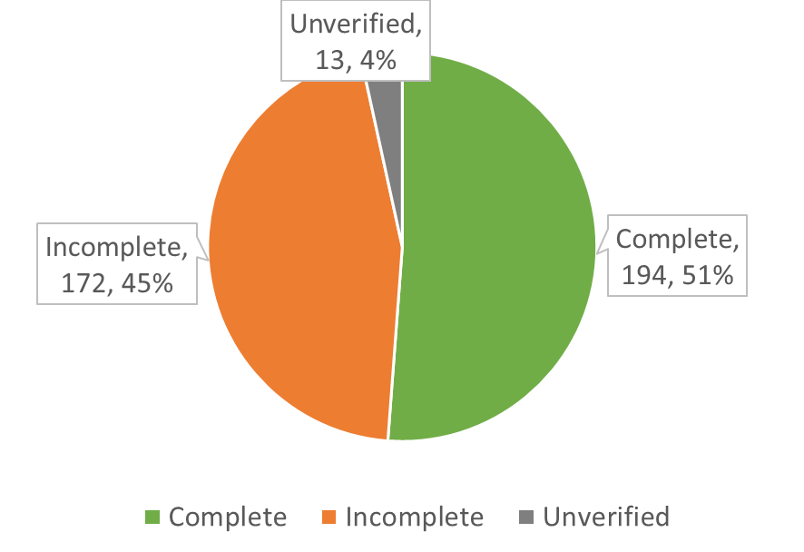
Current MRI Status
379 MRIs to be measured
194 completed measurements
13 unverified – need reviewing / discrepancies
172 with incomplete measurements
21 studies partially done (need one HipVasc)
2 observers: (172 * 2) - 21 = 323
323 total HipVasc measurements

Slide 8
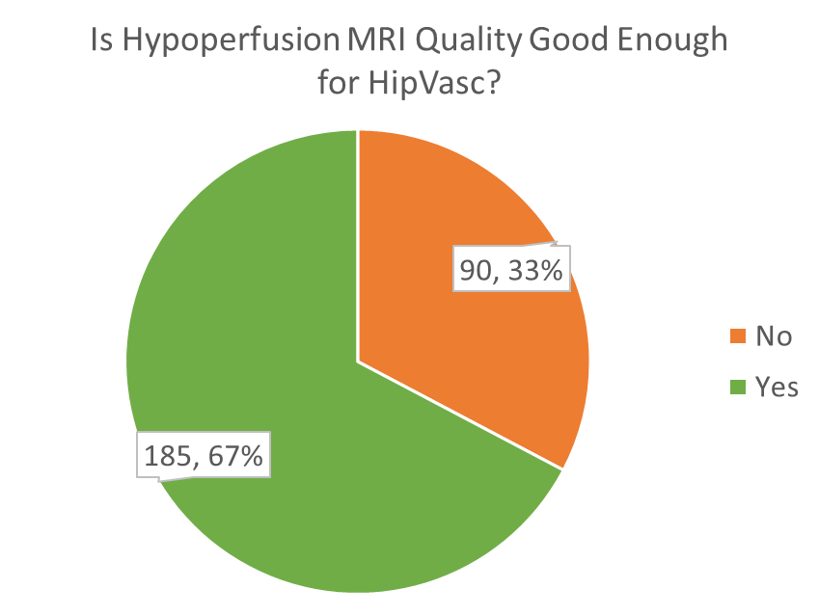
Current MRI Status (6-11 Early Stage)
420 MRIs screened
102 poor quality
VE only
90 complete, 12 incomplete
Essentially complete
318 HipVasc-able
Notes:
In the priority group (8-11 Early stage) 92 are poor quality, 280 are HipVasc-able, 144 are complete, 120 incomplete, 16 unverified

Slide 9
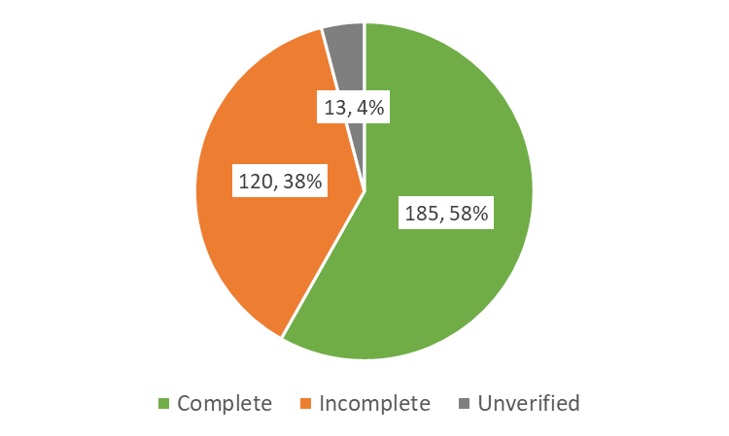
Current MRI Status (6-11 Early Stage)
318 MRIs to be measured
185 completed measurements
13 unverified – need reviewing / discrepancies
120 with incomplete measurements
15 studies partially done (need one HipVasc)
2 observers: (120 * 2) - 15 = 225
225 total HipVasc measurements

Slide 10
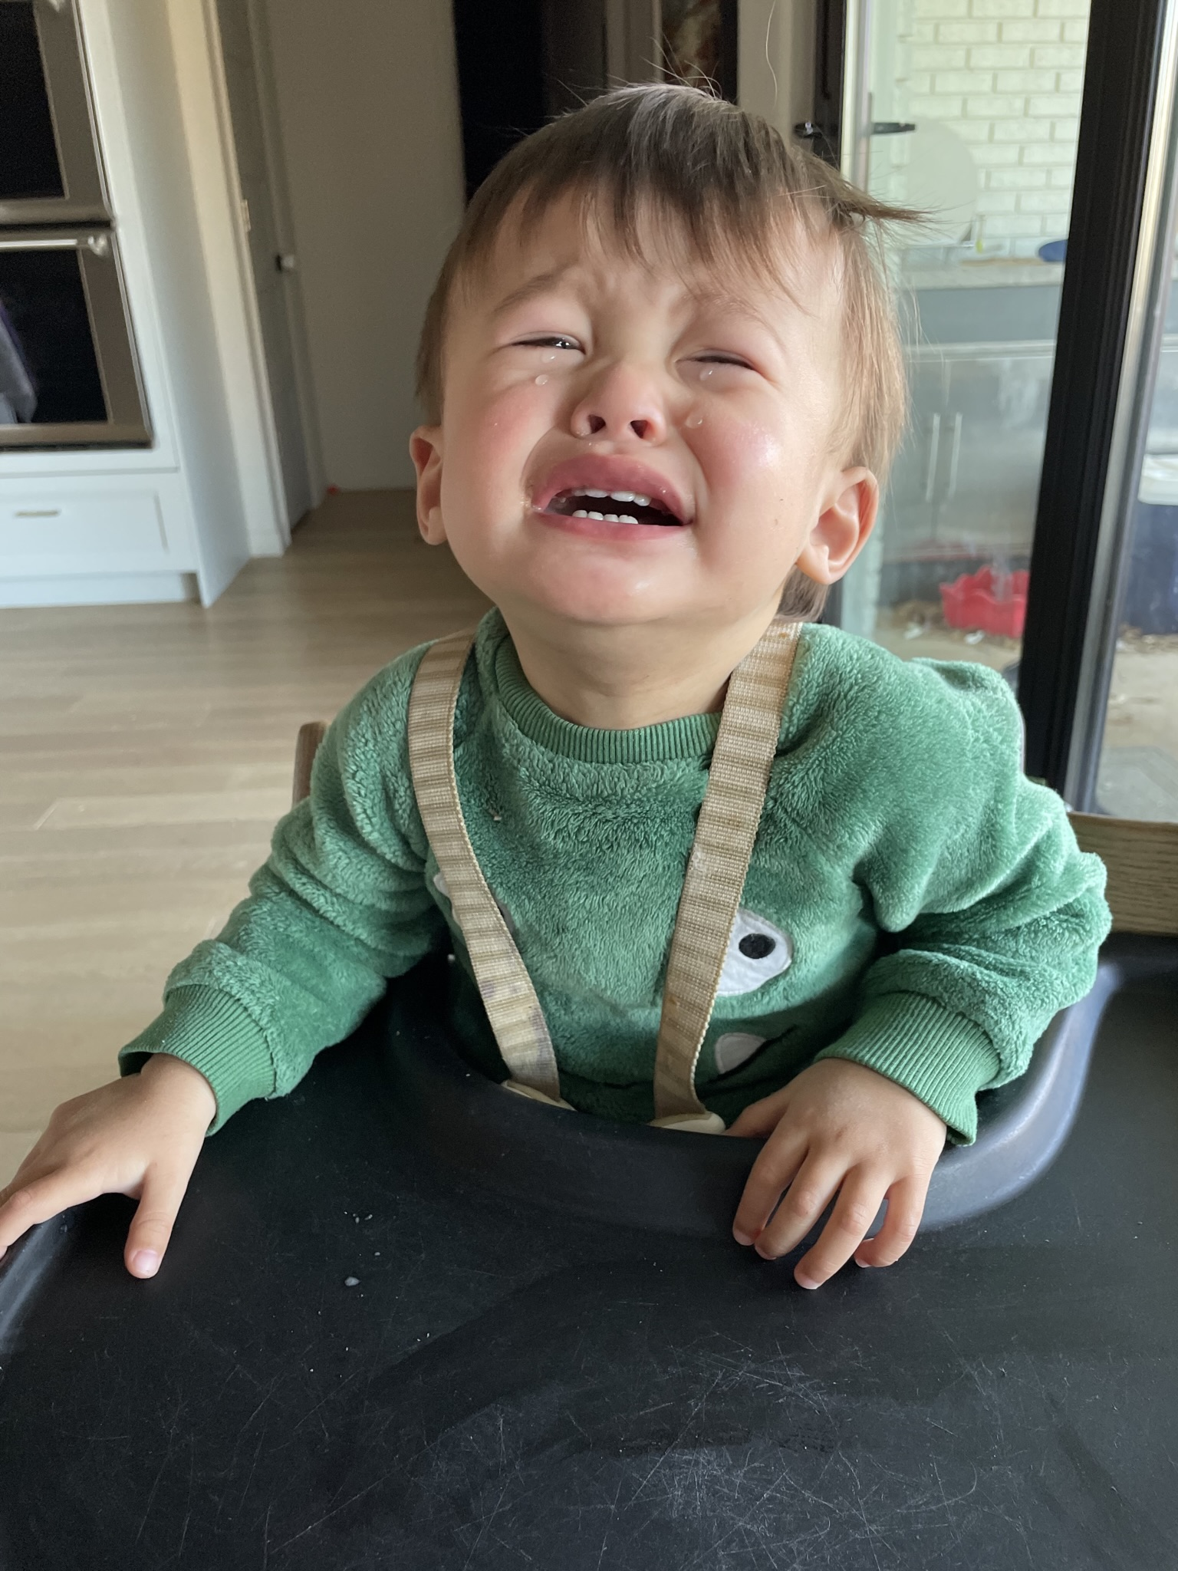
Time to measure
10 min * 225 measurements (6-11y) = 37.5 hrs
10 min * 323 measurements (ALL) = 53 hrs

Slide 11
Work completed

Slide 12
Summary of Work remaining
Screening incoming MRIs (David) → essentially caught up (5 left)
Finish visual estimations on hips with bad MRIs → 24 left
Measure remaining hips in HipVasc → ~ 323 measurements
Batches of 20 x 4 observers, could potentially be done with current backlog in 1 year if do one batch / quarter.
Continue to prioritize by sub-study needs
Future measurements → estimated 20-25 more MRI’s per year
Ongoing screening and measuring
Consider at some point switching completely to visual estimation?

Slide 13
Study: Safety and Usability of Perfusion MRI
Identify factors associated with poor quality MRI’s
Age
Demographics
Sedation or General Anesthesia
MRI scanner
Identify an age cut-off where general anesthesia sedation can be recommended.
Determine if any of the alternative sedation techniques are beneficial.
Confirm safety of perfusion MRI’s and report complication rates.

Slide 14
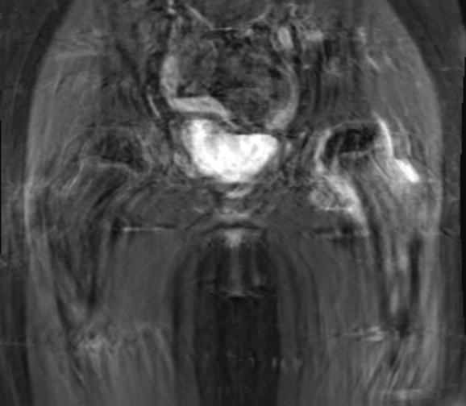
Can we get a good quality perfusion MRI?
Motion Artifact –motion during scan
Ghosting – motion between scans
Scans average about 45 minutes
Kids move during scans
Kids move in between scans
“Ghosting” seen on subtraction images

Slide 15
Methods
I revewied all ”poor quality” MRIs and determined if it was due to
Motion artifact during the scan
Motion artifact between scans
Technical errors (excluded)
David Zimmerhanzel reviewed every MRI and measured time stamps if available.
Total time of MRI
Time of critical sequences

Slide 16
pMRI Usability
493 MRIs total
25 excluded for technical reasons
468 MRIs screened
369 (79%) good
99 (21%) poor (motion)
Mean age 8.15y in both good and bad groups
General anesthesia mean age 7.6y
No anesthesia mean age 8.5y

Slide 17
Factors
Sedation
General anesthesia (86%) best results but not significant (p=0.11)
Light sedation (79%)
No sedation (78%)
Duration of scan
Poor quality was significantly longer (52.6m vs 43.8m, p=.002)
Magnet Strength
3T faster but not more successful (76% vs 81%, p=0.24)
Gender
Males had higher success rate (80% vs 73%) but not significant (p=0.1)

Slide 18
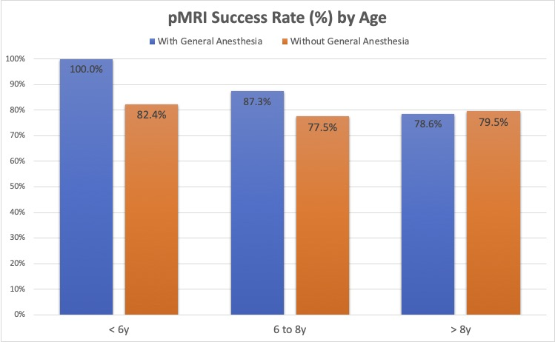
Age for sedation
No significant difference found in comparing age with type of sedation.
Trend towards more successful MRI’s with general anesthesia below 8.5y.

Slide 19
Good studies vs. Total # of studies
Slight upward trend for the high volume institutions, but not likely significant.
Plenty of low-number institutions that did great, and some that did badly.
Very scattered at the under 20 MRI mark

Slide 20
Perfusion MRI safety
493 perfusion MRIs obtained
3 complications (0.6%)
1 minor allergic reaction to contrast
2 nausea/vomiting
Verified with a poll of all IPSG centers
In case MRIs with complications were never submitted
29/45 have reported no complications

Slide 21
Conclusion
pMRI doesn’t seem to have a learning curve
pMRI had a low complication rate (0.6%), all minor
80% success rate in our cohort
Longer pMRIs had a significantly lower success rate
General anesthesia improved success rates below the age of 8.5y.

Slide 22
Thanks to Current Core Measuring Team
Scott Yang
Yasmine Hailer
Luiz de Angeli
David Chong

Slide 23
Motivation
Let me know if interested to measure.
Thanks to Candelaria Mercado for her continued support

Slide 24
Thank You!

