Slide 1
Enrollment, Data Completion & Retention
Wudbhav Sankar, MD – 15 minutes

Slide 2
Enrollment

Slide 3
Total Hips Enrolled by site, Jan 2024 (N=890)
Notes:
*Enrolled = Screening/Calculations form complete, Final approval granted, Cohort assigned
- Overall increase of 158 since last Annual Meeting

Slide 4
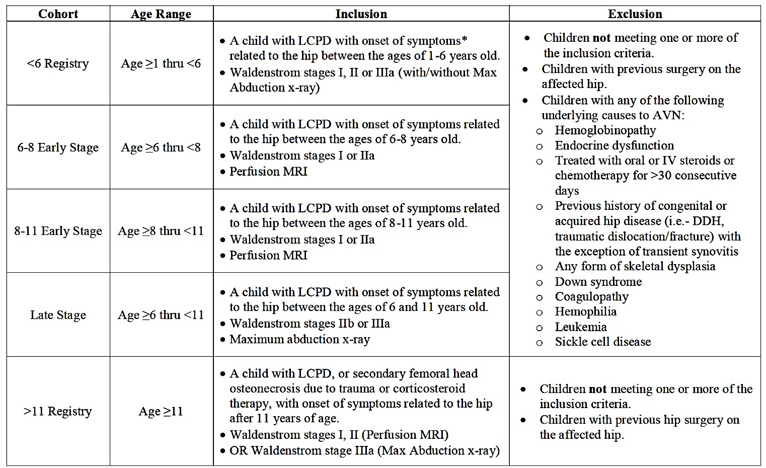
Prospectively Enrolling Studies

Slide 5
Enrollment Trajectory <6 Registry, Jan 2024

Slide 6
Enrollment Trajectory 6-8 Cohorts, Jan 2024

Slide 7
Enrollment Trajectory 8-11 Cohorts, Jan 2024

Slide 8
Enrollment Trajectory Late Stage Cohorts, Jan 2024

Slide 9
Enrollment Trajectory >11 Registry, Jan 2024
Notes:
- Updated enrollment criteria for this group (<2mm collapse requires MRI)

Slide 10
Enrollment Late stage

Slide 11
2 yr Retention

Slide 12
5 yr Retention

Slide 13
Site Retention data (2 year)

Slide 14
Site Retention data (5 year)

Slide 15
Retention Data for Key Studies
6-8 Early Stage Surgical
155 have passed 2-years since treatment baseline
141/155 (91%) have min 2 year data
121 have passed 5-years since treatment baseline
73/121 (60%) have 5 year visit data
6-8 Early Stage Non-Surgical
55 have passed 2-years since treatment baseline
40/55 (73%) have min 2 year data
32 have passed 5-years since treatment baseline
15/32 (47%) have 5 year visit data
Notes:
Based on entered data. Missing data counted as no FU. Partial data counted as full FU
Based on Total Enrollment report generated 1/25/2021, added clinical visit status at 2- and 5-year visit
Blank values are represented as “missed” visits (i.e. – not having visit data)

Slide 16
Retention Data for Key Studies
8-11 Early Stage 6-Weeks NWB
64 have passed 2-years since treatment baseline
48/61 (79%) have min 2 yr data
45 have passed 5-years since treatment baseline
29/45 (64%) have 5 year visit data
8-11 Early Stage 6-Months NWB
64 have passed 2-years since treatment baseline
54/64 (84%) have min 2 yr visit data
53 have passed 5-years since treatment baseline
26/53 (49%) have 5 year visit data
Notes:
Some of these are drilling patients, and were not assigned a weight-bearing cohort.

Slide 17
Power analysis vs. FU Data
Need 55-62 subjects in each group with 2 & 5 year FU
6-8 surgery: 141 (2 year); 73 (5 year)
6-8 non-surgical: 40 (2 year); 15 (5 year)
8-11 6 weeks NWB: 48 (2 year); 29 (5 year)
8-11 6 mos NWB: 54 (2 year); 26 (5 year)
Notes:
*Enrolled = Screening/Calculations form complete, Final approval granted, Cohort assigned
- Overall increase of XXX since last Annual Meeting

Slide 18
Retention, Retention, Retention
Really need to concentrate on retention
Much higher ROI than new enrollee
5 year email notifications go out
Each site needs to create their own workflow esp with gap in lead coordinator
Notes:
*Enrolled = Screening/Calculations form complete, Final approval granted, Cohort assigned
- Overall increase of XXX since last Annual Meeting

Slide 19
5-Year Visit Auto-Reminders

Slide 20
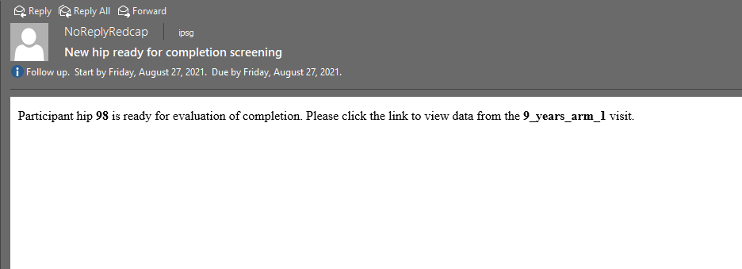
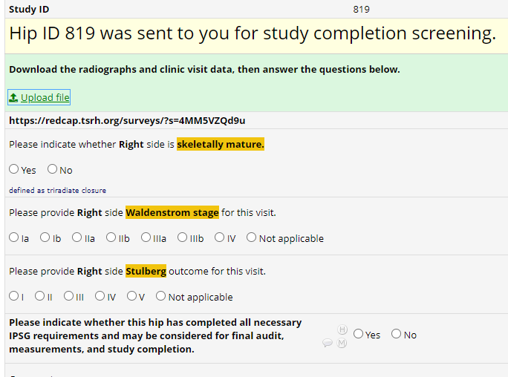

Slide 21
Data Completion Reports

Slide 22
ALL Sites DATA COMPLETION REPORT
Number of Hips Enrolled by Cohort
<6 Registry | 365
>11 Registry | 36
6-8 Early Stage, MRI | 43
6-8 Early Stage, Non-Surgical | 63
6-8 Early Stage, Surgical | 165
8-11 Early Stage, MRI | 25
8-11 Early Stage, Non-Surgical | 11
8-11 Early Stage, Surgical + 6 Months NWB | 65
8-11 Early Stage, Surgical + 6 Weeks NWB | 65
Late Stage | 52
Overall Site Enrollment | 890
Overall Data Completion Rate: 82%
Missing 2-year follow up: 126
Missing 5-year follow up: 199
*based on presence of AP radiograph
**based on AP & Frog Lateral radiograph
Open, Unresponded Data Queries: 430
January 2024

Slide 23
Data Completion Report Metrics
 | Last Cycle
 | Jan 2024 | Apr 2024
Overall Enrollment (Hips) | 890 | 978
Overall Data Completion Rate (%) | 82% | 82%
Unresponded Queries (#) | 430 | 433

Slide 24
Data Completion Rates –by site
DAG | Jan 2024 (%) | April 2024 (%)
ACHC | 100% | 99%
BCCH | 66% | 68%
BOCH | 91% | 92%
CCHM | 95% | 94%
CCMC | 25% | 25%
CCOM | 91% | 89%
CHAB | 100% | 100%
CHCO | 98% | 94%
CHHB | 60% | 60%
CHLA | 61% | 50%
CHOA | 99% | 98%
CHOP | 100% | 99%
CHUV | 96% | 84%
CNMC | 96% | 96%
DAG | Jan 2024 (%) | April 2024 (%)
DPHC | 84% | 87%
GCSH | 99% | 100%
HAMB | 45% | 58%
HUNJ | 97% | 97%
JHMD | 54% | 54%
KMCH | 62% | 63%
KPLA | 88% | 94%
LCCH | 57% | 55%
MFNY | 100% | 100%
NWCH | 98% | 96%
OAPH | 68% | 69%
OCRI | 67% | 66%
OHSU | 71% | 66%
OUHS | 33% | 33%
DAG | Jan 2024 (%) | April 2024 (%)
RCHC | 92% | 93%
SECH | 56% | 56%
SHNC | 63% | 63%
SJCH | 28% | 28%
SNCH | 56% | 56%
SPSM | 80% | 78%
TJPO | 34% | 21%
TSCH | 20% | 18%
TSRH | 81% | 82%
TXCH | 72% | 71%
UCSF | 85% | 82%
UUUS | 99% | 95%
WCHN | 64% | 62%

Slide 25
Thank You!

