Slide 1
Deformity Index update
Dr. Hitesh Shah

Slide 2
Deformity index
Interim radiological outcome for IPSG database.
Notes:
.

Slide 3
Eligible patients for DI
a. Unilaterally affected
b. At least 2-year follow up (with AP)
c. Key cohort requiring MRI
d. Early stage at time of enrollment
Exclude
Bilateral cases
Skeletal dysplasia
Opposite hip radiograph missing

Slide 4
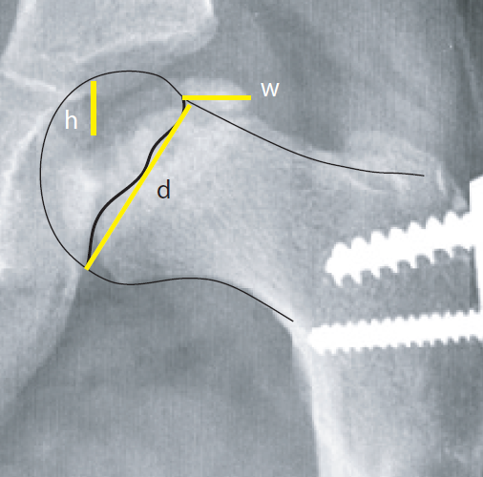
DI
Assign all x rays to TWO raters
Adobe illustrator software
w, h, and d in the data base for each measurer
Calculation of DI
ICC >0.80
Take the average of two raters.
Shah H, Singh KA, Swarup I, Morris W, Kim HKW, Joseph B. Does the Deformity Index Reliably Predict the Shape of the Femoral Head at Healing of Legg-Calvé-Perthes Disease? J Pediatr Orthop. 2022 Feb 1;42(2):e163-e167.

Slide 5
Summary of 2024
5 rounds of measurements
340 patients

Slide 6
Work to be done
Patients under 6 year- 120 patients have finished 2 year f/up
All IPSG data at 2 year follow-up
Notes:
Necessary to retain patient at 2 year and upload in database

Slide 7
Thanks to the team
Kumar Amerendra Singh
Ben Martin
Juan Carlos Abril
Candelaria Mercado
All are welcome

