Slide 1
Does the Deformity Index Reliably Predict the Shape of the
Femoral Head at Healing of Legg-Calvé-Perthes Disease?
Hitesh Shah, Kumar A Singh, Ishaan Swarup, William Morris,
Harry Kim, Benjamin Joseph, IPSG members

Slide 2
Introduction
The aim of treatment of Perthes disease is to preserve the spherical shape of the femoral head.
An important outcome measure of treatment should be an assessment of whether the femoral head is spherical when the disease heals.
Stulberg Classification
Deformity index (DI)
Sphericity deviation score (SDS)
No study compared predictive value of DI with SDS at healing
Categorical , larger sample size
Skeletal maturity

Slide 3
Issue with DI
Excellent ICC with original authors
Recently published study by Tis et al, showed poor ICC
Hence, the measurement technique was modified.

Slide 4
Aims of the study
To assess the reproducibility of a new method of measurement of DI.
To evaluate how accurately DI could predict the shape of the femoral head when the disease healed.

Slide 5
Material and methods
From prospectively collected database, 43 children with unilateral LCPD who had sequential radiographs were identified.
AP radiograph at 2 year
AP and frog lateral radiographs at healing
DI <0.3 -predictive of a spherical femoral head at healing
A healed femoral head with an SDS <10 was regarded as spherical.

Slide 6
Material and methods
Six raters, all of whom are practicing pediatric orthopaedic surgeons with an interest in LCPD, were given a standardized tutorial on the techniques of measurement of DI and SDS.

Slide 7
Material and methods
Soft ware : Adobe Illustrator & Digimizer
X-rays : AP images of the pelvis
Measurements to be made on AP x-ray

Slide 8
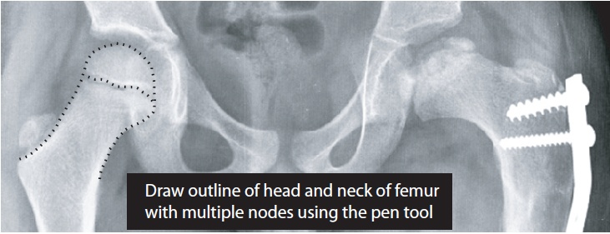
Step 1

Slide 9
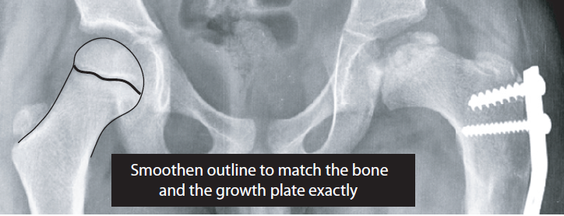
Step 2

Slide 10
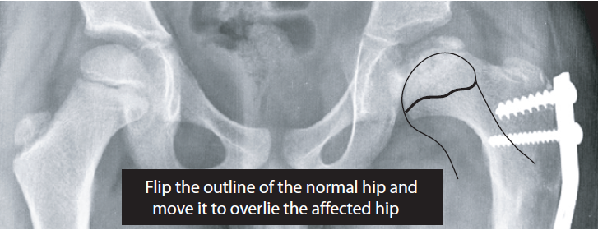
Step 3

Slide 11
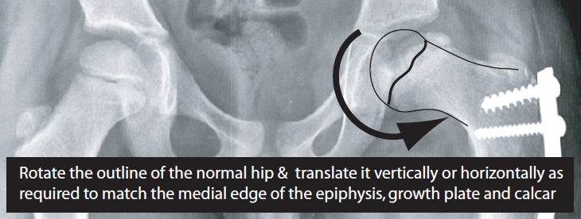
Step 4

Slide 12
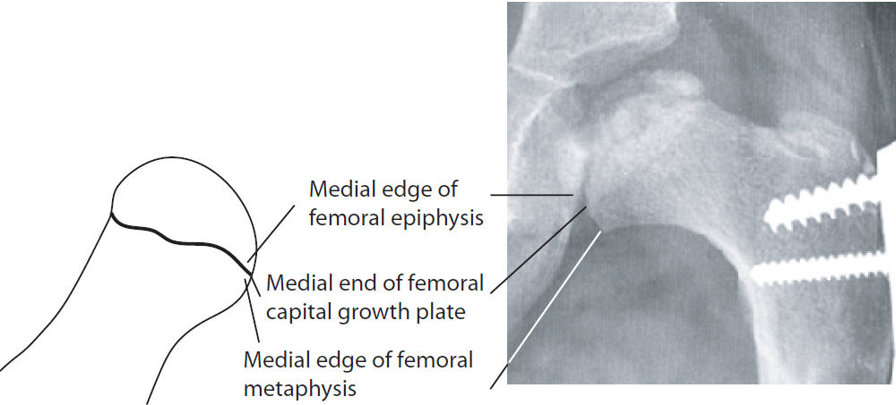
Landmarks to be identified
Outline of normal hip Perthes hip

Slide 13
Landmarks to be identified
Outline of normal hip Perthes hip

Slide 14
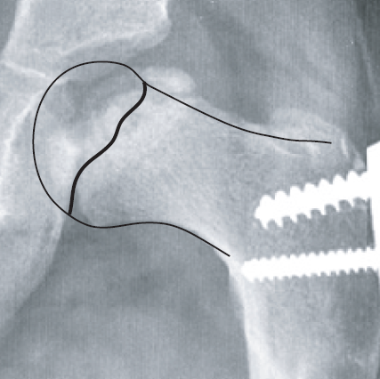
Try to match these three landmarks on the
flipped outline of the normal hip with the same
three landmarks on the underlying image of
the diseased hip as closely as possible

Slide 15
Then rotate the outline of the normal hip
to get the calcar to match as closely as possible

Slide 16
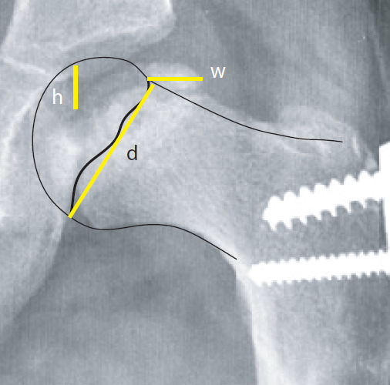
Lines to be drawn after matching
the images
Calculate the Deformity index
    h + w
    d

Slide 17
SDS

Slide 18
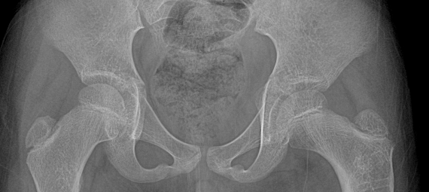
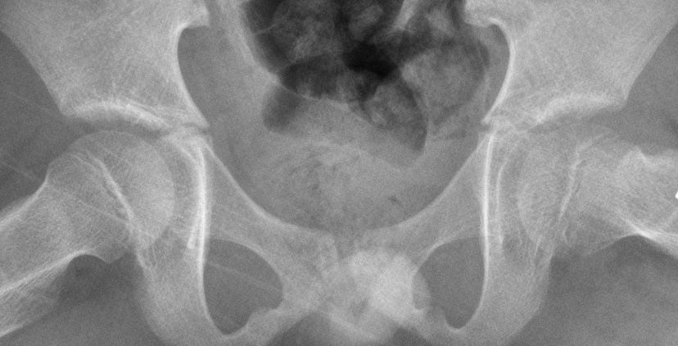
1
Once scaling has been done in this way it will account
for magnification differences of the AP and lateral views
1

Slide 19
Marking the reference points

Slide 20
Marking the reference points
Two reference points are marked at the medial and lateral margins of the growth plate

Slide 21
Marking the reference points
Two reference points are marked at the medial and lateral margins of the growth plate

Slide 22
Drawing the maximum inscribed circle

Slide 23
Drawing the maximum inscribed circle (mic)

Slide 24
Drawing the maximum inscribed circle (mic)
Draw a circle connecting the two dots

Slide 25
Drawing the maximum inscribed circle (mic)
Adjust the size of the circle:
  To touch as many points on the articular margin as possible...............

Slide 26
Drawing the maximum inscribed circle (mic)
Adjust the size of the circle:
  ................Without extending outside the head

Slide 27
Drawing the maximum inscribed circle (mic)
x
Too large a circle; does not touch
all possible points on the epiphysis

Slide 28
Drawing the maximum inscribed circle (mic)
x
The circle extends beyond the
margin of the epiphysis

Slide 29
Drawing the maximum inscribed circle (mic)

The circle touches all possible points on the epiphysis
without extending outside the margin of the epiphysis

Slide 30
Drawing the minimum circumscribed circle (mcc)

Slide 31
Drawing the minimum circumscribed circle (mcc)

Slide 32
Drawing the minimum circumscribed circle (mcc)
Draw a larger concentric circle that just touches the articular margin without extending into the head

Slide 33
Drawing the minimum circumscribed circle (mcc)
x
The circle is too large; it does not
touch the surface of the epiphysis

Slide 34
Drawing the minimum circumscribed circle (mcc)
x
The circle is too small; it extends
into the the epiphysis

Slide 35
Drawing the minimum circumscribed circle (mcc)

The circle touches the surface of the epiphysis
but does not extend into the epiphysis

Slide 36
Draw the radii of the mic and mcc on the AP view
Draw the mic and mcc on the lateral view
Measure their radii

Slide 37
SDS

Slide 38
Quantitative measure of sphericity
Three measures of deviation from sphericity are computed:
  Roundness error in the AP view
  Roundness error in the Lateral view
  Degree of ellipsoid deformation

Slide 39
Roundness error is the difference in the radii of the MCC and MIC.

Slide 40
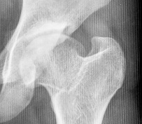
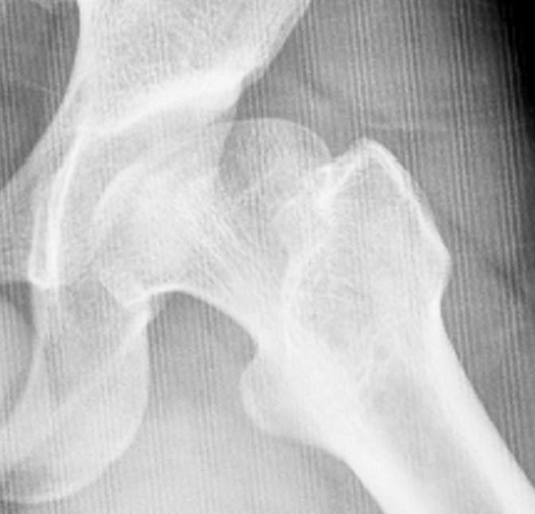
Ellipsoid deformation is the difference in the radii of the femoral head in the AP and lateral views.

Slide 41
The
Roundness Error in AP view
Roundness Error in Lat view
Ellipsoid deformation
were added to obtain the
Sphericity Deviation Score

Slide 42
The calculations will be done automatically once the values of the radii of the MIC and MCC in the AP and lateral x-rays have been entered on the programmed Excel sheet

Slide 43


Slide 44
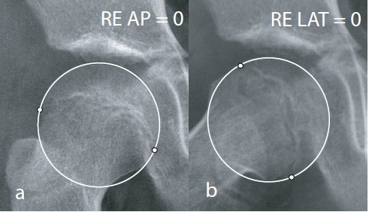
Roundness error AP = 0
Roundness error Lat = 0
Ellipsoid deformation = 0
Sphericity Deviation Score 0

Slide 45
Roundness error AP = 0
Roundness error Lat = 0
Ellipsoid deformation = 0
Sphericity Deviation Score 0
Stulberg Class at skeletal maturity : Class I

Slide 46
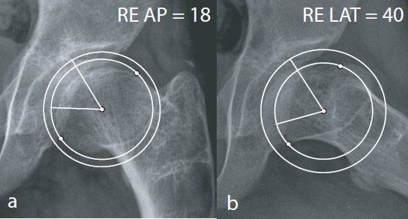
Roundness error AP = 18
Roundness error Lat = 40
Ellipsoid deformation = 10
Sphericity Deviation Score 68

Slide 47
Roundness error AP = 18
Roundness error Lat = 40
Ellipsoid deformation = 10
Sphericity Deviation Score 68
Stulberg Class at skeletal maturity : Class IV

Slide 48
Material and methods
All 6 authors measured DI and SDS on radiographs of 20 patients twice with an interval of 2 weeks between measurements.
The intraobserver and interobserver reliability of measurement was assessed.
After establishing that reproducibility was good, measurements were made on the remaining radiographs and further analysis done.

Slide 49
Material and methods
One investigator (B.J.), who was blinded to the SDS values of the hips, classified the shape of every femoral head at healing into 1 of 2 groups, spherical and aspherical, based on subjective visual assessment of the AP and lateral views.
The SDS values of the 43 hips at healing were compared with the corresponding DI values and with the subjective classification of the shape of the femoral head.

Slide 50
Statistical methods
The intraclass correlation coefficient was computed to assess reproducibility of measurements.
The Pearson correlation coefficient was calculated to test the association between DI and SDS.
The positive and negative predictive values of DI <0.3 to predict the shape of the femoral head at healing were calculated.

Slide 51
Results
 | DI | SDS
Intra-observer reproducibility | 0.69-0.76 | 0.83-0.98
Inter-observer reproducibility | 0.75 | 0.81

Slide 52
Results
The mean duration of disease was 3.97 ± 0.96 years
The age at healing of the disease was 11.44 ± 1.51 years.
26/43 hips-spherical at healing
20 hips -<10 SDS at healing (19 spherical by visual)
8 hips-SDS- 10-12 (6 spherical by visual)

Slide 53
Results
32 hips had DI values <0.3 at 2 years implying that these hips would be spherical at healing.
In reality, however, only 17 of these 32 hips had spherical femoral heads with SDS values <10.
Three hips with SDS values <10 had DI values > 0.3.
Positive correlation-0.43 (p < 0.01)
Positive predictive value 53%
Negative predictive value 73%

Slide 54
Discussion

Slide 55
Reproducibility of Measurement of SDS and DI
We believe that the difficulty in accurately superimposing the bony landmarks of the diseased and normal hips is responsible for varied inter-rater reliability.
Notes:
The reproducibility of measurement of SDS was excellent, reaffirming previous reports. In the present study, 4 of the 6 investigators were measuring SDS for the first time. The reproducibility of measurement of DI by the modified method described in this study was good despite the method being used for the first time by all 6 investigators. We believe that attention to details of matching the bony landmarks emphasized in the tutorials

Slide 56
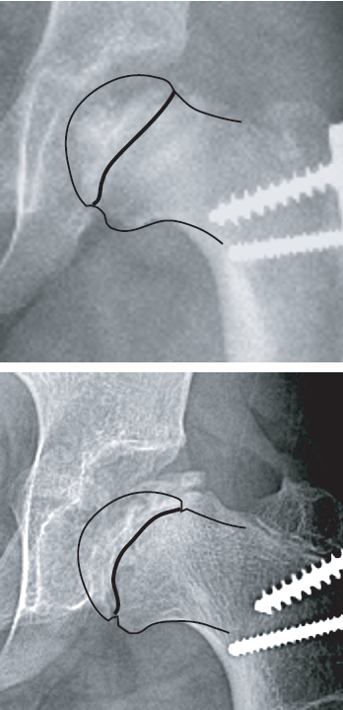
PARTIAL MATCHING OF CALCAR
In these two examples the following
reference points are well matched:
Medial corner of femoral epiphysis
Medial end of capital growth plate
Medial femoral metaphyseal beak

Slide 57
PARTIAL MATCHING OF CALCAR
However, only the proximal half of the calcar of the diseased hip matches the normal calcar. This is because the children have undergone varus derotation osteotomies and the orientation of the proximal femur has been altered.

Slide 58
PARTIAL MATCHING OF CALCAR
Note in the lower image that the outline of the normal hip had to be rotated quite a lot in order to get the reference points to match the operated hip

Slide 59
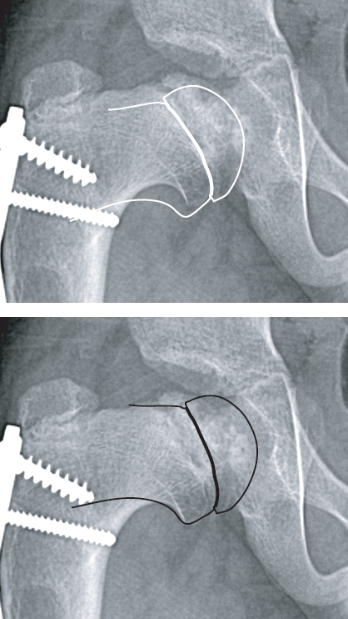
PARTIAL MATCHING OF CALCAR
In the top figure the following
reference points are well matched:
Medial corner of femoral epiphysis
Medial end of capital growth plate
Medial femoral metaphyseal beak
However, the calcar does not match

Slide 60
PARTIAL MATCHING OF CALCAR
In the bottom figure the following
reference points are well matched:
Medial corner of femoral epiphysis
Medial end of capital growth plate
Medial femoral metaphyseal beak
The calcar is partially matched.
It will not be possible to match the entire calcar because of altered alignment of the proximal femur

Slide 61
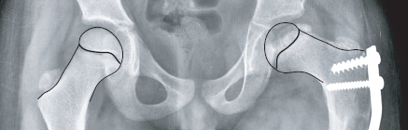
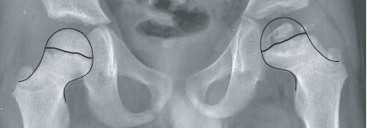
Examples of outline of the normal hip (R) and the flipped image of the normal hip superimposed on the Perthes hip (L) after matching the reference points

Slide 62
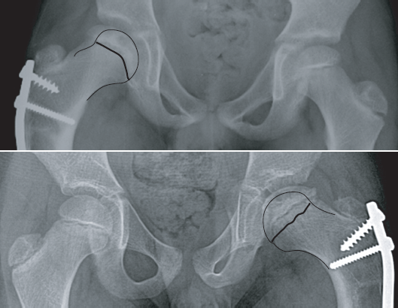

Slide 63
Defining the Criteria of a Spherical Femoral
Head
Notes:
A perfectly spherical femoral head should have an SDS value of 0. In reality, however, the normal femoral head is often not perfectly spherical. The SDS value of normal hips is frequently in the order of 4 or 5, but is invariably below 10. On the basis of this observation it was suggested that a femoral head in healed LCPD may be regarded as “spherical” if the SDS value is <10. This appears to be an acceptable criterion as in the present study 19 of 20 hips with SDS values <10 were classified as spherical on visual assessment.
In this study, a subset of 8 femoral heads had SDS values between 10 and 12 and 6 of them appeared spherical on visual assessment. This raises the question whether
femoral heads with SDS values under 12 should also be regarded as “spherical” as it may fall within the limits of measurement error. However, for the time being, we
suggest retaining the original threshold for sphericity at SDS 10 and regard femoral heads with SDS 10 to 12 as “nearly spherical” until data from further studies are
available. Ideally, long-term follow-up of patients into adulthood are needed to determine the comparative frequencies of degenerative arthritis among patients with spherical and nearly spherical femoral heads before increasing the threshold value for sphericity to 12.

Slide 64
DI—Accuracy and Predictive Value
Notes:
The predictive value of DI < 0.3 to identify spherical hips at healing with SDS <10 was only 53%. However, if the nearly spherical hips with SDS 10 to 12 are also included, the predictive value improves to 78%. Investigators who plan to use DI as an outcome measure to evaluate treatment of LCPD should be aware of these limits of its predictive value. We believe that it would be more appropriate to wait for 2 years more and measure the final shape of the healed femoral head with a more reproducible continuous measure like the SDS.

Slide 65
Conclusion
DI can be measured with an acceptable degree of reproducibility with the modified method.
However, the predictive value of DI <0.3 to accurately predict hips that are likely to heal with spherical femoral heads is not high enough to recommend its use as an outcome measure of treatment of LCPD.

Slide 66

Thank You!

