Slide 1
IPSG Research Proposals & Data Extraction
Susan A. Novotny, PhD and Molly McGuire, MPH, CCRP

Slide 2
Review of IPSG Sub-Study Approval Workflow
Sub-Study Proposal Form
Submitted by study team
Scientific Review
IPSG Executive Committee &
Scientific Review Panel
Clarification Requested
Study Team
Crosswalk Generated
Inclusion/Exclusion Criteria
Outcome Variables Identified
Clarification Requested
Study Team
Data Pull
IPSG Coordinator
***Molly will be placing the sub-study proposal form and codebook in the chat

Slide 3
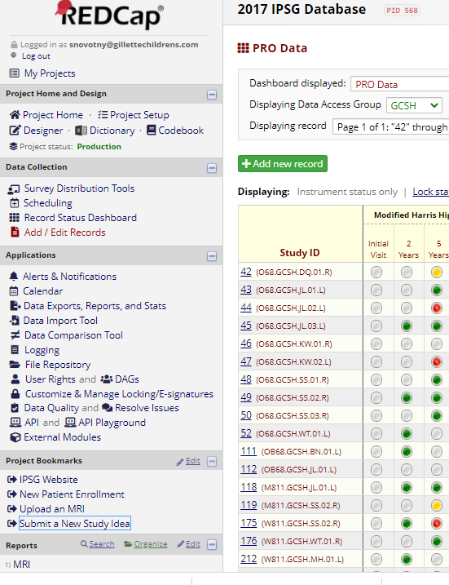
Three Ways to Submit a New Study Proposal
IPSG Website: Member Log In
REDCap Proposal submission page: https://redcap.tsrh.org/surveys/?s=JLDFA8WWYM
Bookmark housed within IPSG Database

Slide 4
3 Tips and Tricks
Proposing Sub-Studies

Slide 5
Tip #1: TWO Crosswalks will be generated
Sub-Study Proposal Form
Submitted by study team
Mind the Gap:
Draft your proposal with the two crosswalks in mind
Scientific Review
IPSG Executive Committee &
Scientific Review Panel
Clarification Requested
Study Team
Crosswalk Generated
Inclusion/Exclusion Criteria
Outcome Variables Identified
Clarification Requested
Study Team
Data Pull
IPSG Coordinator

Slide 6
What we mean by two crosswalks…….
IPSG Database
Crosswalk Generated
Inclusion/Exclusion Criteria
Outcome Variables Identified
WHO is the Study Population
Detailed set of Inclusion
and Exclusion Criteria
What data do you want
and from when
Detailed explanation of what data you want, and from what time points.

Slide 7
Example From Sankar’s 2020 Proposal
Hypothesis: Decreased perfusion correlates with increased duration of Waldenstrom Stage II and worse lateral pillar class, as has been shown previously in single center study.
Inclusion criteria applied in REDCap:
Diagnosis of LCPD
Age between 6-11 at disease onset
Waldenstrom stage IIa or less at time of surgical treatment
Intended surgical intervention (varus osteotomy)
Preoperative perfusion MRI
2+ years of follow up
Exclusion criteria applied by Sub-Study Team:
1) less than 2 years of follow up
2) incomplete radiographic data where the patient is missing 1 or more follow up radiographs.

Slide 8
Terminology Timeout: CODEBOOK
Codebook: NOUN
a list of symbols or other expressions arranged as a key for encoding and decoding secret messages.
a list of variables contained within the IPSG database, that allow surgeons to decode their study design into a precise language the geeks pulling your data understand.

Slide 9
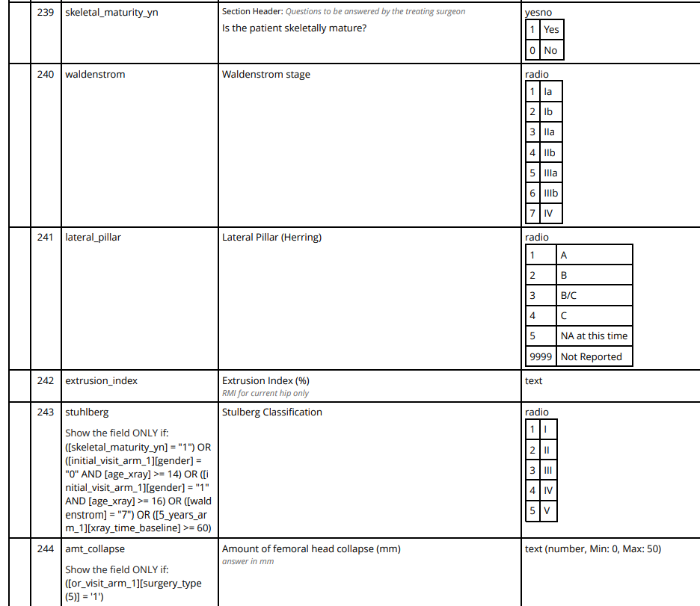
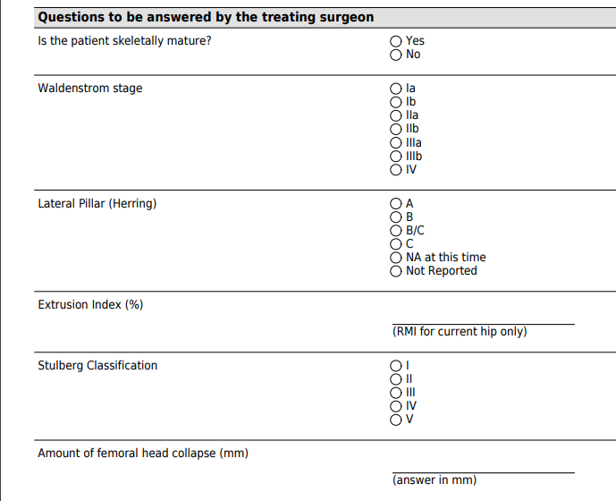
Data Collection Tool
Corresponding Data in the Codebook

Slide 10
Inclusion Criteria Crosswalk From Sankar’s Proposal
# | Variable Name | Field Label | Answer Choices and Format of Returned Data | Source | Notes | Why this variable was pulled
29 | age_at_diagnosis | Patient's age at diagnosis | Returns patient age in years at time of diagnosis (not onset) | Screening Form, Initial Screening Event | Filter include if between 6.000 and 11.999. | Study team requested the variable in the commonly selected inclusion/exclusion document.
32 | waldenstrom_investigator | What is this patient's Waldenstrom stage at presentation to an IPSG member or their group? | 1 Ia 2 Ib 3 IIa 4 IIb 5 IIIa 6 IIIb 7 IV | Screening Form, Initial Screening Event | Filter include if ([waldenstrom_investigator]=1OR 2) OR ([waldenstrom_ipsg]=1 OR 2) | Waldenstrom stage I at time of initial visit OR pre-op visit
50 | waldenstrom_ipsg | What is the IPSG leadership's measure of this patient's waldenstrom stage? | 1 Ia 2 Ib 3 IIa 4 IIb 5 IIIa 6 IIIb 7 IV | Screening Form, Initial Screening Event
118 | surgery_type | What procedures were performed on this date of service? | 7 surgery_type___7 Femoral varus osteotomy | OR Form | Filter contains 7 for instance in which [surgery_date] if the surgery date is equal to [baseline_date_tsrh]. Need to check on secondary procedures. | Study team wants only patients who had osteotomies.

Slide 11
In Summary
Inclusion Criteria From Investigator: “Waldenstrom 2A”
(([initial_screening_arm_1][waldenstrom_investigator] = "1" OR [initial_screening_arm_1][waldenstrom_investigator] = "2") OR ([initial_screening_arm_1][waldenstrom_ipsg] = "1" OR [initial_screening_arm_1][waldenstrom_ipsg] = "2"))
Study team manually exclude hips for progression to 2a or 2b by time of initial visit [waldenstrom]
Note: 17 hips met this exclusion criterion
Variable Name | Field Label | Answer Choices and Format of Returned Data | Source | Notes | Why this variable was pulled
waldenstrom_investigator | What is this patient's Waldenstrom stage at presentation to an IPSG member or their group? | 1 Ia 2 Ib 3 IIa 4 IIb 5 IIIa 6 IIIb 7 IV | Screening Form, Initial Screening Event | Filter include if ([waldenstrom_investigator]=1OR 2) OR ([waldenstrom_ipsg]=1 OR 2) | Waldenstrom stage I at time of initial visit OR pre-op visit
waldenstrom_ipsg | What is the IPSG leadership's measure of this patient's waldenstrom stage? | 1 Ia 2 Ib 3 IIa 4 IIb 5 IIIa 6 IIIb 7 IV | Screening Form, Initial Screening Event
Inclusion
Variable Name | Field Label | Answer Choices and Format of Returned Data | Source | Notes | Why this variable was pulled
waldenstrom | Waldenstrom stage | 1 Ia 2 Ib 3 IIa 4 IIb 5 IIIa 6 IIIb 7 IV | Radiographic Data Form, Initial Visit and all Pre-Op Visits | Filter exclude if [waldenstrom][initial_visit]=3, 4, 5, 6, or 7 OR if [waldenstrom][pre-opvisit]=3,4,5,6 or 7 | Study team wants to exclude those cases who have progressed to Waldenstrom stage IIa by time of MRI and surgical treatment. This is the closest we could get. NOTES: Four hips had advanced to IIA or IIB by the initial or pre-op visits (39, 549, 45, and 238)
Exclusion

Slide 12
Tip #1: Understand that TWO Crosswalks are required
IPSG Database
Crosswalk Generated
Inclusion/Exclusion Criteria
Outcome Variables Identified
WHO
(Study population)
Extremely Detailed set of Inclusion and Exclusion Critera
What and When
(data you want from the population)
Detailed explanation of what data you want, and from what time points.

Slide 13
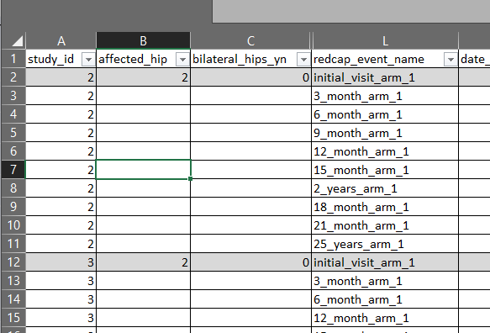
Exemplar Codebook for the Data Pull
Variable Number | Variable Name | Field Label | Answer Choices and Format of Returned Data | Source
1 | study_id | Study ID | number | Screening Form, Screening Visit
22 | affected_hip | Current affected hip for study enrollment | 1 Right, 2 Left | Screening Form, Screening Visit
23 | bilateral_hips_yn | Does this patient have bilateral Perthes? | 1, Yes 0, No | Screening Form, Screening Visit
29 | age_at_diagnosis | Patient's age at diagnosis | Returns patient age in years | Screening Form, Screening Visit
 | age_at_mri | Calculated age at time of pre-op MRI | Returns patient age in years | New variable
50 | waldenstrom_ipsg | What is the IPSG leadership's measure of this patient'sWaldenstrom stage? | 1 Ia 2 Ib 3 IIa 4 IIb 5 IIIa 6 IIIb 7 IV | Screening Form, Screening Visit
58 | gender | Gender | 0 Female 1 Male | Demographics Form, Initial Visit
 | Timepoint |  |  | Radiographic Form, All Timepoints through 2 years

Slide 14
Its worth the time to be comprehensive up front!
Sub-Study Proposal Form
Submitted by study team
Scientific Review
IPSG Executive Committee &
Scientific Review Panel
Clarification Requested
Study Team
Crosswalk Generated
Inclusion/Exclusion Criteria
Outcome Variables Identified
Clarification Requested
Study Team
Data Pull
IPSG Coordinator

Slide 15
Tip #2: Extraction of actual Radiographs or MRI data takes TIME
Radiographs stored in REDCap
they are getting hard to export
700 subjects * AP and Frog (2) * 20 visits each = 28,000 x-ray uploads
subject list must be established first
additional contracts may be required
often require manual quality checks by sub-study team
MRIs are housed separately
data measurements are entered in on rolling basis
several options for investigators
measurement in HIPVASC is slow

Slide 16
Tip #3: Data Auditing and Cleaning processes are constantly in progress, but will never be complete
Instrument | Notes on the instrument
Initial Screening | Easy to pull and Data are clean
Initial Visit | Easy to pull and Data are clean
OR Visit
Clinic visits (3 month – 10+ years) | 2-year timepoint – focus of auditing efforts 2.5+ year time points – have not been audited and may contain missing data elements
[san] molly what do we want to say here: You may propose using data from clinic visits that have not been audited, but realize data cleaning may be required and that missing data may result.
I don’t know - - we don’t have the manpower to stop everything and audit some of our patients for a sub-study

Slide 17
To keep in mind…
Data are in different stages of cleanliness
Incomplete, unaudited, pending queries, missing data, biological implausibilities
Data are in different stages of being entered
Up to four years delayed entry, partially entered
Data are in different timeline stages of study progression
Completed study, hips recently enrolled, missed 2-year but have 3.5-year data, have 5-year visit but not yet 10 years old
We may not know what actually happened (OR procedures, bracing)

Slide 18
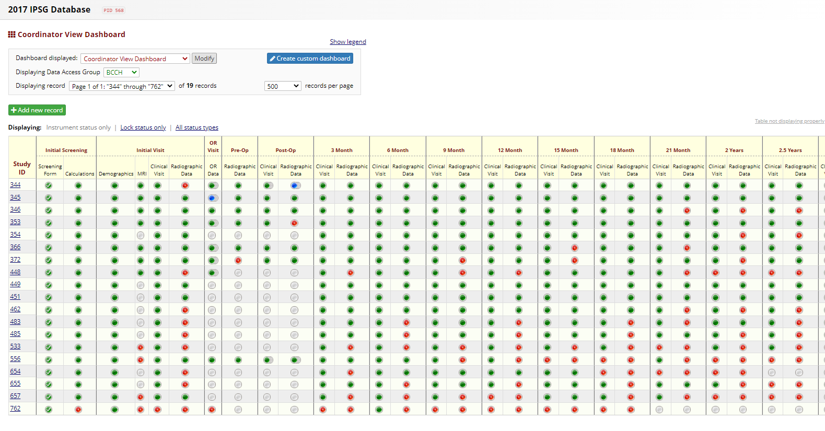
REDCap Data
Notes:
Instrument Notes:
Screening Form – Easy to pull, clean, some missing from early subjects, most reliable
Initial Visit – Easy to pull, clean, some missing, not all data is required
OR Data – Easy to pull, each patient has different number of procedures, may not match planned enrollment cohort, baseline date determined by date of primary surgery which is ascertained rather than discrete, cannot stand alone but is merged with demographic or screening form data outside of redcap.
Follow Up Data – always due for something, may be entered into “Extra clinic visit”, difficult to combine data and to ascertain values for single patient over time

Slide 19
Progress on Substudies

Slide 20
IPSG Publications in the last year
Reliability and Validity of Assessment of LCPD Hypoperfusion with Perfusion MRI | PI is Schrader. Data sent to Dr. Jo 4/24/2020. David Chong drafted manuscript and accepted to JPO 7/23/2021 | JPO
Evolution of LCPD during Fragmentation Stages of Disease | KMCH patients only. Harry, Ben, and Alex will move forward with this separately. This will not be an IPSG project, per JL 1/20/2020
Anatomy-based Containment Surgery: Reviewing Hip Baseline Morphology | Dr. Sankar

Slide 21
Sub-study Progress – SAN I a not sure how much we want to get into this list.
Study Title | Notes
Transphyseal Neck Head Tunneling and Drilling | A sub-study of IPSG focusing on all patients diagnosed with LCPD and treated with drilling. | Currently on pause until we collect enough cases.
BMI and weight gain for children with LCPD enrolled in multicenter IPSG study | Dr. Schrader | Manuscript in final approval stages
2-Year Outcomes of Patients Ages 6-8 at Onset for IPSG: Correlation of Deformity Index and HIPVASC data | Grant Aim 3. Completing new modified DI measurements for all cases, and sending HIPVASC measurements to team. Ongoing for 2+years. Plan to submit abstract to POSNA October 2022.
Late Stage Study | Dr. Martin is PI. Planned original IPSG study. Recently expanded to include patients c/o max abduction imaging. Otherwise not enough patients enrolled to complete study at this point, and currently inactive but enrolling.
<6 Registry Study Demographics | Dr. Goldstein | Data Analysis
>11 Registry study | Planned original IPSG study. Not enough patients yet. No on has claimed responsibility for this cohort. Enrolling, but inactive.
Assessing Recurring Trochanteric Overgrowth in Perthes Disease | Dr. Laine | Requires 2 year follow-up. On hold until sample size increases
Monitoring the psychological and emotional impact of activity restriction during the course of LCPD using PROMIS data | Dr. Fornari/Martin is PI. Submitted to IPSG committee 4/16/2020. Study plan will be converted into 2 yr outcomes abstract for POSNA 2022 (not enough data/cases for 2021 submission)
2-Year Outcomes of Patients Ages 8-11 at Onset for IPSG | Grant Aim 4. Molly generating weight-bearing duration variable and confirming with sites. Aim for oct 2022 submission to POSNA.
Compensatory remodeling of the hemipelvis early in the course of unilateral LCPD | Dr. Sankar | Data analysis
What is the adult experience of perthes disease? An international Web-based survey |  | Under Review at BJO
The Adult Perthes Survey - Functional Outcomes | Dr. Kim's | EPOS podium 11/30/2021 and POSNA podium 12/5/2021
Total Hip Outcomes in the Adult Perthes Survey Cohort | Dr. Millis | Data analysis
Perfusion MRI utility survey | Dr. Laine | Under development
Does the amount and pattern of perfusion on initial MRI correlate with the duration of fragmentation after femoral osteotomy for Perthes Disease? | Dr. Sankar | Awaiting legal approval on radiographs

