Slide 1
IPSG Strategic Plan 2:
Increase community support, outreach, funding
Jennifer Laine, MD
January 29, 2022

Slide 2
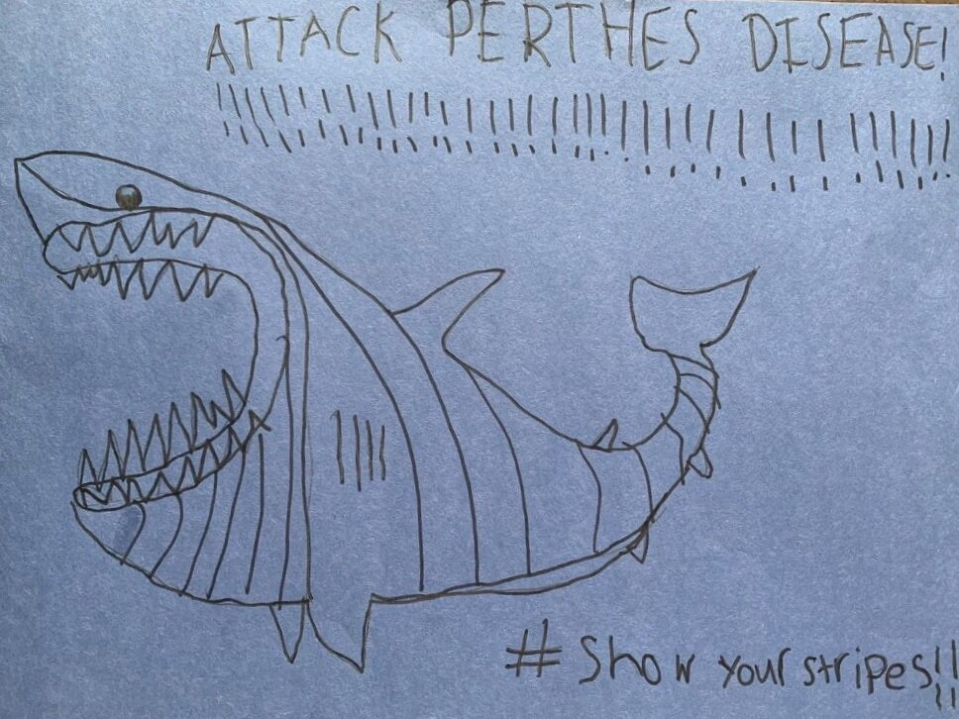
Outline
Why?
Annual Goals
Opportunities and Threats
5- Year Goals
IPSG Community Fundraising History
Fundraising Language
Return to Goals - discussion
Image: pertheskids.org

Slide 3
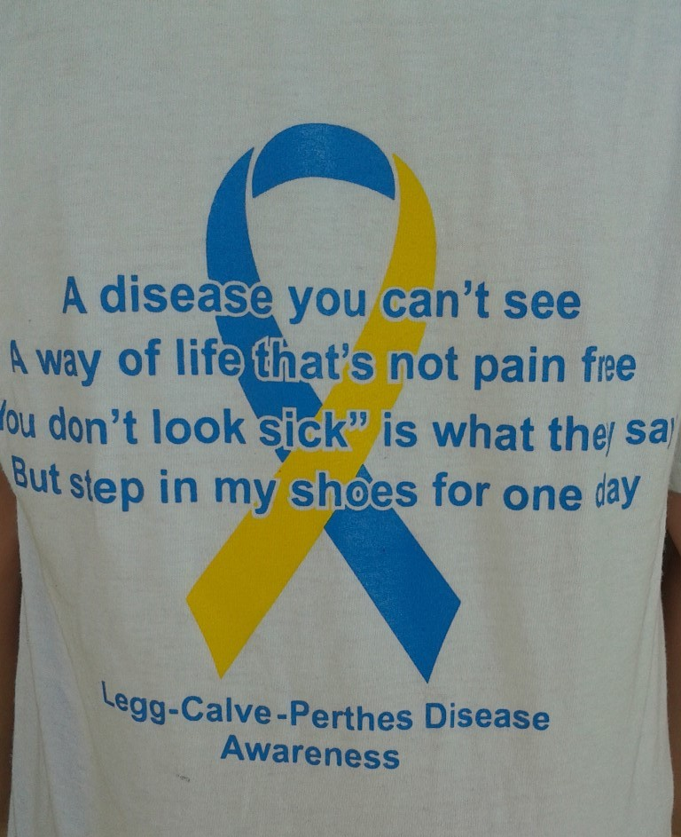
Increase community support, outreach, funding -- WHY?
Challenging to gain community awareness:
  Rare disease
  Pediatric
  Not life-threatening
  Not externally visible
Patients and families feel isolated
Conflicting Answers for patients/families
Difficult to research. Need more funding!

Slide 4

Goal: Encourage Education & Engagement
At least two Facebook live or Webinar events per year
At least 5 members participate in annual parent conference
At least 1 publication per year for physicians and/or public
At least 1 case discussion among members per year
At least 3 conference presentations per year
Notes:
Discussion of our strategic plan last summer – we have concrete, achievable goals set out within this arena
Some have been delayed for pandemic reasons

Slide 5

Threats
Opportunities
Perthes support group
IPSG ambassadors
Restart parent conference
Increased financial needs:
  Expanded research effort
  Increased FTE needs
  (Molly’s 1.0FTE = 6.0)
  Possible loss of TSRH support

Slide 6
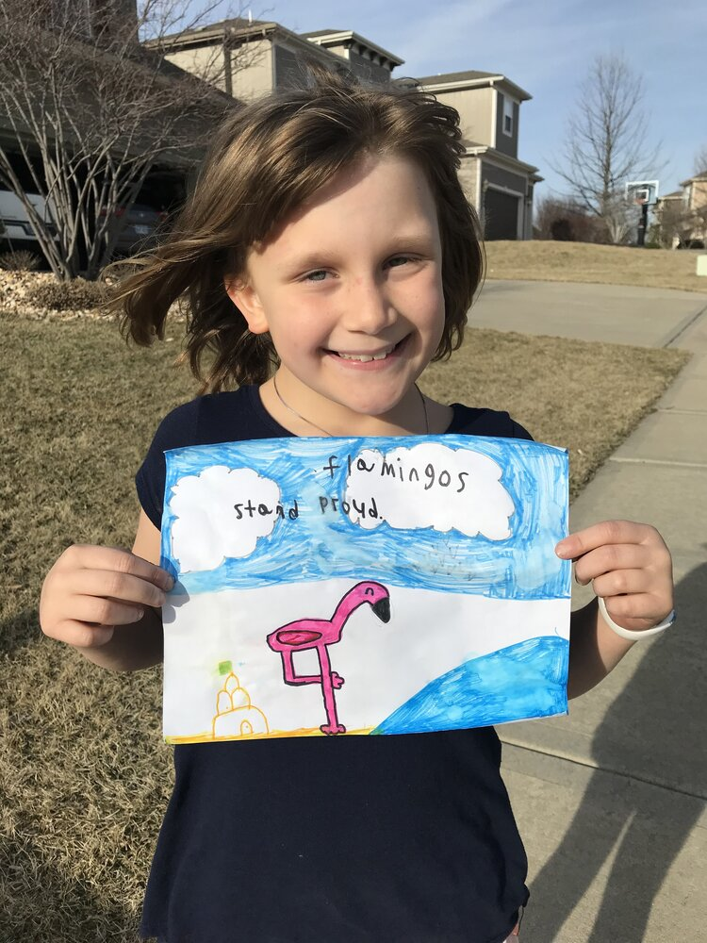
What are our primary goals for the next 5 years?
Finish primary studies by 2026?
Promote increased lay role?
Strategic growth in membership, projects, recruitment etc.?
Engagement of international and young members?
In person vs. virtual meetings
Image: pertheskids.org

Slide 7
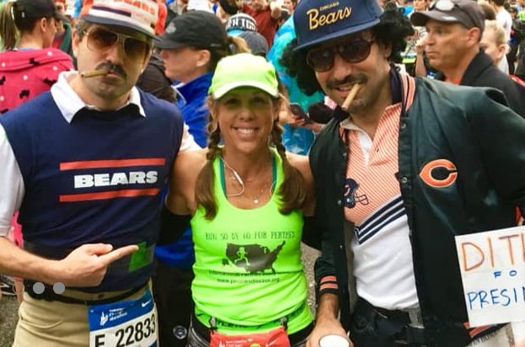
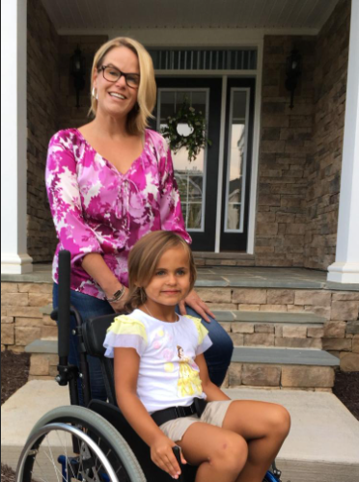

Ambassador/Champion -
Potential roles
Help with fundraising efforts
Social Media
Gain awareness
Help engage families
Inform research efforts
Community newsletter to keep families and potential donors engaged
Image: perthesdisease.org
Image: princewilliamtimes.com

Slide 8
Ambassador/Champion -
Potential roles
Maybe this should be at team?
Could promote through website (PKF?)
Roles and responsibilities
Application process, 2(?) year term
Image: perthesdisease.org
Image: princewilliamtimes.com

Slide 9

How do we raise funds to support growth and additional projects in the next 5 years?
Increased membership
Writing scientific grants
Raising foundational and philanthropic support
Image: perthes.org February 2019 Newsletter
Notes:
Cameron Mathison

Slide 10


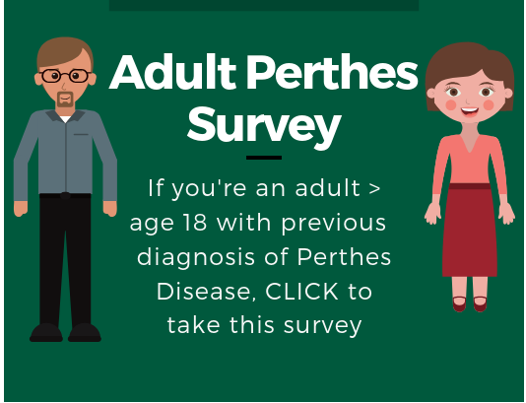
Perthes Foundations
Formed relationships with Perthes Foundations
Collaborative projects
Enhanced engagement and potential for outreach/education for public
Potential for additional qualitative research through Adult Perthes Survey framework?

Slide 11
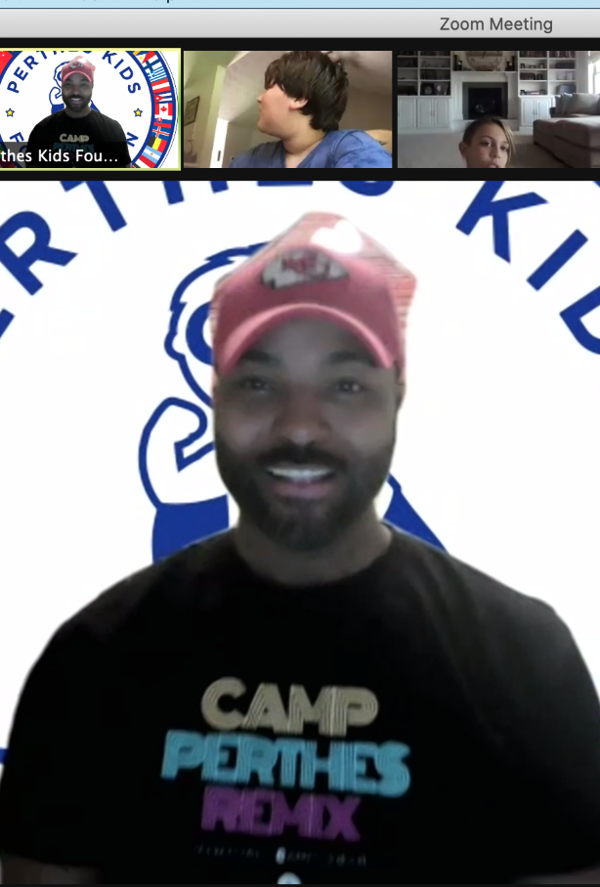
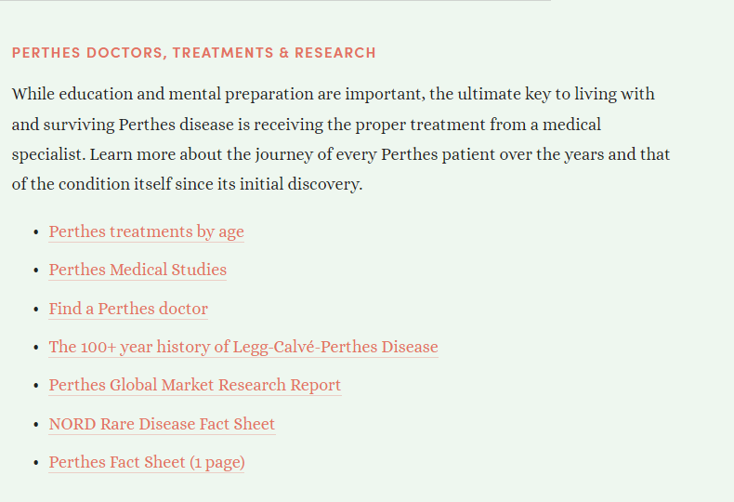
Outreach Efforts tied to Foundations
Perthes Camp
FB live events
Parent Conferences
Website presence

Slide 12
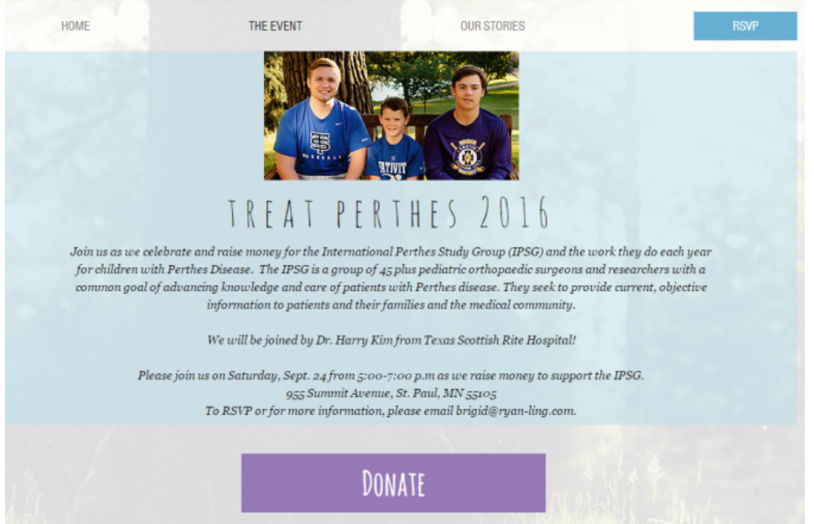
Community Fundraising To-Date
50 by 60 marathons by Michelle Rector
Fundraiser in Willsey Family home in St. Paul
T-shirt sales at Basketball fundraiser
Donations through website (recent donation!)
Possible new fundraiser in MN by family

Slide 13

Fundraising Language
JoLanne Hanson, Development Officer at Gillette Children’s Foundation
Framework/Language for fundraising discussions with patients/families donors
Four Step Approach

Slide 14
When a family asks if/how they can help…
Thank them for their interest
  Can emphasize importance of condition
  Importance of raising awareness

Slide 15
When a family asks if/how they can help…
Not everyone is ready to donate right away…
2) Give them options
  Engage on how they would like to help
  Examples of options would be:
    Donation
    Opportunities to learn more
    Opportunities to get more involved
    Join email list for future events
    Sign up for a newsletter to stay engaged
Notes:
Not everyone is ready to donate right away

Slide 16
When a family asks if/how they can help…
3) Encourage/Support any level of giving
  “every dollar makes a difference”
  “ with an entire community working on this together, we can do a lot of good”
  We take donations because ___% of our research is covered by donations from community, people like yourself
  Tell them where the funds would go (e.g. ongoing research) and how it would help

Slide 17
When a family asks if/how they can help…
4) Thank them for their interest again
  “please invite your family and friends on this journey” – to help raise awareness, recognition of Perthes

Slide 18
Goal: Encourage Education & Engagement
At least two Facebook live or Webinar events per year
At least 5 members participate in annual parent conference
At least 1 publication per year for physicians and/or public
At least 1 case discussion among members per year
At least 3 conference presentations per year
Notes:
Going back to our specific goals, if time, I though we could discuss some of these more specifically

Slide 19
At least two Facebook live or Webinar events per year
Webinar topics?
Opportunities for FB live events?

Slide 20
At least 5 members participate in annual parent conference
Do we restart this conference?

Slide 21
At least 1 publication per year for physicians and/or public
<6 article for AAP
Translating scientific articles for website

Slide 22
Promote increased Perthes champion role?

Slide 23

Thank You!

