Slide 1
Patient-reported outcomes of over 900 adults who had childhood Legg-Calve-Perthes disease (LCPD)
Harry Kim, Molly McGuire, Roi Almakias, Michael B. Millis, Bella Vakulenko-Lagun
Study from the International Perthes Study Group.

Slide 2
Background
LCPD is one of the most common childhood hip disorders that can affect the quality of life in adulthood due to development of femoral head deformity and osteoarthritis.
Very little data on how LCPD patients are functioning as adults.
Of the studies that are available, most are retrospective with <60 patients.
Furthermore, there is no comparison of outcome to age and gender matched normative data.

Slide 3
PURPOSE
Collect a large patient reported outcome (PRO) data from adults who had childhood LCPD using a web-based survey method and to compare their results to normative data.

Slide 4
METHODS
IRB approval
English REDCap-based web survey was built and advertised among Perthes support groups and IPSG Facebook.
The survey link was available on the IPSG website from May 2019 to August 2020.
Childhood and adult Perthes history (age at onset, treatments)
UCLA activity level
SF-36: validated general health measure
Hip disability and Osteoarthritis Outcome Score (HOOS): validated hip disability measure

Slide 5
Patient-Related Outcome Measures
HOOS (5)
Symptoms
Pain
Function in daily living
Function in sports and recreation
Hip-related quality of life
Overall
SF-36 (8)
Physical function
Bodily pain
Role physical
General health
Vitality
Social function
Role emotional
Mental health
Statistical analysis: t-test and linear and proportional odds regressions.

Slide 6
Participants
Total number of adults (>18) who attempted to participate N=1,505
Duplicate records identified by email address and background characteristics N=89
excluded
Of 1505 participants who attempted to take the survey, 1182 completed the patient reported surveys
Of 1182 respondents, 921 did not have a THR and are the focus of this study.
Median time-to-completion of survey: 11 minutes.
Participants who completed demographics & LCPD history N=1,416
Dropped out in one of UCLA, SF-36 or HOOS health surveys N=234
excluded
Participants who completed all the sections except for the body pain diagram N=1,182
excluded
Those who had THR N=234
Non-THR participants N=921

Slide 7
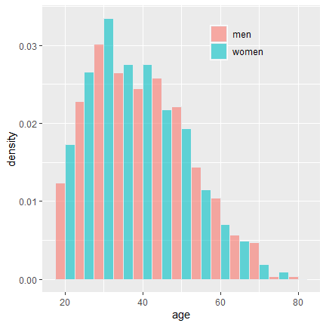
RESULTS
408 males/ 513 females (55.7%)
Mean age at survey: 37.8 ± 12.3 years
Median 36
Range 18-75
14.3% bilateral disease

Slide 8
RESULTS
Most respondents were from 4 English speaking countries with USA being the most common.
Countries | Percent
USA | 47.0%
UK | 26.6%
Australia | 10.1%
Canada | 3.8%
Other | 12.5%

Slide 9
RESULTS
Age at the onset of symptoms; similar to known distribution of Perthes
Age at onset of symptoms | Male (N=408) | Female (N=513)
Age < 6 | 38.7% 50.1%
Age 6-7 | 29.4% 26.5%
Age 8-11 | 23.8% 15.0%
Age >11 | 7.1% 7.0%
Unsure about age | 1.0% 1.4%

Slide 10
RESULTS
860 of 921 respondents received some form of treatment as a child.
Treatments Received during Childhood | Male (N=408) | Female (N=513)
Surgery | 37.2% 38.8%
Bracing | 32.8% 30.6%
Casting | 32.8% 25.1%
Weight bearing restrictions | 47.8% 43.9%
Activity restrictions | 61.3% 63.0%
Physiotherapy | 40.7% 42.7%
Walking aid and/or wheelchair | 55.1% 52.8%
Traction | 4.9% 5.5%
Other (non-surgical) treatment | 3.2% 5.1%
I was not treated for Perthes | 6.1% 7.0%
Do not remember | 1.2% 1.0%

Slide 11
RESULTS
About 60% did not have surgery as a child.
Number of surgeries before age 18 | Male (N=408) | Female (N=513)
0 | 61.3% | 60.6%
1 | 13.0% | 11.3%
2 | 14.5% | 13.8%
3+ | 11.3% | 14.2%

Slide 12
RESULTS
Co-morbidities | Number (%)
 | Male (N=408) | Female (N=513)
Hypertension | 10.8% 10.1%
Diabetes | 3.9% 2.7%
Obesity (self-reported) | 11.5% 19.1%
Bleeding or clotting disorder | 1.2% 3.1%
Genetic disorders of bone or connective tissue | 2.9% 4.3%
Hip dysplasia | 7.1% 11.9%
Asthma | 0.5% 1.2%
Athritis/Fibromiaglia | 0.5% 3.3%
Spine Condition | 0.2% 1.9%
Other (e.g., cancer, IBS, anxiety) | 6.9% 10.3%
None of the above | 66.9% 51.5%

Slide 13
RESULTS
Surgeries and treatments after age 18 | Male (N=408) | Female (N=513)
Hip surgery (do not know what it was called) | 2.4% 6.4%
Hip arthroscopy/scope | 2.7% 6.4%
Periacetabular osteotomy | 1.7% 2.3%
Surgical hip dislocation | 0.5% 1.8%
Resurfacing | 1.2% 2.5%
Any surgery | 6.4% 12.3%
Physical therapy | 6.9% 16.0%
Steroid injection | 2.0% 6.2%
Other (acupuncture, chiropractors, and medication) | 1.2% 2.3%

Slide 14
RESULTS
Activity Level | Male (N=408) | Female (N=513)
10. I regularly participate in impact activities such as jogging, tennis, skiing, acrobatics, ballet, heavy labor, or backpacking. | 0.5% 0.0%
9. I sometimes participate in impact activities such as jogging, tennis, skiing, acrobatics, ballet, heavy labor, or backpacking. | 5.9% 7.0%
8. I regularly participate in active activities such as fast walking, golf or bowling. | 6.1% 7.2%
7. I sometimes participate in active activities such as fast walking, golf, or bowling. | 6.4% 17.3%
6. I regularly participate in moderate activities such as moderate walking or heavy housework. | 4.4% 8.2%
5. I sometimes participate in moderate activities such as moderate walking or heavy housework. | 18.9% 29.0%
4. I regularly participate in mild activities such as slow walking, limited housework, or limited shopping. | 3.9% 3.5%
3. I sometimes participate in mild activities such as slow walking, limited housework or limited shopping. | 13.5% 10.7%
2. I am mostly inactive: restricted to minimal activities of daily living. | 11.0% 4.9%
1. I am wholly inactive: dependent on others; cannot leave residence. | 29.4% 12.1%

Slide 15
UCLA Score
1 = I am wholly inactive: dependent on others; cannot leave residence.
6 = I regularly participate in moderate activities such as moderate walking or heavy housework.
10 = I regularly participate in impact activities such as jogging, tennis, skiing, acrobatics, ballet, heavy labor, or backpacking.

Slide 16
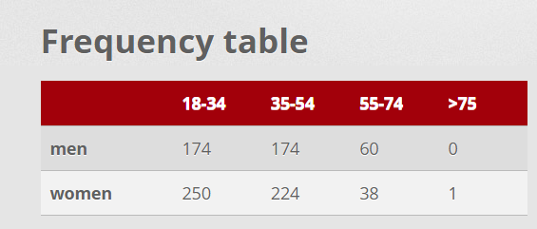
RESULTS
In comparison to the normative data, the LCPD respondents had significantly lower HOOS scores in all 5 scales (p<0.0001) for all age groups (18-34, 35-54, 55-74).
However, the sample size was small in the >55 groups

Slide 19
RESULTS
SF-36 scores of the respondents were significantly lower (p<0.0001) for all scales except for 55+ age group.
However, the sample size was small for the >55 groups

Slide 20
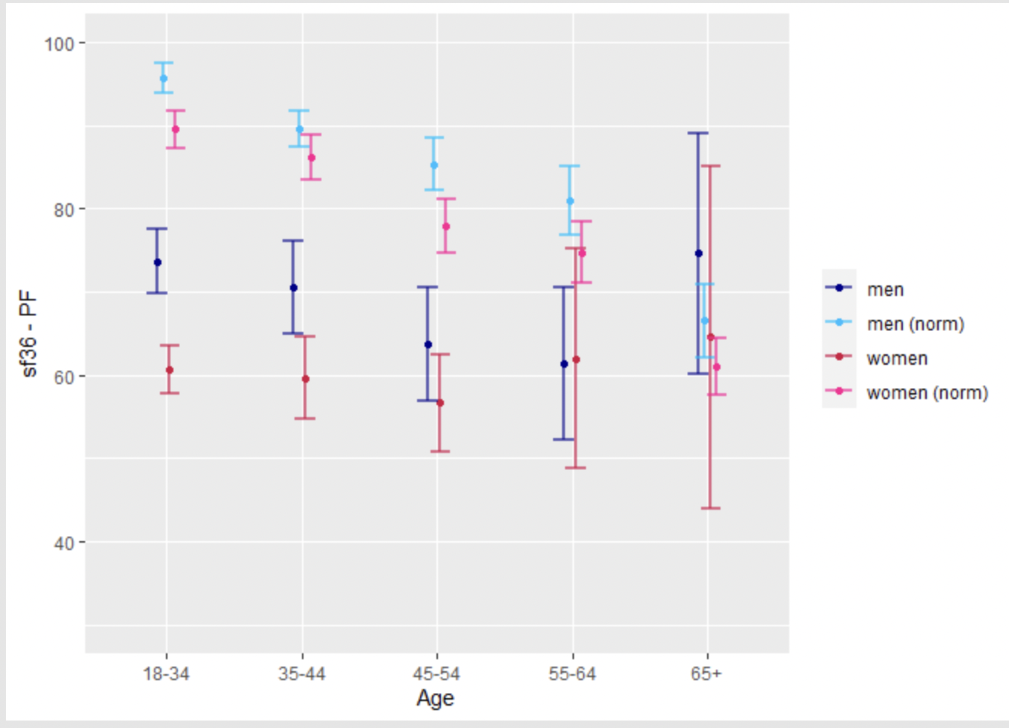
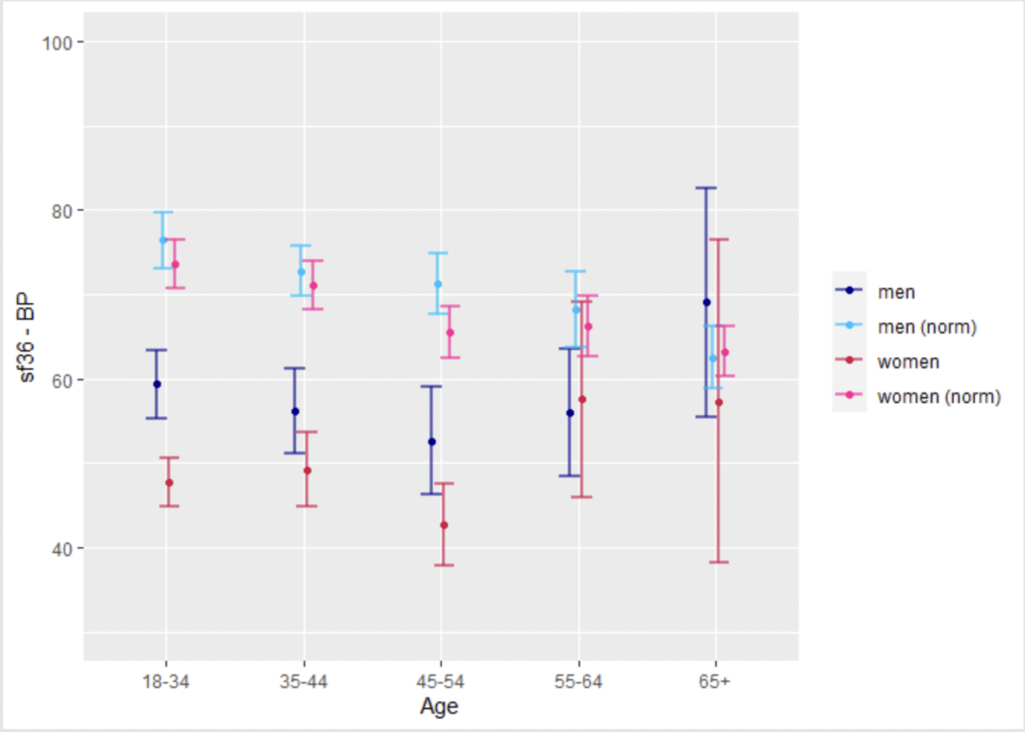
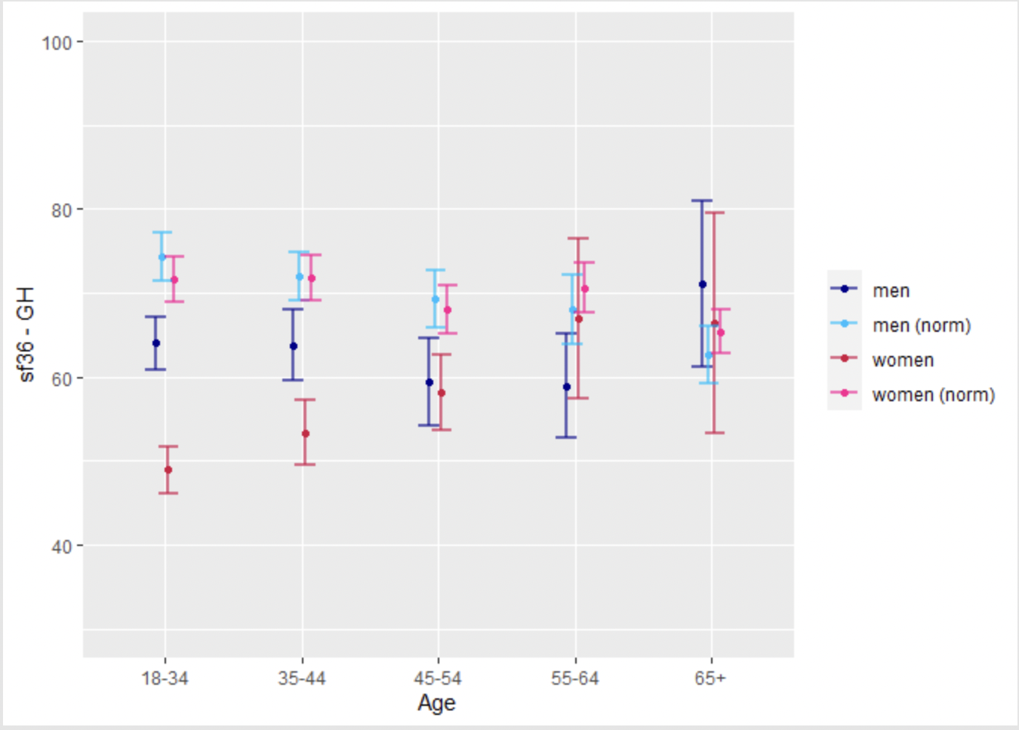
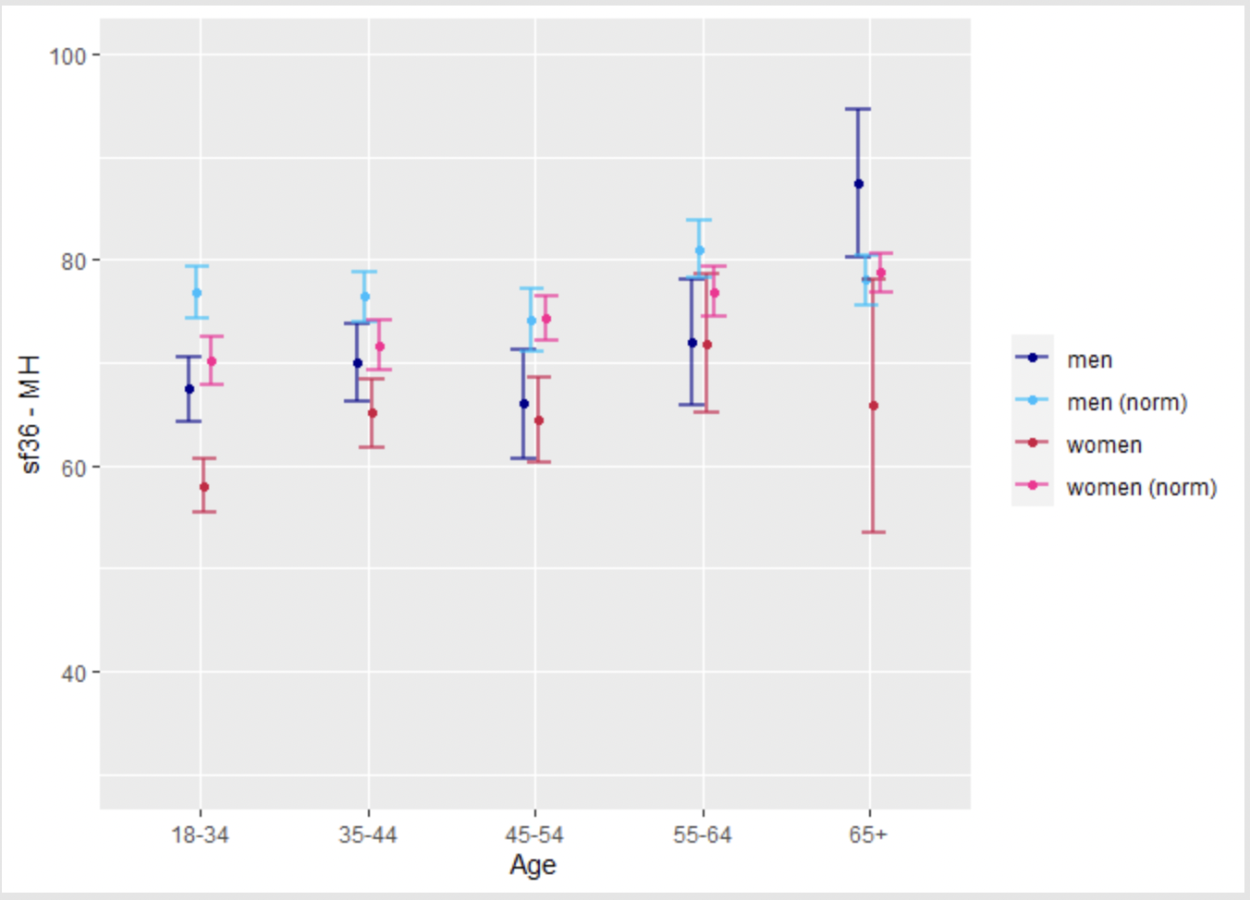
Physical Function
Bodily Pain
General Health
Mental Health

Slide 21
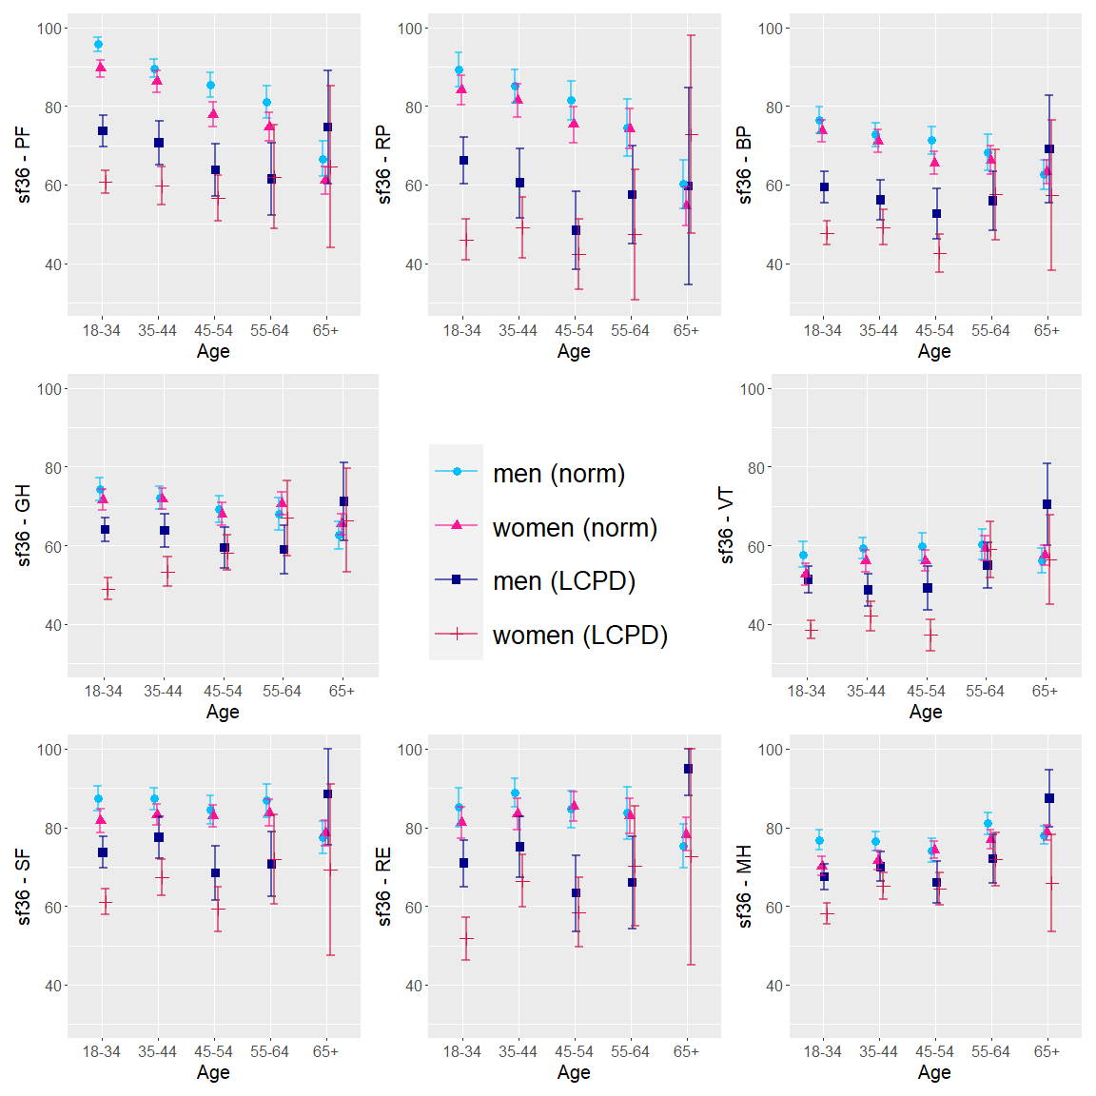

Slide 22
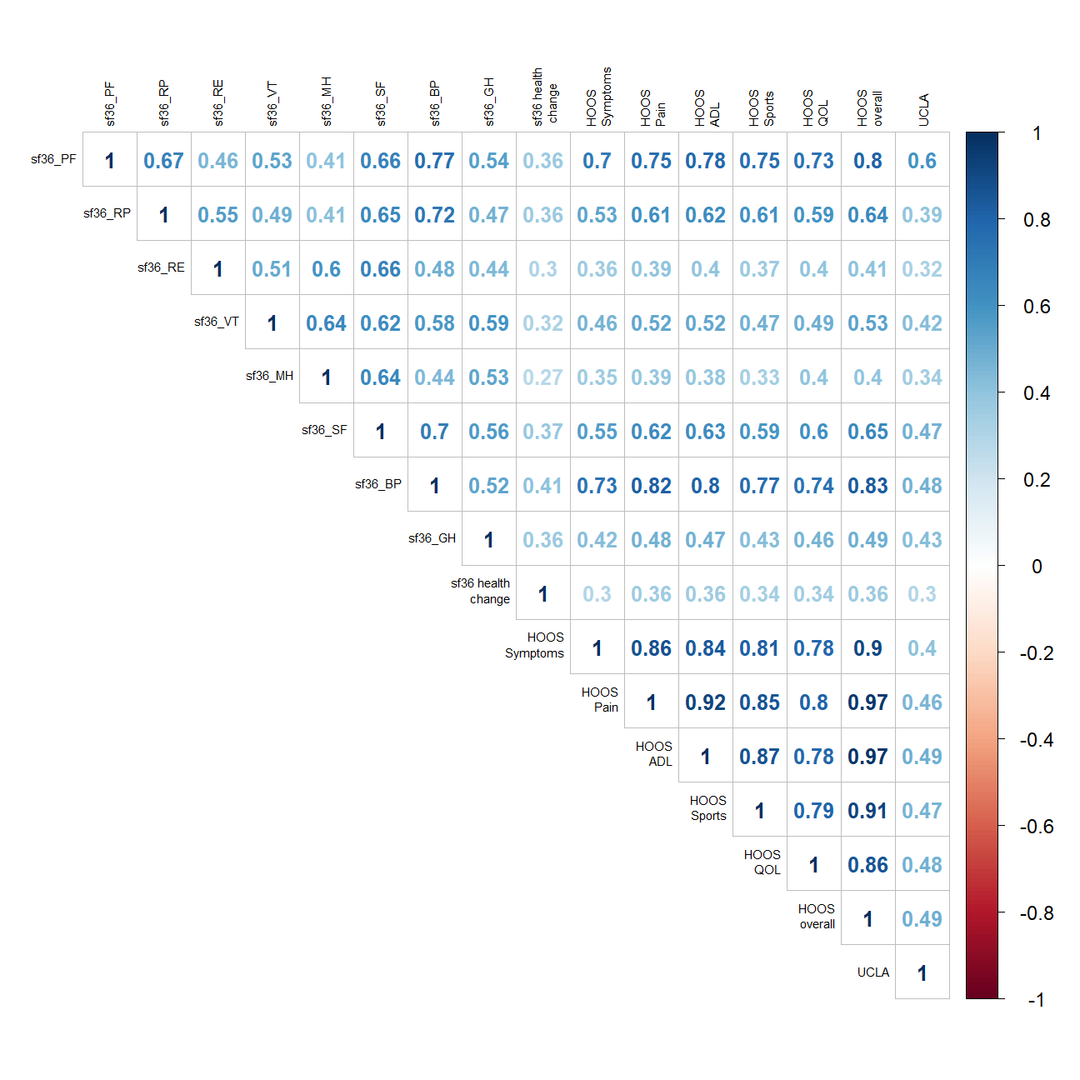
RESULTS
Pairwise correlations showed a strong positive correlation within HOOS scales (0.78-0.92) and with SF-36 Bodily Pain (0.73-0.83) and Physical Function (0.70-0.80), indicating construct validity.

Slide 23
RESULTS
Females, higher BMI, and age >11 at onset had significantly worse SF-36 and HOOS scores with female sex being the most consistent and strong negative factor associated with a decrease in HOOS and SF-36 scores.
Age >11 at onset compared to <6 at onset was the strongest negative factor associated with a decrease in HOOS symptoms, quality of life, and overall scores.
Example of HOOS-Quality-of-Life linear regression
Non-significant factors were current age, unilateral/bilateral Perthes, bracing and casting in childhood.
Variable | Regression coefficient | p-value | Interpretation
BMI | -1 | <0.001 | 1 unit increase in BMI decreases QOL by 1
Female sex | -11 | <0.001 | For females, QOL is 11 units less (worse)
Number of surgeries under age 18 | -2 | 0.001 | Every additional surgery decreased QOL by 2 units
Age at diagnosis: >11y | -16 | <0.001 | Age >11 at diagnosis had 16 units less (worse) QOL score compared to age <6 at diagnosis

Slide 24
DISCUSSION
This web-based survey provides a large dataset which confirms the burden of LCPD in adults, especially females, who had childhood LCPD.
Strength- provides respondents’ perspective, however, at one point of time
Limitations
Possible selection bias
Study focused on those without THR at the time of survey

Slide 25
CONCLUSION
Adult LCPD respondents of the survey, especially females, had significantly worse pain, physical function, mental health, and hip related quality of life than age matched general population.

Slide 26
Thank You!

