Slide 1
10th Annual Meeting

Slide 2
What year was this?
2012 – the inaugural meeting!

Slide 3
Welcome!
Harry Kim, MD – 10 minutes

Slide 4
Thank You!
All Participants/Presenters/Moderators/Coordinators
Molly McGuire (IPSG Manager)
Stuart Almond (communications)
Amy Krajewski (video)
Matt Ferguson (research administration)
Alice Marcee (attorney)
Lisa Gardner
Selena Murcia-Mendez
Notes:
Presenters, moderators time and effort
Fantastic job organizing the meeting, looking after all the details and even making the slides for some presentations;
Stuart for his technical expertise on running a Zoom meeting goes smoothly

Slide 5
Thanks to Executive & Steering Committee Leadership!
IPSG Chair
Harry Kim, MD
Executive Committee
Jennifer Laine, MD
Wudbhav Sankar, MD
Harry Kim, MD
IPSG Manager
Molly McGuire, MPH
Membership
Derek Kelly, MD
Science Editor
Shawn Gilbert, MD
MRI
David Chong, MD
Web/Social Media
Scott Yang, MD
Rachel Goldstein, MD
Treasurer
Benjamin Martin, MD
Foundations & Grants
PROMIS & PROs
Eric Fornari, MD
Data Monitoring & Retention
Wudbhav Sankar, MD
Publications
Jennifer Laine, MD
Scientific Review
Susan Novotny, PhD
Radiographic Outcomes
Hitesh Shah, MD
William Morris, MD
Notes:
Develop the agenda and format of the meeting, ideas and input

Slide 6
Announcements
Meeting is being recorded
Keep microphone on mute
Speak one at a time and announce your name
Encourage using chat for comments/questions
Moderator will address chat comments after each topic
We are recording attendance – make sure your name is correct

Slide 7
Meeting Format
Two sessions: 2.5 hours each
07:00 – 09:30 Dallas Time (“Morning”): Harry, Woody, Jennifer
09:30 – 10:30 Inaugural Ben Joseph Case Discussions: Derek
18:00 – 20:30 Dallas Time (“Evening”): Woody & Jennifer
20:30 – 21:30 Inaugural Tony Herring Case Discussions: Ben Martin
Pre-recorded talks on IPSG Website www.perthesdisease.org

Slide 8
Morning Agenda
7:00am – 7:10am Introduction, Accomplishments, Meeting Format & Goals Harry
7:10am – 7:20am Membership/Treasury Report Derek/Ben M.
7:20am – 7:40am Improving Retention & Reporting of Primary Studies Woody
7:40am – 8:00am Modified DI Results and Implications for 2-Year Follow-Up Hitesh
10-MIN BREAK
8:00am – 8:15am Website/Social Media Report Scott Y./Rachel
8:15am - 8:30am Increase Community Support, Outreach, Funding Jennifer
8:30am – 8:45am Long-Term Study on Adult-Report of Perthes Outcome Harry
8:45am – 9:15 am Adult Perthes Survey – Functional Findings in non-THA Group Harry
9:30am – 10:30am INAUGURAL BEN JOSEPH CASE DISCUSSION SERIES Derek

Slide 9
Evening Agenda
6:00pm – 6:20pm Perthes Disease: A Review of the Literature Skip
6:20pm – 6:40pm Why is Patient-Reported Data Useful for LCPD? Eric
6:40pm – 7:00pm <6 Registry – Data Overview and Study Ideas Rachel
10-MIN BREAK
7:00pm – 7:20pm Discuss Research Proposals & Data Extraction Susan
7:20pm – 7:40pm Bone Wash Technique – The Practical Application Harry
7:40pm – 8:00pm Progress toward MRI Measurement David C.
8:00pm – 8:15pm Closing Remarks Harry
8:30pm – 9:30pm INAUGURAL BEN JOSEPH CASE DISCUSSION SERIES Ben M.

Slide 10
What is IPSG?
A group of specialists and researchers with a common goal of advancing knowledge and care of patients with Perthes disease.
Notes:
Care about children; makes us special people; disease not too many people want to specialize or research on

Slide 11
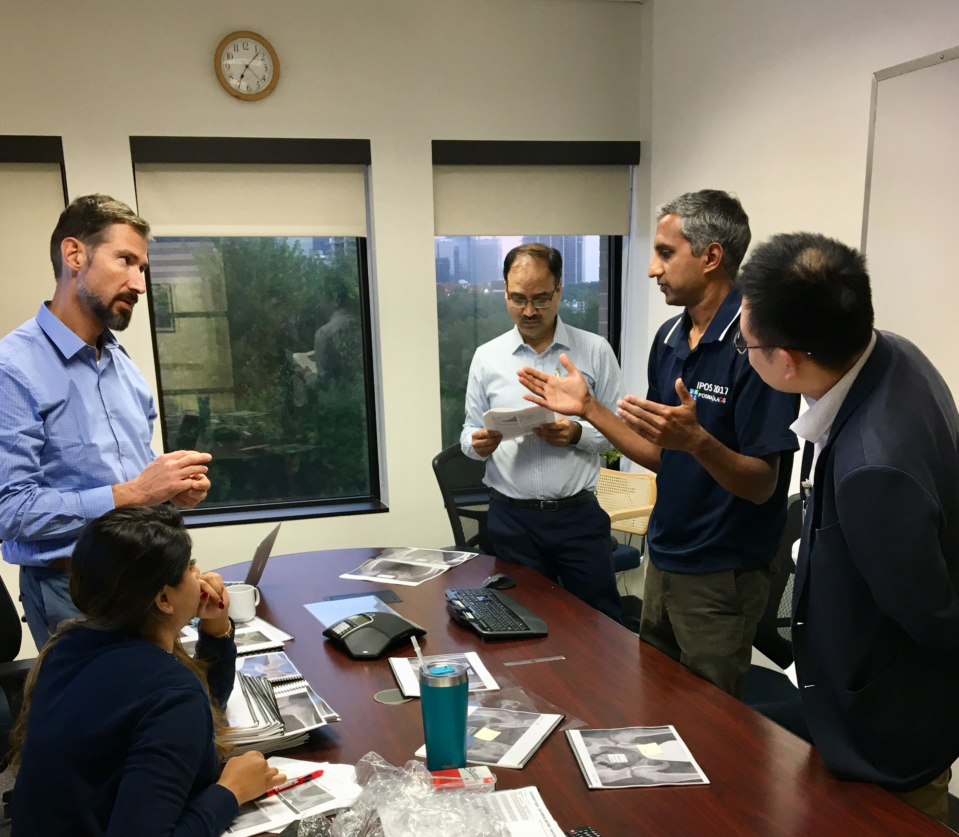
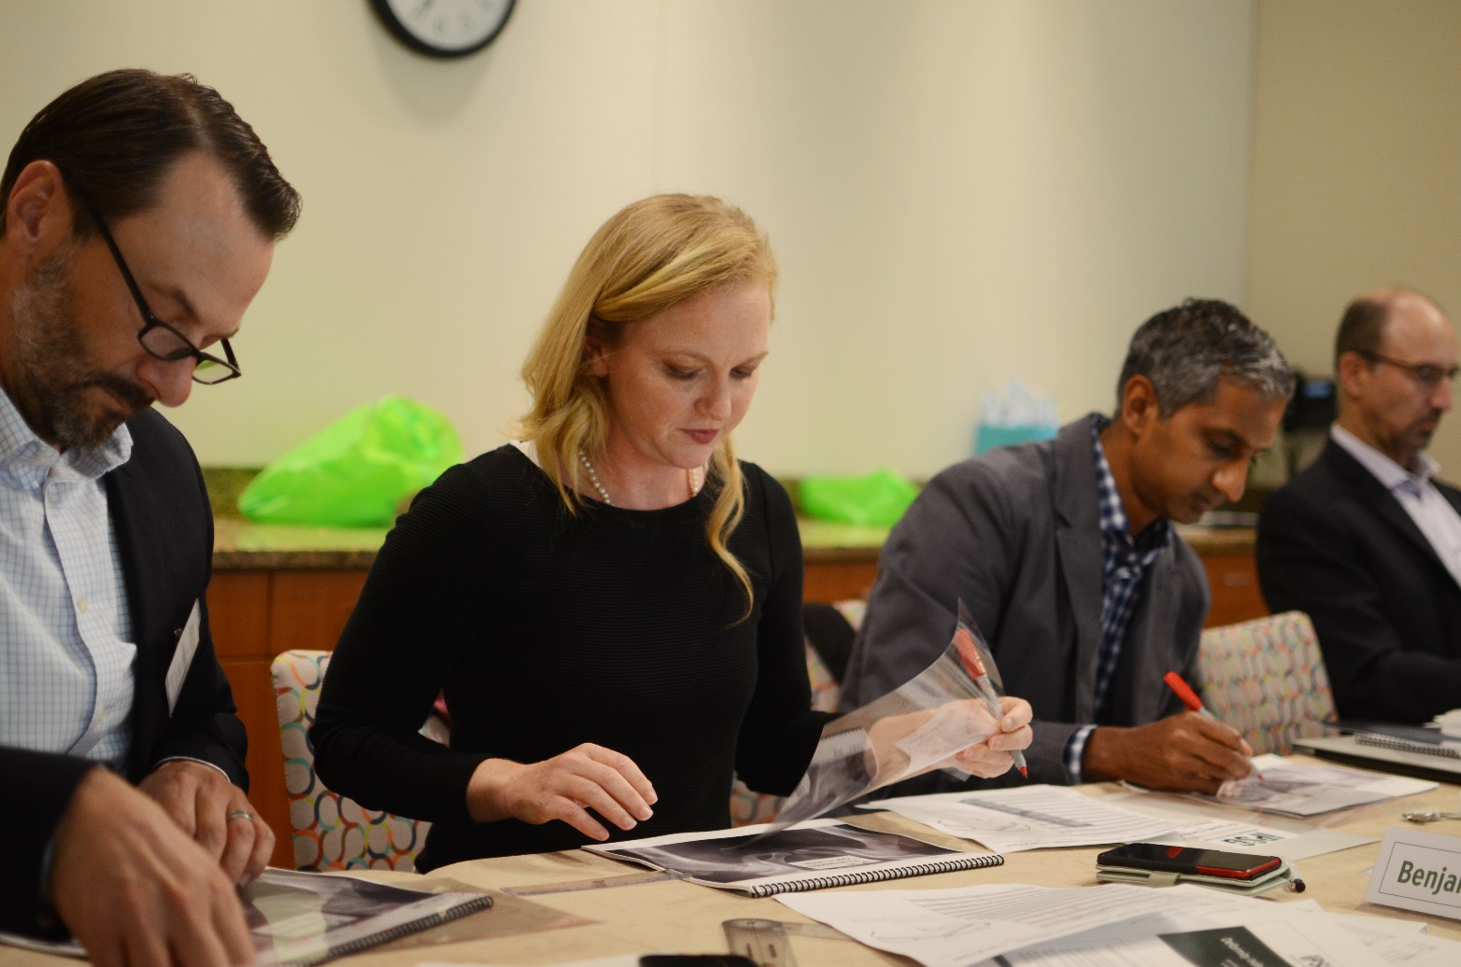
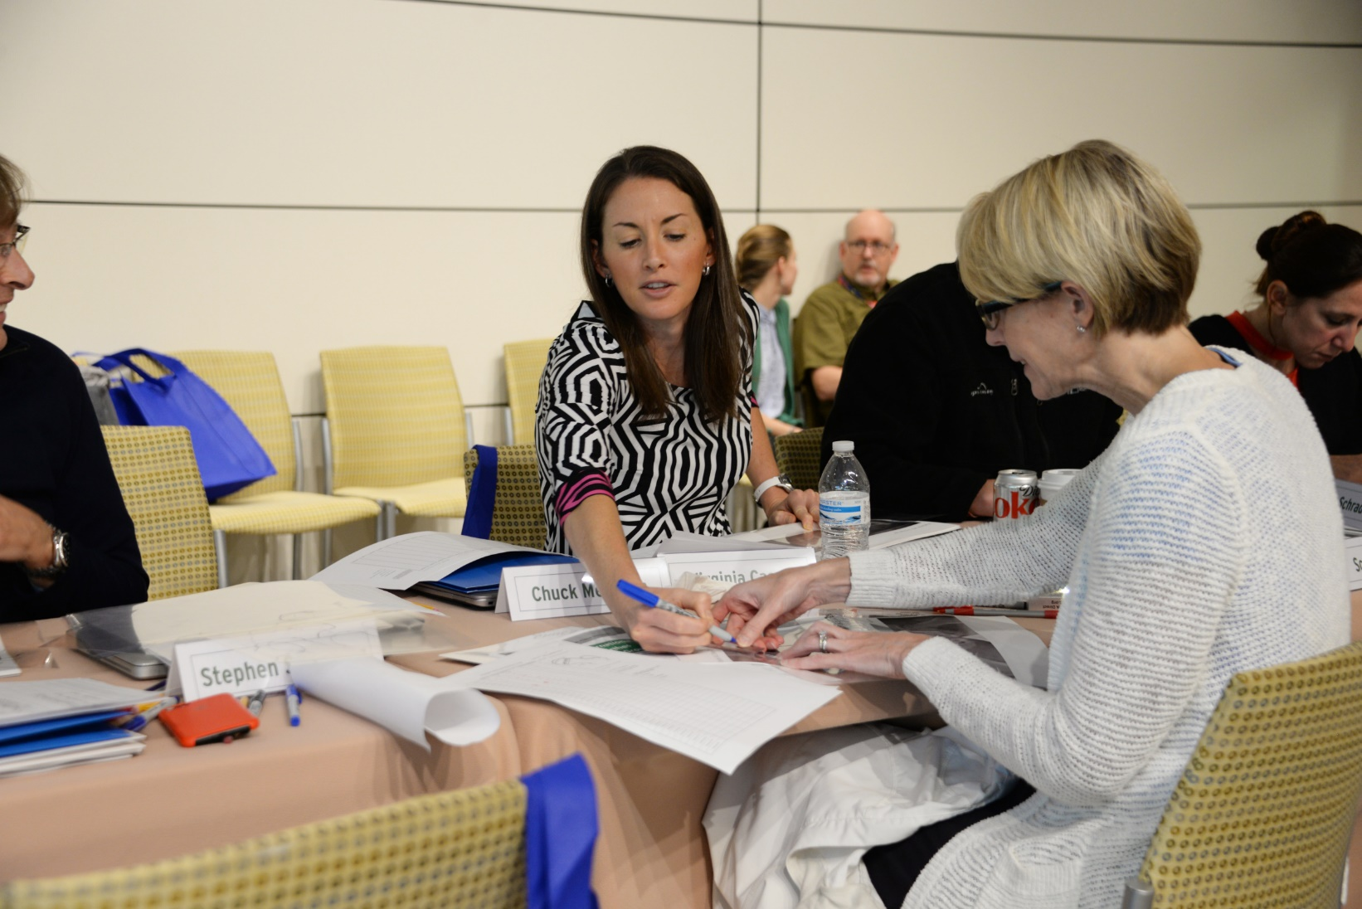
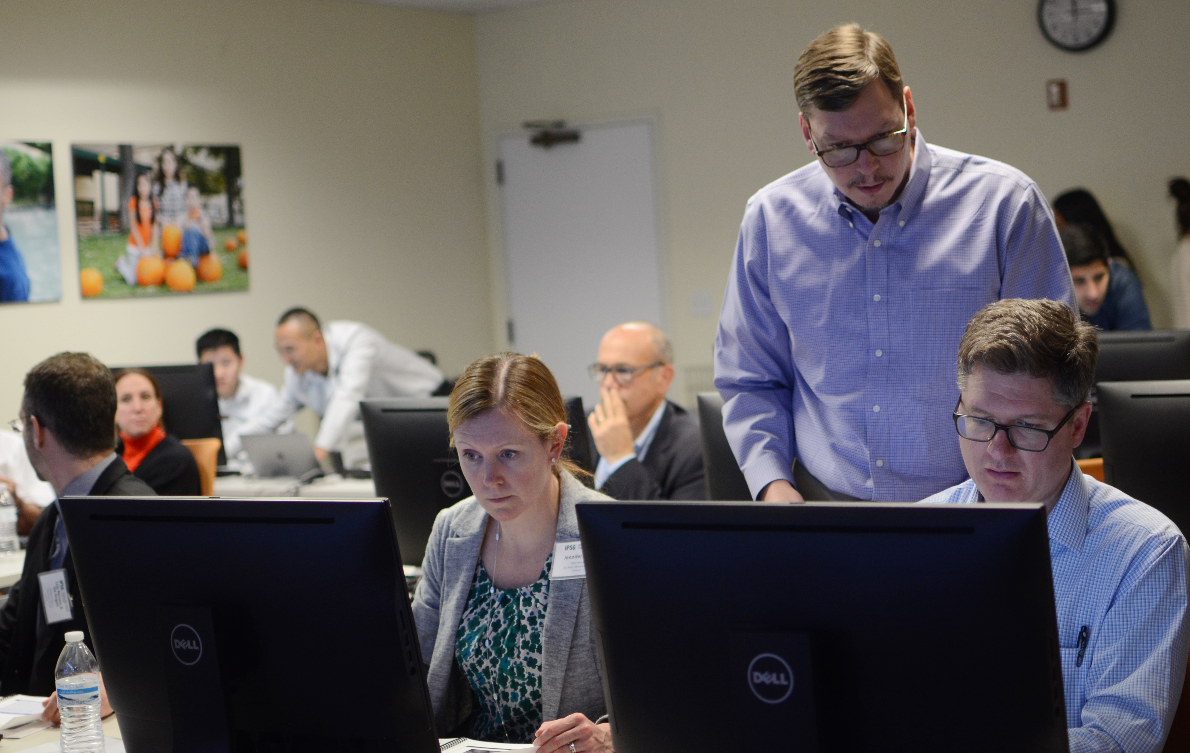
We are a study group:

Slide 12
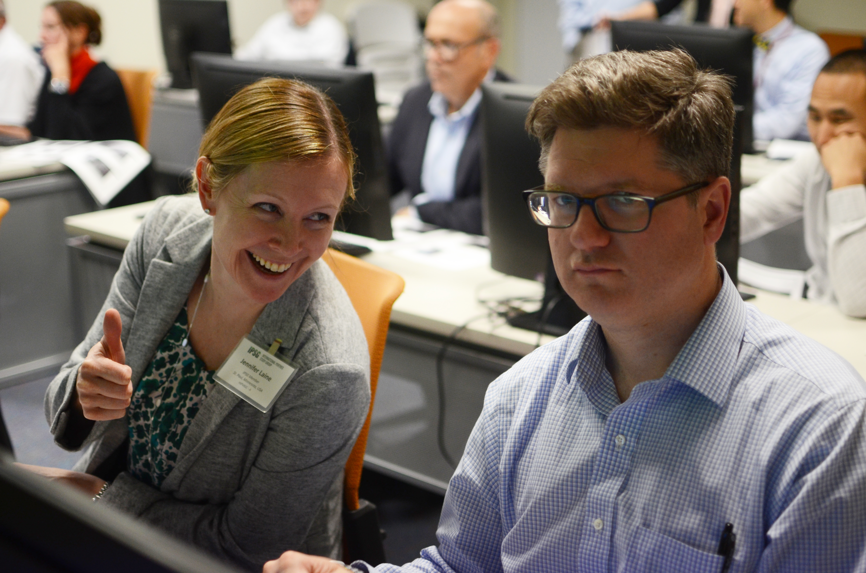
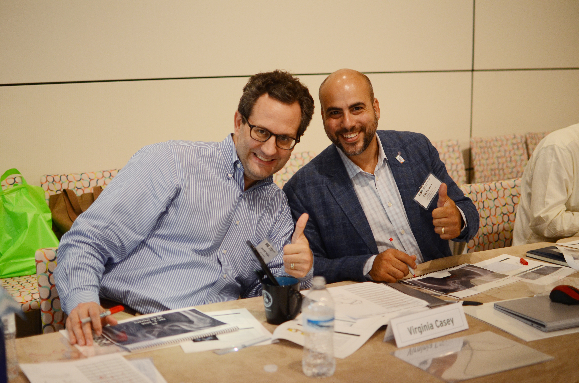

Slide 13
We publish

Slide 14
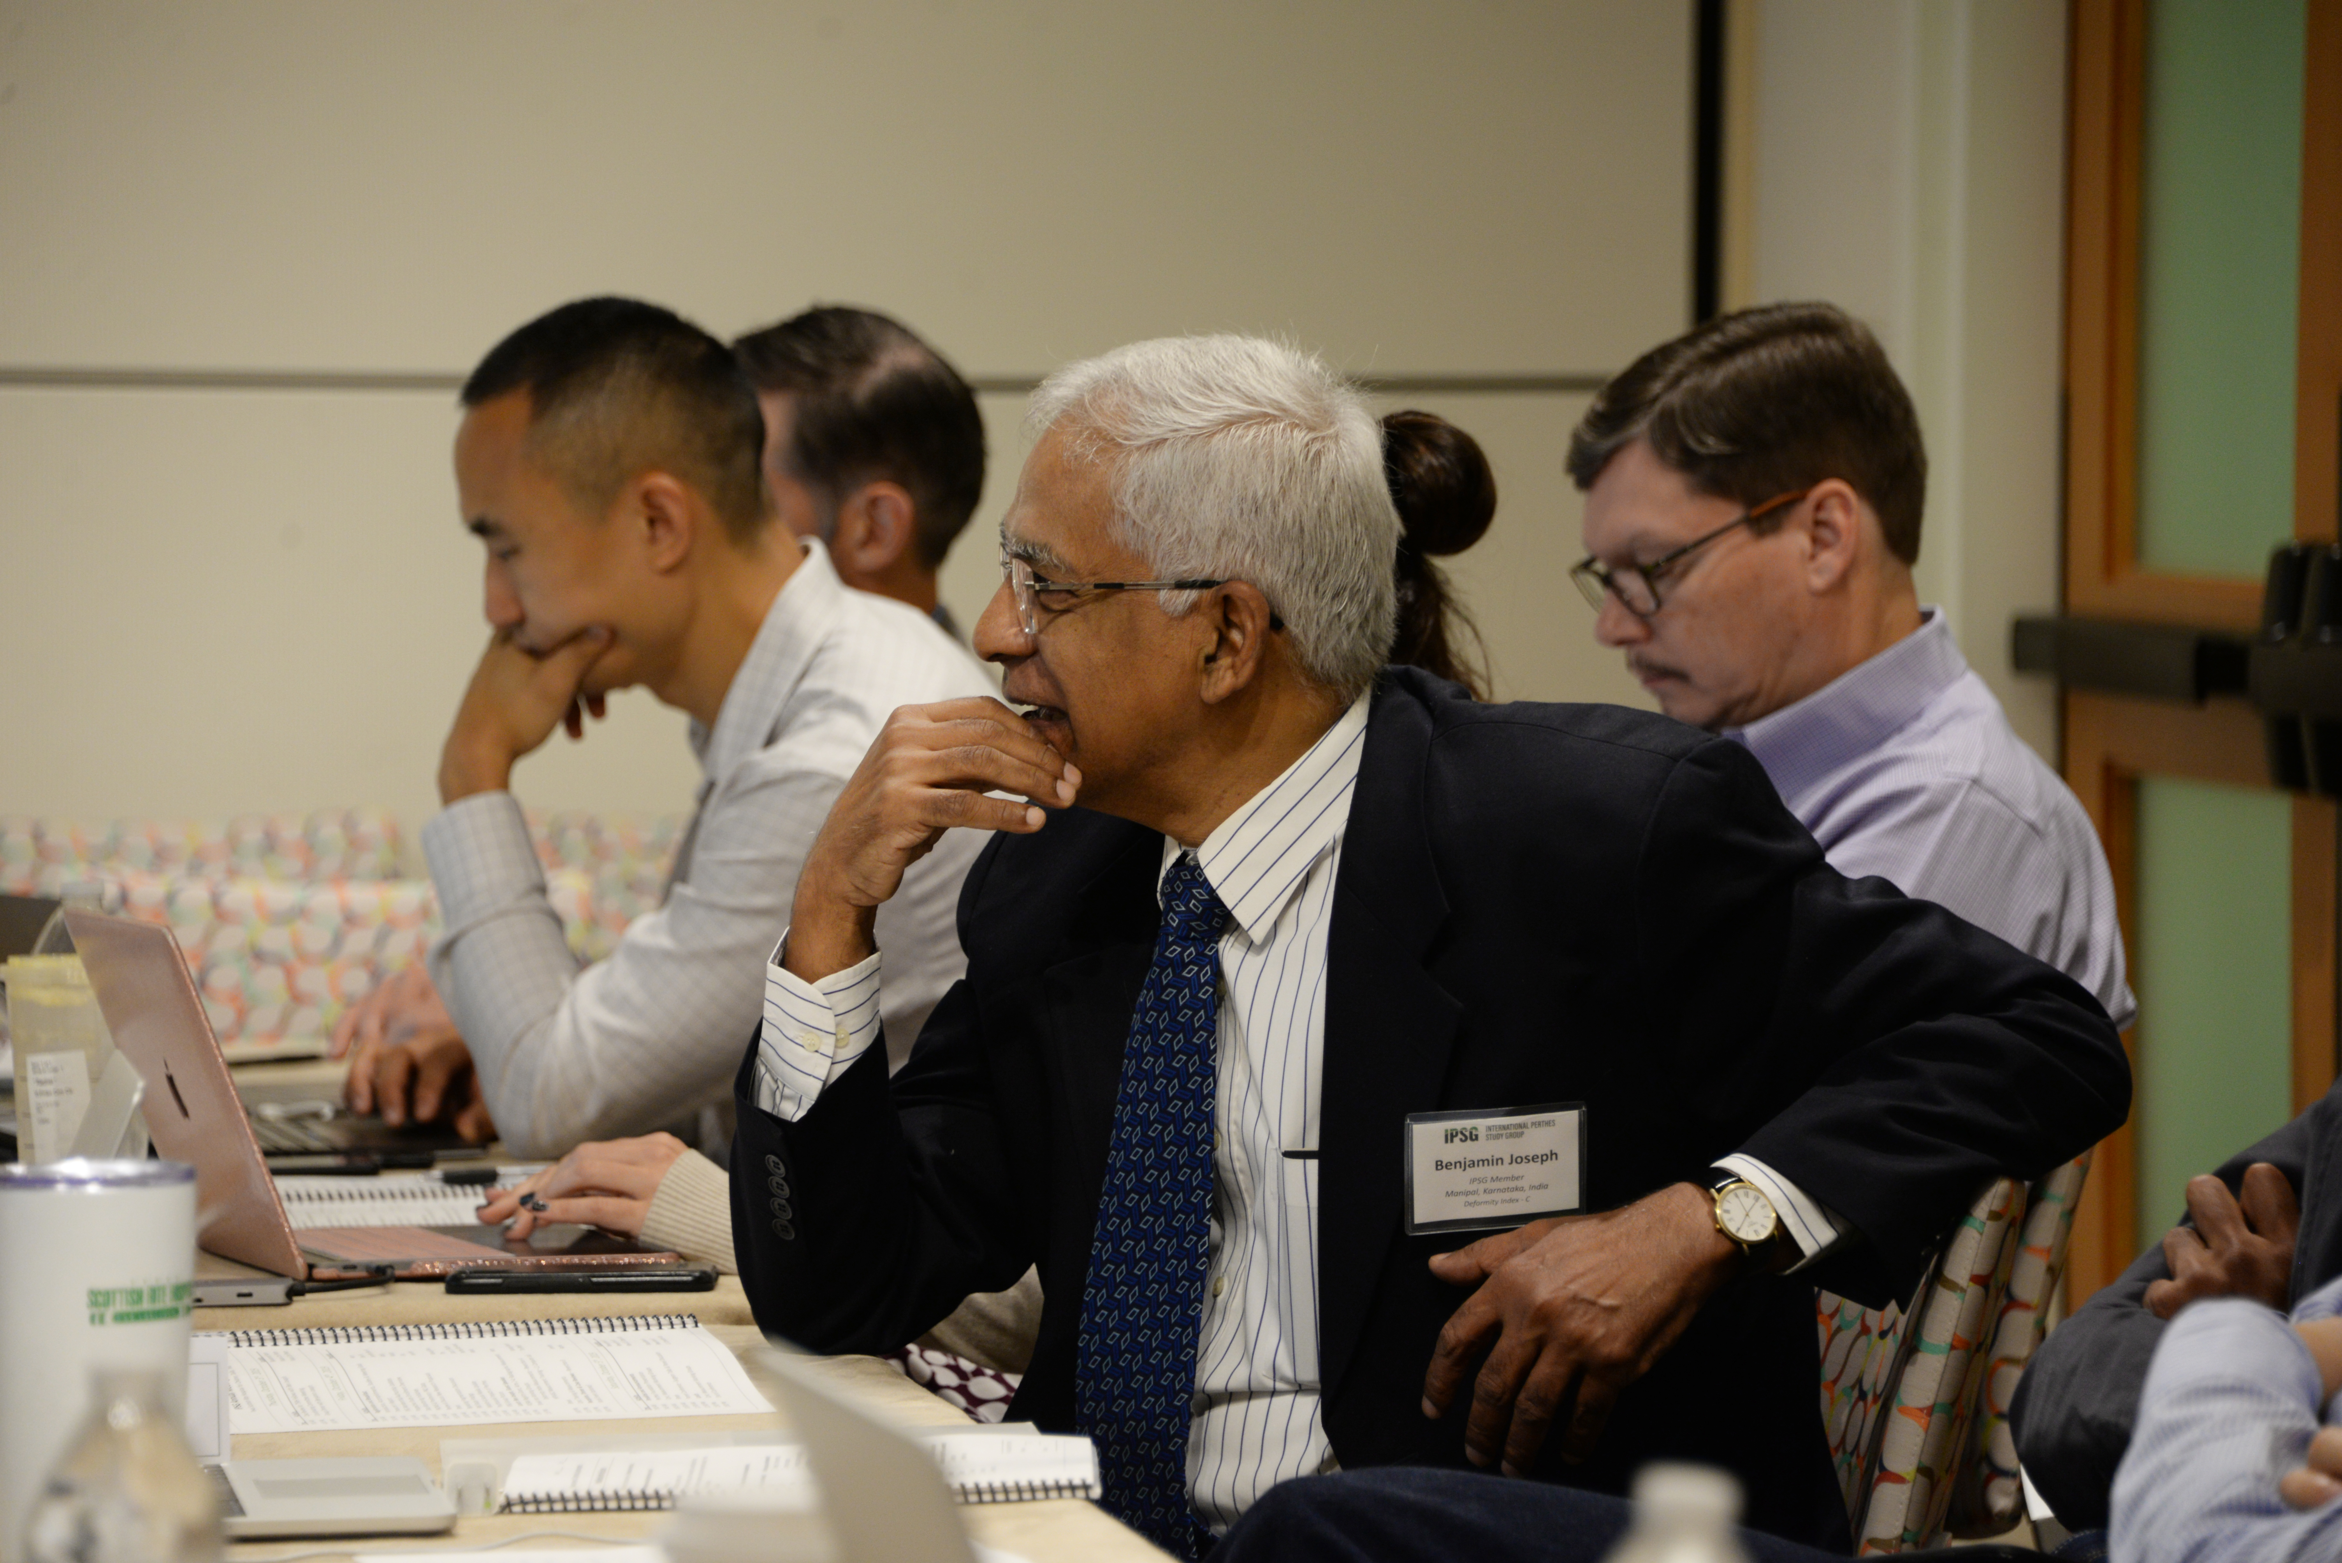
We think about Perthes

Slide 15
We have a mission
Determine what is the best way to treat patients with Perthes.
Make an impact on knowledge and treatment of Perthes now.

Slide 16
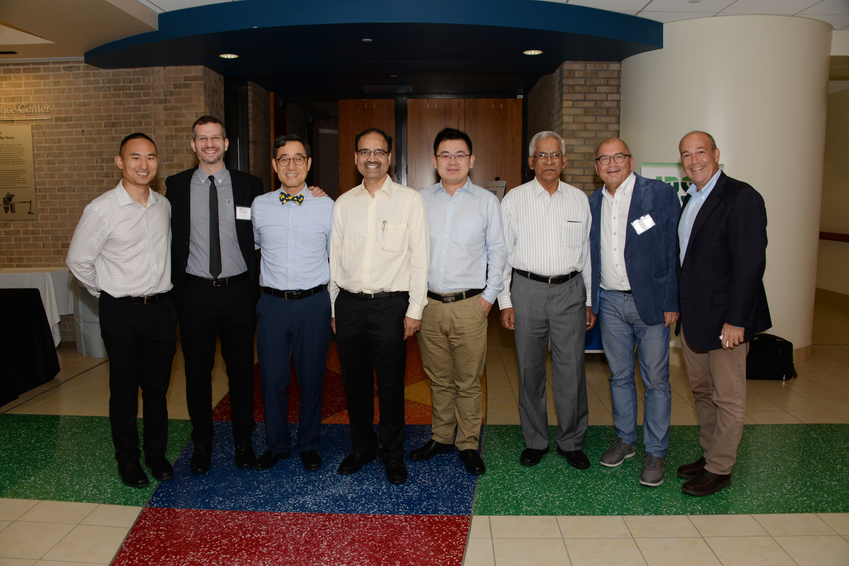
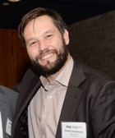
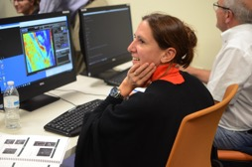
Study Group Vision
International, multicenter web-based prospective database of Perthes
Many centers to have adequate patient volume
Recruit more centers as needed (non-op centers!!!)
Multiple projects at one time
Prospective and retrospective studies

Slide 17
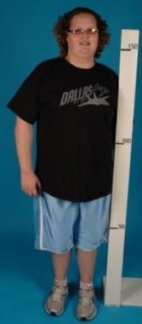
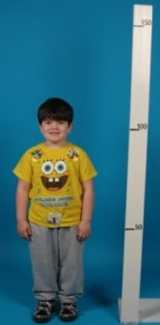
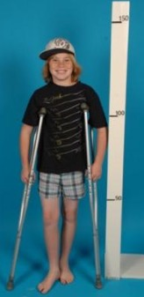
Study Group Vision
Prioritize studies
Phase 1
Early Stage study (pre-collapse; stage 1,2A): age 6-8, 8-11, >11
Role of perfusion MRI as a prognosticator of outcome
Phase 2
Late stage study (post-collapse; stage 2B and 3A); age 6-11
Early-onset Perthes registry (age <6)
Late-onset Perthes registry (age >11)
Age <6
Age 6-8/8-11
Age >11

Slide 18
Summary of Core Studies

Slide 19
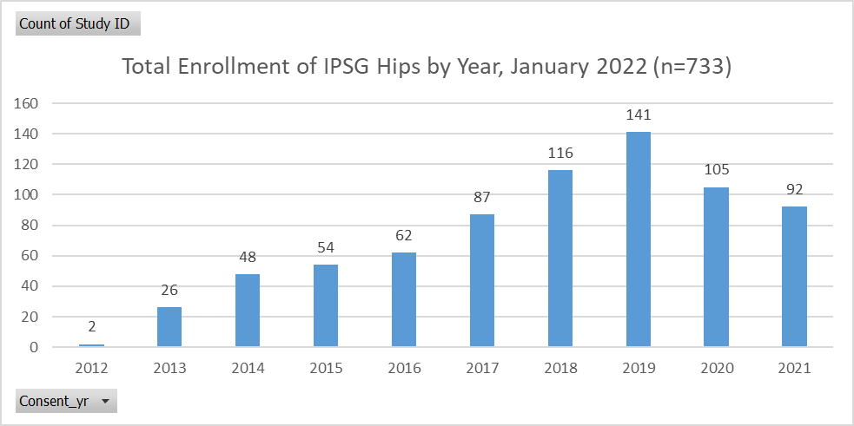
2021 Accomplishments and Activities
Notes:
>700 patients enrolled

Slide 20
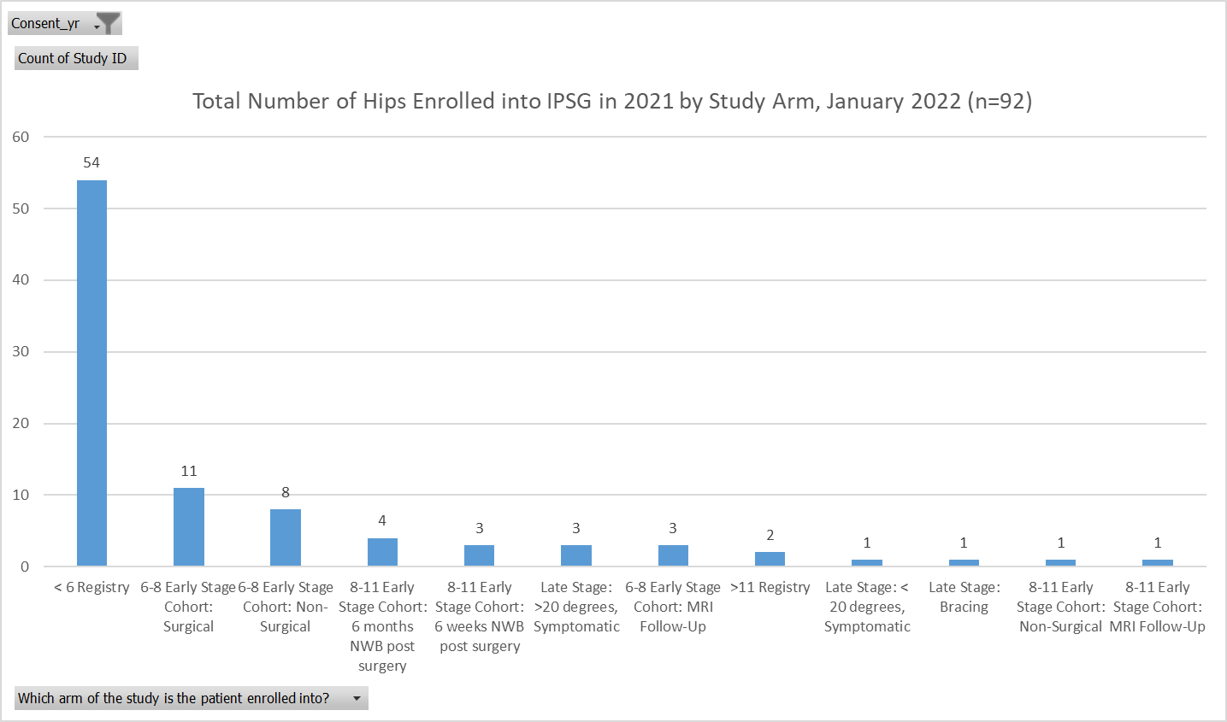

Slide 21
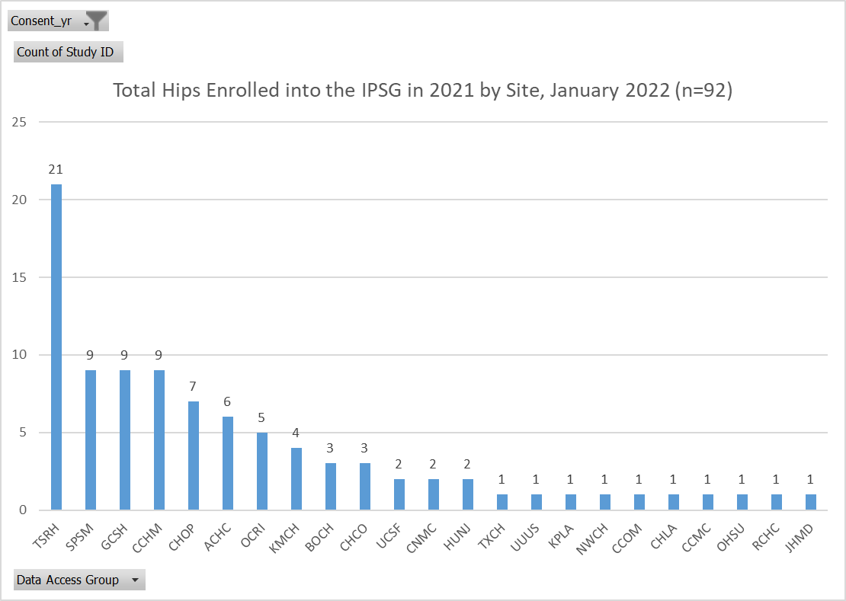

Slide 22
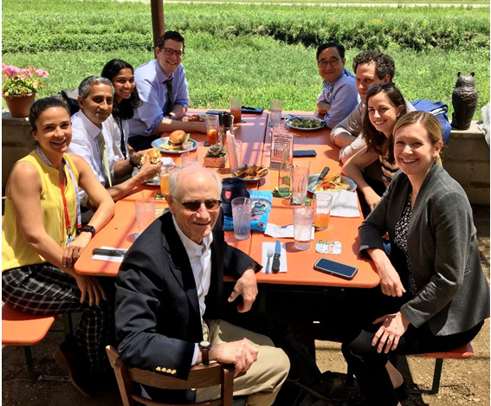
2021 Accomplishments and Activities, Cont.
New Membership Database
54 Institutions
Research coordinator meetings
4 publications this year
Members Lunch @ POSNA
Quarterly Newsletters

Slide 23
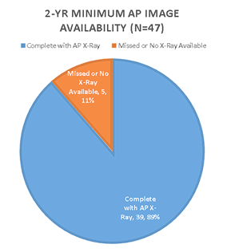
2021 Accomplishments and Activities, Cont.
New Membership point
2YR Retention Rate
39 Contracts/DUAs executed
64 Members
POSNA Registry Grant Complete
3 POSNA Podium Presentations
2 New Sub-Groups
MRI & X-Ray Measurement

Slide 24
2021 Publications
Reproducibility of Radiographic Measurements Made in the Active Stages of Legg-Calvé-Perthes Disease: Evaluation of a Prognostic Indicator and an Interim Outcome Measure. Tis JE, Laine JC, Sankar WN, Jo CH, Kim HKW; International Perthes Study Group. J Pediatr Orthop. 2021 Feb 1;41(2):93-98. PMID: 33229962
Demographics and Clinical Presentation of Early-Stage Legg-Calvé-Perthes Disease: A Prospective, Multicenter, International Study. Laine JC, Novotny SA, Tis JE, Sankar WN, Martin BD, Kelly DM, Gilbert SR, Shah H, Joseph B, Kim HKW; International Perthes Study Group. J Am Acad Orthop Surg. 2021 Jan 15;29(2):e85-e91. PMID: 32868700
Hip morphology in early-stage LCPD: Is there an argument for anatomic-specific containment? Courtney Selberg, Joshua Bram, Patrick Carry, Rachel Goldstein, Tim Schrader, Josh Hyman, Jennifer Laine, Harry Kim, Wudbhav Sankar; International Perthes Study Group.
Reliability and Validity of Visual Estimation of Femoral Head Hypoperfusion on Perfusion MRI in Legg-Calve-Perthes Disease. Chong DY, Schrader T, Laine JC, Yang S, Gilbert SR, Kim HKW; International Perthes Study Group. J Pediatr Orthop. 2021 Oct 1;41(9):e780-e786. PMID: 34411045.

Slide 25
2022 Publications
Does the Deformity Index Reliably Predict the Shape of the Femoral Head at Healing of Legg-Calvé-Perthes Disease? Shah H, Singh KA, Swarup I, Morris W, Kim HKW, Joseph B. J Pediatr Orthop. 2022 Feb 1;42(2):e163-e167. PMID: 34995259.
What is the adult experience of Perthes disease? Initial findings from an international Web-based survey. Molly F. McGuire, Bella Vakulenko-Lagun, Michael B. Millis, Roi Almakias, Earl P. Cole, Harry K.W. Kim. Bone and Joint Open [accepted]

Slide 26
Goals for 2022:
Enhance Community Outreach
Fundraising opportunities
Community Advocate role
Implement Long-Term Survey Study
IRB modifications
Legal council
Lead-site driven
Set up 2-Year and 5-Year Auditing Teams
Variations in Preop and Postop management
Assess treatment cross-over
Capture bracing treatment data

Slide 27
Goals for 2022:
Key your eyes on the 5-year follow up

Slide 28
Closing Remarks
Feedback on the virtual meeting
Thanks to Molly
Thanks to the presenters, moderators, coordinators, and steering committee members

Slide 29
Thank You!

