Slide 1
Under Six Registry
Rachel Goldstein, Jennifer Laine, Molly McGuire

Slide 2
Background
Traditional teaching is Perthes happens in “school aged” kids (6-10)
Perthes presenting <6 all do well
Anecdotally seeing more very young patients with Perthes

Slide 3
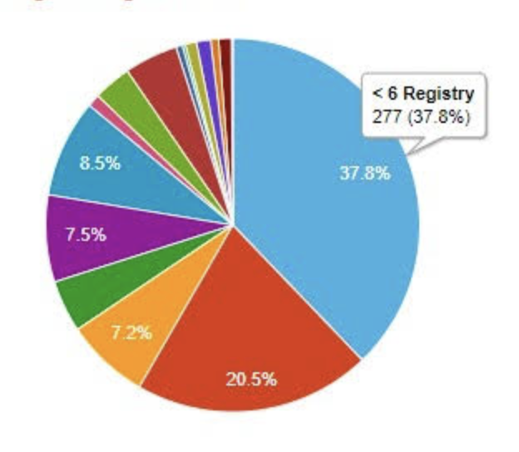
Background

Slide 4
Definitions
Prior looks into this data: age less than 6 at onset of symptoms
Data point is unreliable (recall bias)
New definition:
Age less than six at TIME OF DIAGNOSIS

Slide 5
Summary of Demographics <6 years old

Slide 6
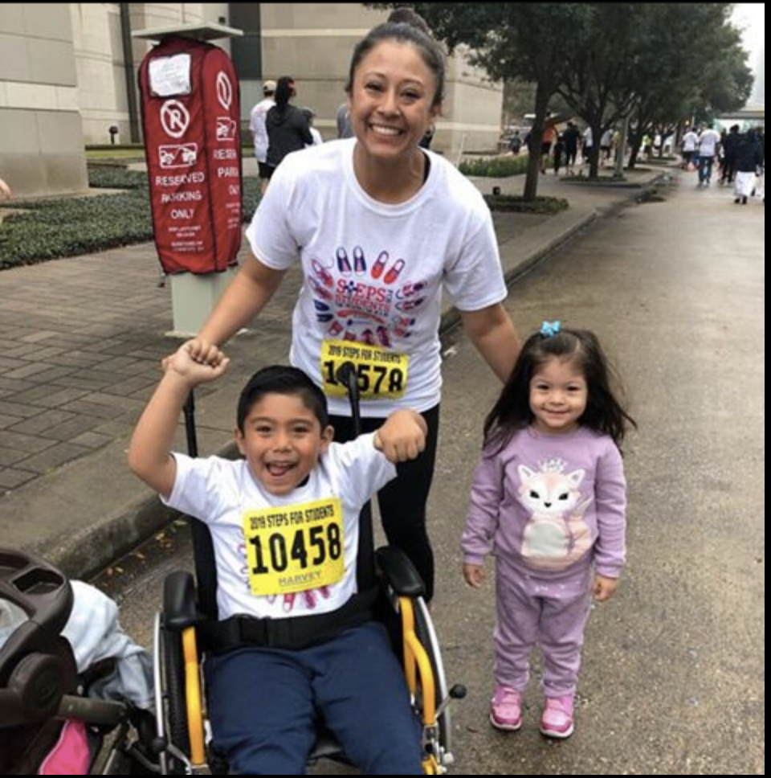
Population
225 individual patients
Avg age at diagnosis: 4.34 (1.55-5.95)
Male: 188 (84%)

Slide 7
Institutions

Slide 8
Affected Hip
Notes:
About 80% unilateral

Slide 9
Ethnicity

Slide 10
Duration of symptoms
Notes:
About 1/3 of patients had symptoms for more than 6 months before diagnosis

Slide 11
Presenting symptom
Notes:
About 2/3 presented with pain and limp. And about a ¼ presented with a painless limp

Slide 12
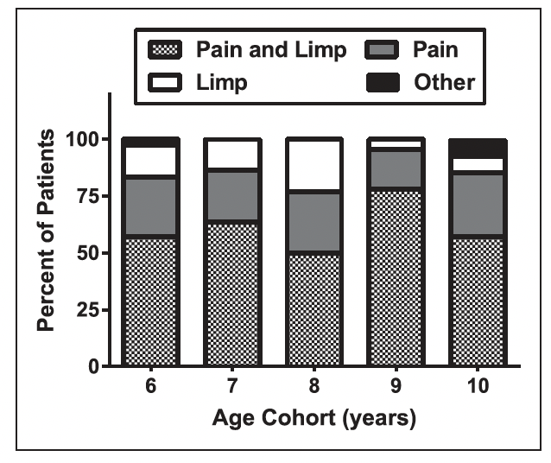
Presenting symptom

Slide 13
Previous Providers Seen
Notes:
Average number of providers seen before presentation to an IPSG member was 2 (range 0-11). Almost 3/4 were seen by their PMD. About 50% were seen by a different orthopedic surgeon before presentation to an IPSG member.

Slide 14
Waldenstrom stage

Slide 15
Smoking in the Home

Slide 16
Household Education Attainment
Notes:
About 2/3 of those reported had a college or graduate degree

Slide 17
Pre-Perthes Activity Level

Slide 18
Comparisons to the 6-10 Group

Slide 19
Sex
Notes:
Sex distribution is essential the same

Slide 20
Affected Hip
Notes:
About 80% unilateral

Slide 21
Affected Hip
Notes:
About 80% unilateral

Slide 22
Comparison Ethnicity
Notes:
Difference in ethnicity likely related to different site enrollments

Slide 23
Presenting symptoms
Notes:
Similar percentage presenting with both pain and limp but much higher percentage of younger patients presenting with a painless limp

Slide 24
Research plan

Slide 25
Initial Publication
Focus on the demographics of this group
Goal: bring awareness to the diagnosis in the <6 year olds
Data:
General demographic data
Delay to diagnosis data
Target journal: Pediatrics

Slide 26
Next steps
Other ideas?

Slide 27
Thank you

