Slide 1
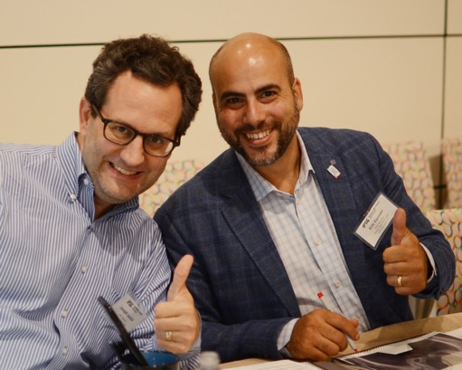
Patient-Reported Outcome Data
Eric Fornari, MD – 10 minutes

Slide 2
What PROs are we using?
PRO | Frequency | Domains | Reference
Clinic Visit Questionnaire | Each Visit | Pain, Medications, Physical Activity | IPSG Surgeon Members
PROMIS | Each Visit (Proxy for 5-8 years old) | Mobility, Fatigue, Anger, Anxiety, Depressive Symptoms, Pain Interference, Peer Relationships | DeWalt, D., Gross, H., Gipson, D., et al. (2015). PROMIS® Pediatric Self-Report Scales Distinguish Subgroups of Children within and across Six common Pediatric Chronic Health Conditions. Quality of Life Research, 1-14.
Modified Harris Hip Score | Initial, 2-year, 5-year, and final follow-up visits (if ≥10 years old) | Pain, Hip Function | Byrd, J. W. and K. S. Jones (2000). Prospective analysis of hip arthroscopy with 2-year follow-up. Arthroscopy 16(6): 578-587.
Modified HOOS-15 | 5-year visit, and each visit thereafter | Pain, Other Symptoms, Physical Function in Daily Living, Function in Sport and Rec, Hip-Related QOL | Klassbo M, Larsson E, Mannevik E. (2003) Hip disability and osteoarthritis outcome score. An extension of the Western Ontario and McMaster Universities Osteoarthritis Index. Scand J Rheumatol. 32(1):46-51. *modified by the IPSG for younger population
Iowa Hip Score | Discontinued 5/2018 |  | Larson, C. B. (1963). Rating scale for hip disabilities. Clin Orthop Relat Res 31: 85-93.

Slide 3
PROMIS Data Collection
Collected at each visit for kids over 5 years old

Slide 4

PROMIS Administration
Regulatory modifications and site training is on-going
Three sites added since 2019 Annual Meeting (CHOP, UCSF, CCOM)
10 sites collecting total
Standard of care clinic OR research-only administration
To start collecting PROMIS, contact IPSG@tsrh.org

Slide 5
PROMIS Data Collection
1087 initial, 3-,6-,9-, and 12-month visits completed for all enrolled participants
179 visits where PROMIS was administered
160 were completed by the appropriate respondent for the age of the participant (80 Pediatric Surveys and 80 Proxy Surveys)
Notes:
Note:
Pre and Post Op surveys not included here

Slide 6
Please explain why PROMIS was not collected…
Questionnaires not assigned in Epic | did not start collection of PROMIS
pt not seen | Ipad is not working.
Patient is Spanish speaking (prior to Spanish PROMIS implementation) | Patient did not complete survey via email
non functioning ipad | Patient was sent email link - was not completed
Visit occurred prior to PROMIS implementation | Missed due to COVID restrictions
PROMIS not assigned in clinic | Staff oversight
Patient just turned 6 the week before and PROMIS had not been assigned | Form was taken home by family and not returned at the next visit.
Not yet approved (Electronic version) | unsure
Patient didn't have time | patient too young
Unable to administer | We are trying to get a flag in place to monitor the depressive surveys
Parent survey emailed - no responses to survey. | Patient was too young
We are trying to put a flag in place to monitor the depressive surveys

Slide 7
Pediatric Self-Report Data
Children >8 at time of survey

Slide 8
Pediatric Self-Report Data
80 age-appropriate surveys
Collected from Mar2015-Dec2020 at CHOA, TSRH, GCSH and OHSU
Age range 8.01-14.52 (mean 10.35)
80 surveys represent 37 unique hips
Notes:
*Post Op (n=13) and Pre Op visits not included

Slide 10
POSNA Registry Grant Aim 1
“Obtain PROMIS data before and after initiating non-operative and operative treatments”
Notes:
Final report is due this summer
Need more initial visit and pre-op data

Slide 11
Pediatric PROMIS Trends Over Time – pt542
Surgical Intervention
Notes:
Drilling and FVO
Patient was >8 at the time of each survey

Slide 12
Proxy-Report PROMIS Data
Children <8 at time of survey

Slide 13
Proxy Parent-Report Data
80 age-appropriate surveys collected
Collected from Apr2014-Dec2020 at BCCH, CHOA, CHOP, TSRH, GCSH, and OCRI
Age range 2.61-7.99 (mean 6.26)
80 surveys represent 40 unique study IDs
Notes:
Pre and Post Op (n=11) surveys not included here.
Should not include kids <5 years old in actual analyses!

Slide 15
Proxy PROMIS Trends Over Time – pt463
Osteotomy
Implant Removal

Slide 16
What to do with this data?

Slide 17
Asked 3 questions
  Are restrictions on weightbearing and activity associated with physical health measures (as expressed by the PROMIS mobility, PROMIS pain interference, and PROMIS fatigue) of children in the active stages of Perthes disease?
  Are these restrictions associated with poorer scores for mental health measures (PROMIS depressive symptoms and PROMIS anxiety)?
  Are these restrictions associated with poorer scores for social health measures (PROMIS peer relationships)?

Slide 19
Results:
More severe weightbearing/activity restrictions WERE associated with worse patient-reported mobility scores.
The pain interference, fatigue, depressive symptoms, anxiety, and peer relationships scores were NOT associated with the severity of weightbearing and activity restrictions.
Final line…
“Future studies are warranted to examine the longitudinal trends of patient reported outcomes to better understand how this chronic disease impacts children’s lives over time.”

Slide 20
PROMIS Data Sub-Study Concepts
Impact of activity restrictions and mobility restrictions on QoL
Describe QoL before and after FVO
Describe QoL before, during, and after bracing/casting
Understanding mobility and anxiety in Perthes patients
2-year cross-sectional sample: are our kids normal?
Impact on socioeconomic status on PROMIS scores/trends
Where are patients at the healed stage?
  Back to normal? Better than where they started? Are improvements lasting?
Notes:
-Engage Michelle Langer, our PROMIS consultant, to help formulate questions based on the data we have.

Slide 21
Modified Harris Hip Score
Children >10 years old at time of survey

Slide 22
Modified Harris Hip Score Data Collection
Initial Visit
2-Year Visit
5-Year Visit
64 age eligible hips
33 attempted survey
30 completed survey
103 age eligible hips with visit data
60 attempted survey
57 completed survey
67 age eligible hips with visit data
45 attempted survey
42 completed survey
Notes:
- Note: “age eligible with visit data” means they were at least 10 years old at the time of the visit, and the visit actually happened (i.e. – not missed)
- Note: 49 surveys were collected on patients <10 across these three time points. They are not included in the analysis here.
- Completion Rates: 47% completion at initial visit, 55% at 2-year visit, 63% at 5-year visit

Slide 23
Average MHH Scores at Initial, 2- and 5-Year Visits
Notes:
- Would be interesting to look at patient report of mhhs by cohort to see if some patients recover faster.

Slide 24
Modified HOOS-15
Children >10 at time of survey

Slide 25
Modified HOOS-15
Site | Count of study_id
achc | 4
boch | 1
ccom | 1
chhb | 2
chop | 2
cnmc | 3
gcsh | 2
spsm | 1
tsrh | 3
txch | 3
Grand Total | 22
66 age-eligible hips with 5-year visit data (did not miss visit)
22 attempted and completed the survey (no missing data)
Scores 0-100

Slide 26
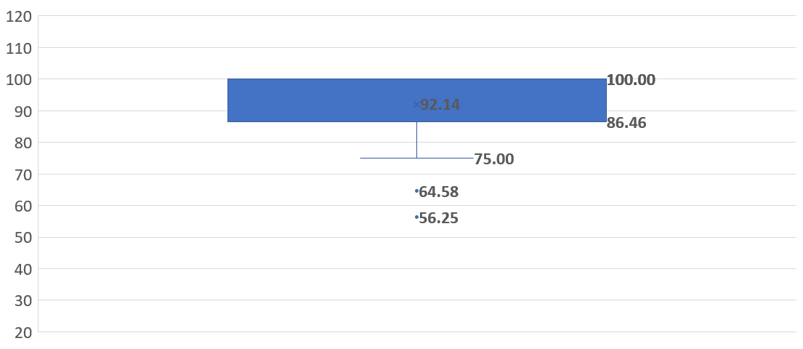
HOOS-15 Sum Score
Notes:
After 5 years of treatment, most of our kids in this sample did okay.
Two have low HOOS scores, which are outliers to 95% of the confidence interval.
Most kids end up in the 86-100 range, mean 92.

Slide 27
Average Modified HOOS-15 Domain Scores at 5-Year Visit, n=22 hips

